Slide 1
Massachusetts Unemployment Trust Fund Status
May, 2021
Economic Research Division

Slide 2
Overview
1.
UI Trust Topline Stats
2.
UI Trust Balance/Benefits/Contributions
3.
Charging and Solvency
4.
Bonding
5.
Current Claimant Characteristics

Slide 3
Massachusetts UI Trust Topline Stats
Around $22 billion in unemployment benefits were disbursed to roughly 1 million claimants in 2020. $5.9 billion in benefit obligations came from the Massachusetts UI Trust. The remaining came from federal programs such as the $600 and $300 benefit supplements as well as the new Pandemic Unemployment Assistance program for groups like the self-employed as well as assistance for those who exhausted state benefits.
As of March 31, 2021, the preliminary Massachusetts Unemployment Insurance Trust Fund ending balance was -$2.927 billion. Massachusetts borrowed a total of $2.201 billion in 2020 and $10.8 million in January 2021. Interest on federal advances from September 7 through September 30, 2021, totaling $6 million must be paid by September 30, 2021. The loan interest payment on borrowing for 2022 is expected to be $122 million.
For 2021, tax rate schedule E was set by legislation for employer payrolls and is projected to generate $2.037 billion in employer contributions. This is a decrease of $414 million due to the lower tax rate set by the legislation schedule freeze. However, the distribution of those contributions for 2021 changed significantly due to the socialization of costs among all employers as a result of COVID-19 related claims and a corresponding solvency assessment of 9.23%.

Slide 4
Massachusetts UI Trust Topline Stats Continued
Bonding legislation to payback the entirety of federal loans was recently authorized and will allow the Commonwealth to avoid prohibitive federal unemployment tax increases on employers which would trigger in December of 2022.
The current tax rate on average for employers is $692 per employee with a $15,000 taxable wage base.
Around 500,000 claimants continue to collect UI in Massachusetts. Around 90,000 of those are being covered through the state’s UI Trust fund. The long-term unemployed trend higher towards women and communities of color.
Claimants can receive up to half of their average weekly wage up to a cap of $855. An additional $25 per dependent allowance is also available to claimants. Regular UI contributions for state benefits are capped at 30 weeks. Federal extensions are currently covering many claimants in Massachusetts who have exhausted their 30 weeks of state covered benefits.
Many federal programs such as Pandemic Unemployment Assistance as well as other programs are set to expire the week ending September 6th, 2021.

Slide 5
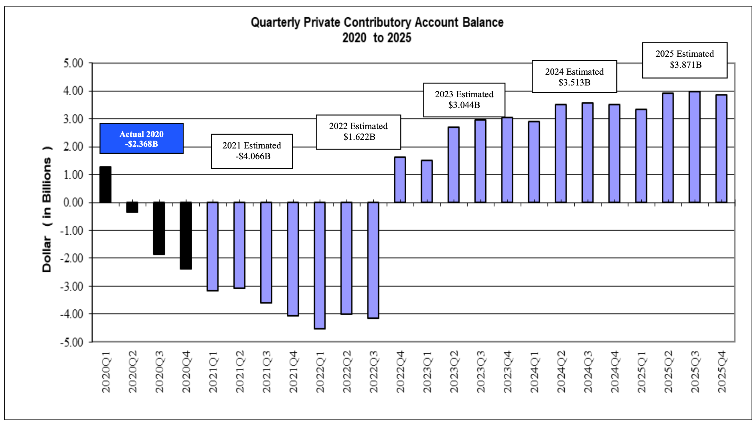
Massachusetts UI Trust Balance (2020-2025)

Slide 6
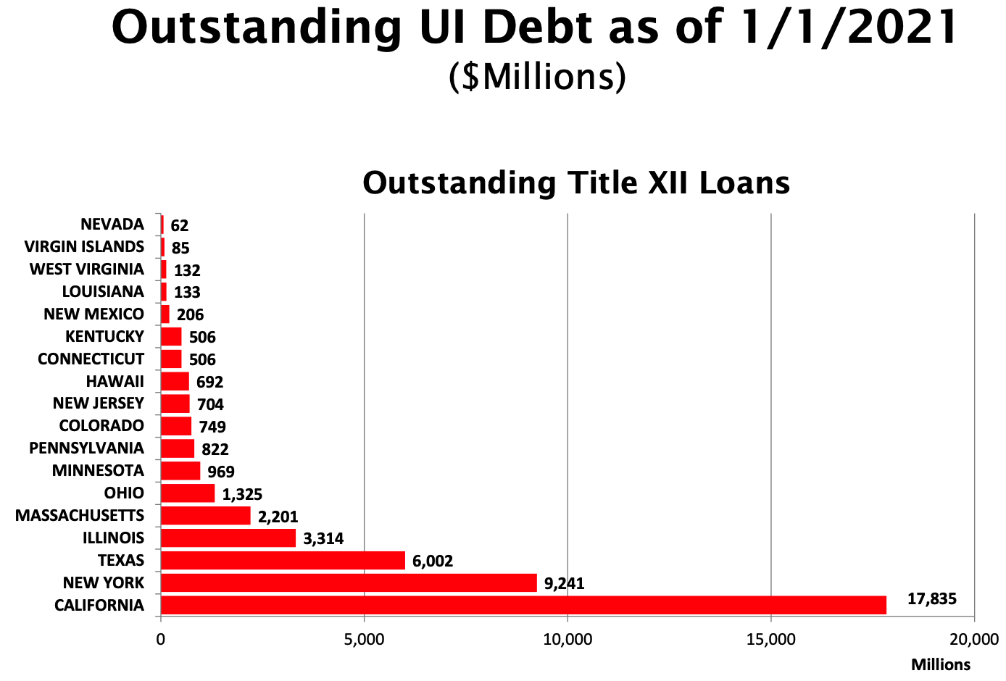
Massachusetts UI Trust Debt Comparison
*Totals not adjusted for population

Slide 7
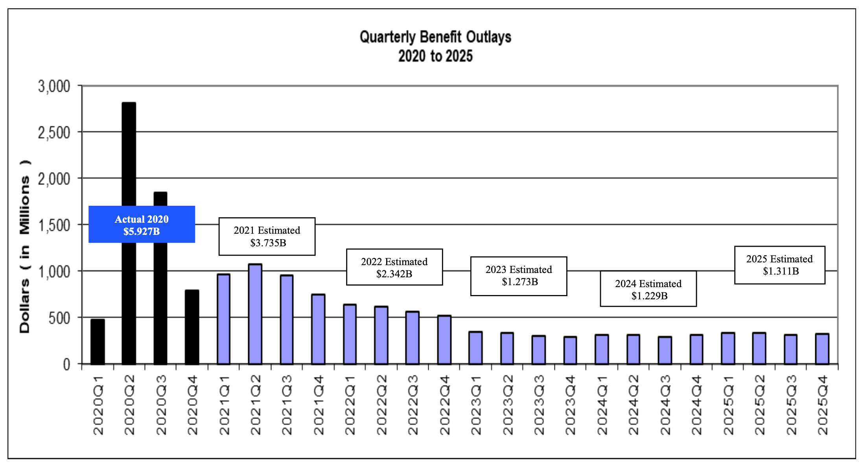
Massachusetts UI Trust Benefit Outlays (2020-2025)

Slide 8
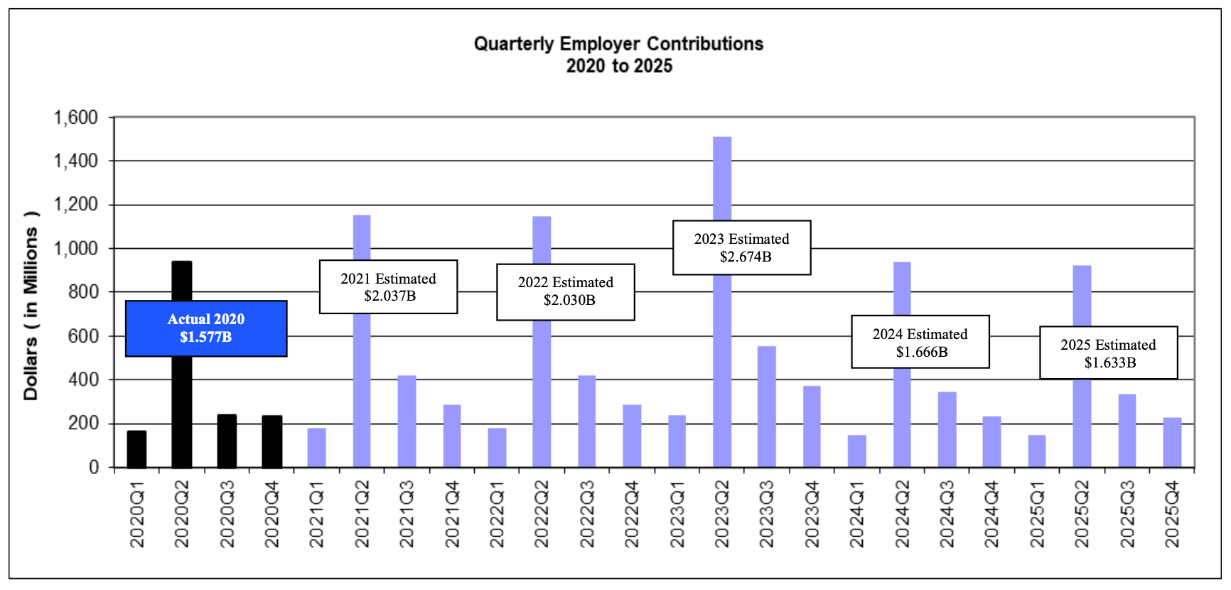
Massachusetts UI Trust Contributions (2020-2025)

Slide 9
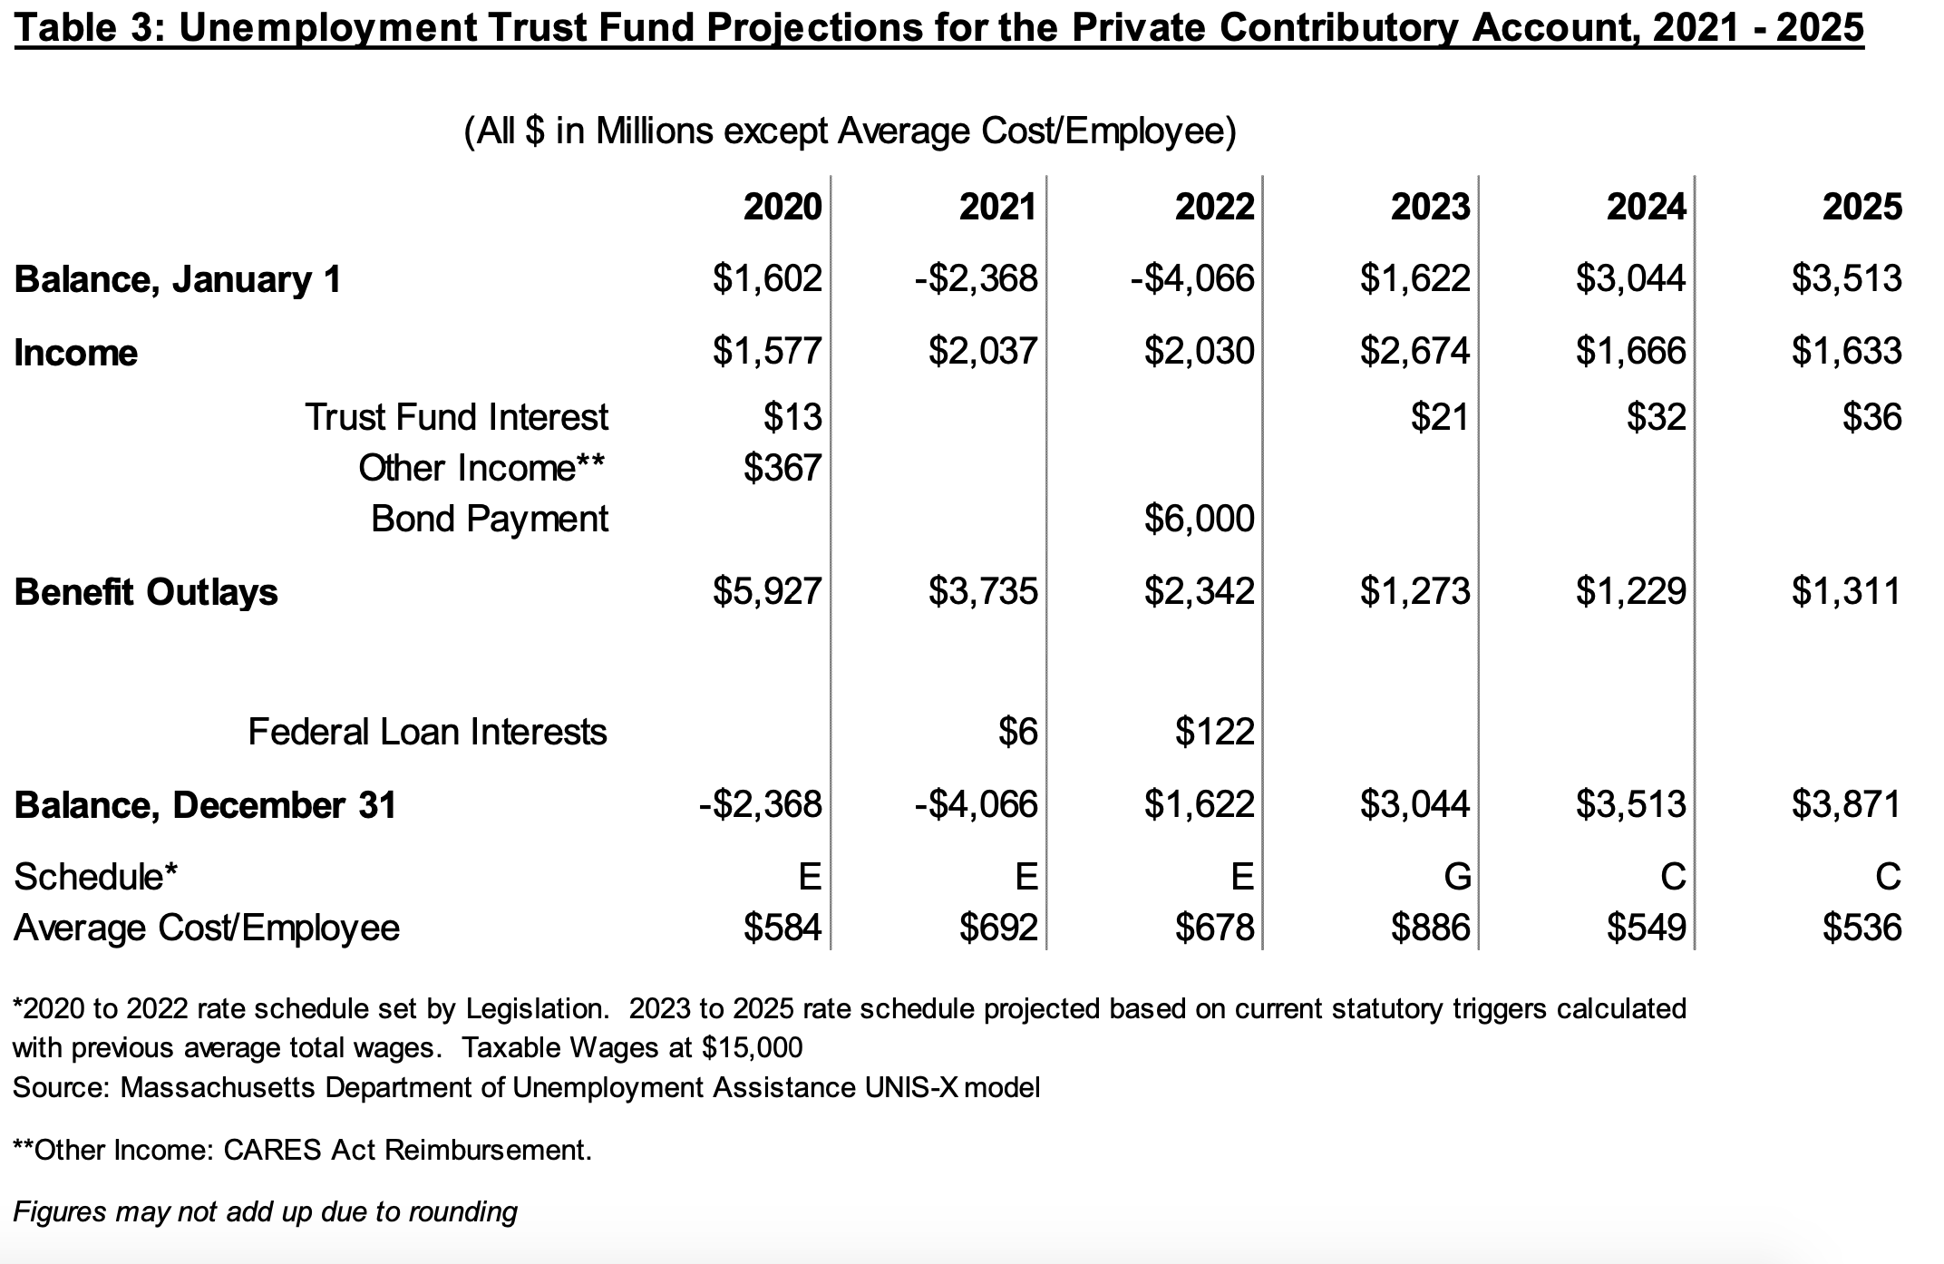
Massachusetts UI Trust Benefit Outlays (2020-2025)
Trust Fund Interest Income
CARES Act Reimbursement Income
Income From Bond Authorization

Slide 10
UI Trust Charging and Solvency
An employer’s total annual UI contribution is driven by:
A ‘direct’ employer contribution charge: covers direct UI costs associated with a particular employer; calculated via an experience-weighted rate.
A solvency assessment: funds benefits that are not the responsibility of individual employers but whose costs are distributed proportionally across all employers.
The 2021 average ‘direct’ employer contribution under the schedule E freeze increased because of lower reserve percentages in employer accounts due to benefits paid out in 2020.
The 2021 employer solvency assessment also increased given that total taxable wages are projected to rise as the economy begins to recover and the high socialization of costs that could not be charged through individual employer experience rating increases.
Employer solvency assessment = average taxable wages X solvency reserve ratio
Solvency ratio = closing balance of the solvency account/ average combined annual taxable payrolls over the last three years

Slide 11
Experience Ratings and Solvency
Reserve Ratio system: In general, employer’s rates reflect the general state of the fund as well as the employer’s individual experience
Changes in the UI Fund’s total solvency moves employers across the table…
Table of Employer Contribution Ratios by Reserve % and Schedule
Employer Account Reserve Percentages | D | E | F | G
17.0 or more | 0.84 | 0.94 | 1.07 | 1.21
>14.0 but less than 15.0 | 1.18 | 1.34 | 1.53 | 1.73
>10.0 but less than 10.5 | 2.25 | 2.56 | 2.91 | 3.30
>1.5 but less than 2.0 | 4.26 | 4.84 | 5.50 | 6.25
Negative, from -3.0 to -5.0 | 7.27 | 8.26 | 9.38 | 10.66
…While experience moves them up and down the table
…and solvency assessment acts like experience, but is generally small

Slide 12
Effects of UI Legislation on Charging
Results of charging COVID claims to the solvency account by legislation
2021 legislation (bonding plan) prevented employers from moving across the table
STOP
Table of Employer Contribution Ratios by Reserve % and Schedule
2020 UI legislation insulated employers from their own COVID-related layoffs
Employer Account Reserve Percentages | D | E | F | G
17.0 or more | 0.84 | 0.94 | 1.07 | 1.21
>14.0 but less than 15.0 | 1.18 | 1.34 | 1.53 | 1.73
>10.0 but less than 10.5 | 2.25 | 2.56 | 2.91 | 3.30
>1.5 but less than 2.0 | 4.26 | 4.84 | 5.50 | 6.25
Negative, from -3.0 to -5.0 | 7.27 | 8.26 | 9.38 | 10.66
STOP
The assignment of COVID claims to the solvency assessment is pushing all employers noticeably down the table

Slide 13
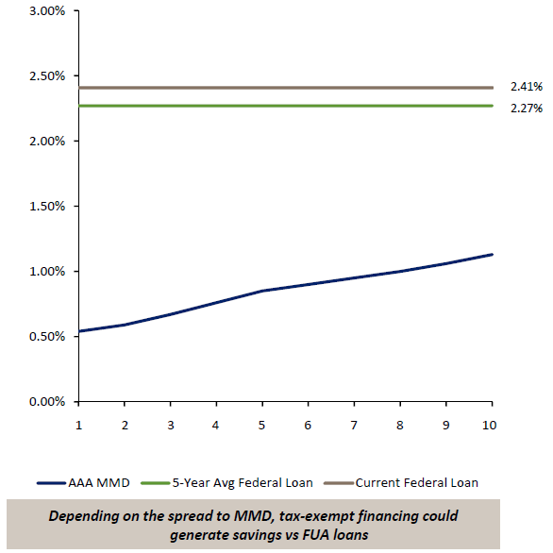
Unemployment Compensations Bonds
Tax‐Exempt Bonds, More Affordable
FUA Advance vs. Hypothetical AAA Tax‐Exempt
Federal loan interest rate is tied to weighted average of outstanding (taxable) public debt, and currently 2.408%, and adjusts annually.
High-quality long-term municipal bonds are less than half the cost, which requires a lower assessment on employers to service.

Slide 14
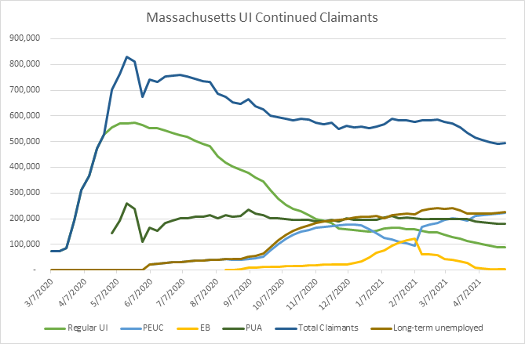
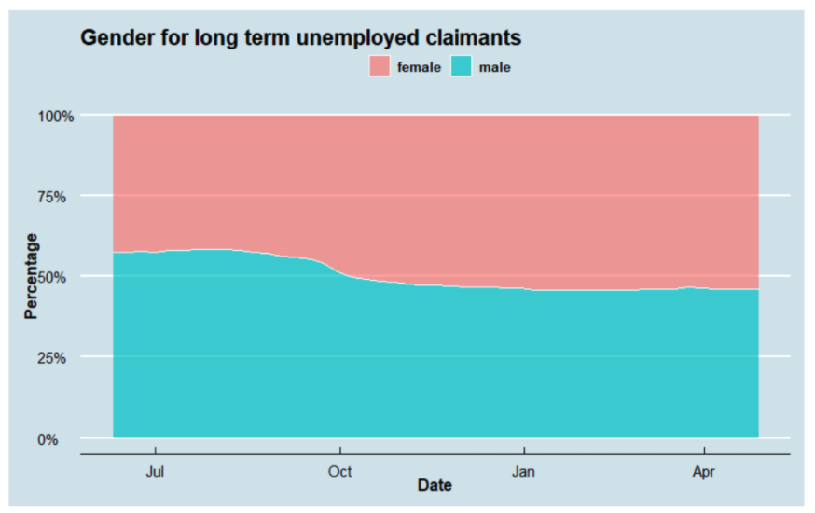
Massachusetts UI Claimant Pool (May, 2021)

Slide 15
Appendix

Slide 16
UI Preliminary Modeling Assumptions
UI Modeling Notes & Assumptions
Official forecasted estimates of gross benefits, average employer contributory rates, UC revenue through 2022 are based on the preliminary February 2021 Quarterly UI Report
Assumption have been made beyond 2022 based on achieving certain solvency targets
All estimates are subject to change based on Moody’s forecast of unemployment rate, average wages, and employer and employee contributions
Unemployment rates are based on Moody’s projections as required by federal law

