Slide 1
UI Trust Fund Study Commission
Kevin R. Hennessey CEO of Brabo Payroll

Slide 2
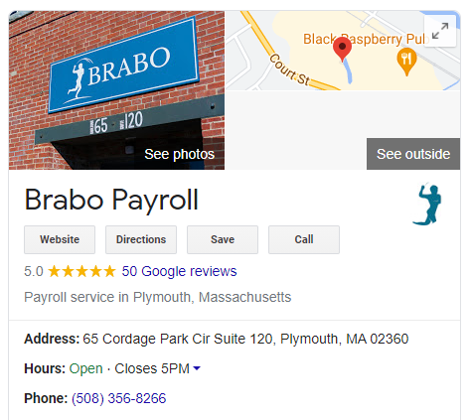
Brabo Payroll: Who We Are
Massachusetts based Payroll, Benefits, and HR Advisory firm specializing in small and mid sized businesses
500+ clients paying over 6,000 Massachusetts residents
BRABO PAYROLL | Kevin Hennessey

Slide 3
Objectives
Disproportionate Impact to Underserved Employers and Communities
Taxable Wage Base
Benefit Limits
Benefits Terms
Return to Work Programs
Unified System
Rate Timeline Accountability
BRABO PAYROLL | Kevin Hennessey

Slide 4
Disproportionate Impact to Underserved Employers and Communities
Many factors repeatedly impacting the same demographic of employers
Minimum wage increase
PFML
MA Sick Time
EMAC
MA Unemployment/$15,000 base
Industries hardest hit
Hospitality (43.1% minority employed)
Retail (47% women employed, 36.6% minority employed)
Transportation/Logistics (20.7% Black/African American employed)
Security (28.4% Black/African American employed)
Health Care/Home Health Care (74.6% women employed)
Child Care (95.6% women employed)
Businesses in underserved communities
https://www.bls.gov/cps/cpsaat18.htm
BRABO PAYROLL | Kevin Hennessey

Slide 5
Taxable Wage Base
Has been $15,000 for well over a decade
The taxable wage base should be dynamic by indexing to either state minimum wage, or the social security limit, like PFML
Consider adding employee contribution
Consider Employee experience rating based on individual use/abuse
Pennsylvania, Alaska, and New Jersey currently utilizes this
BRABO PAYROLL | Kevin Hennessey

Slide 6
Benefit Limits & Terms
If contributions increase, benefit payouts should be increased for higher earners
Graduated benefit amount
Consideration: A declining benefit over time
Full benefit 13 weeks
Reduced benefit (75% of benefit) for remaining 13 weeks
BRABO PAYROLL | Kevin Hennessey

Slide 7
Return to Work Programs
Consider partnering with businesses to direct applicants directly to businesses, to prevent fraud, better track effort and results of those seeking employment
Offering a benefit to those accepting a job with lower pay than previously earned
BRABO PAYROLL | Kevin Hennessey

Slide 8
Unified System
MassTaxConnect and UI should be one system, like California
More efficient and cost effective for both government and business
Less administrative burden on small businesses
More transparent
BRABO PAYROLL | Kevin Hennessey

Slide 9
Rate Timeline Accountability
Rates should always come out prior to the new year
Businesses need to have the ability to budget for upcoming year
BRABO PAYROLL | Kevin Hennessey

Slide 10
Any Questions?
BRABO PAYROLL | Kevin Hennessey

