Slide 1
A 21st Century Education System in Support of Future Success
For Presentation to Mass. Future of Work Commission

Slide 2
MBAE has a 37 Member Affiliate Network
1Berkshire
Blackstone Valley Chamber of Commerce
Cape Cod Canal Region Chamber of Commerce
Cape Cod Chamber of Commerce
Concord Chamber of Commerce
Cranberry Country Chamber of Commerce
Greater Boston Chamber of Commerce
Greater Holyoke Chamber of Commerce
Greater Lynn Chamber of Commerce
Greater Westfield Chamber of Commerce
Mass Biotech Council (MassBio)
Massachusetts Competitive Partnership
Massachusetts High Technology Council
Mass. Technology Leadership Council
Massachusetts Society of CPAs
Metro South Chamber of Commerce
MetroWest Chamber of Commerce
NAIOP-MA
Nashoba Valley Chamber of Commerce
Neponset River Regional Chamber
Newton-Needham Regional Chamber
North Central Mass. Chamber of Commerce
One SouthCoast Chamber
Orleans Chamber of Commerce
Plymouth Area Chamber of Commerce
Quincy Chamber of Commerce
Retailers Association of Massachusetts
Salem Chamber of Commerce
Springfield Business Leaders for Education
Springfield Regional Chamber
Stoneham Chamber of Commerce
Taunton Area Chamber of Commerce
TechNet
United Regional Chamber of Commerce
Western Mass Economic Development Council
Worcester Regional Chamber of Commerce
Notes:
We work in partnership with 37 affiliates collectively representing over 31,000 MA employers

Slide 3
MBAE and the employers we represent believe that an excellent public education system is the essential foundation of a sound and equitable economy.
We promote and support continuous improvement in our schools to ensure that EVERY student receives a high quality education that prepares them for success in college, career and citizenship.
Notes:
MBAE is a 30 year old organization founded by a businessperson and an educator that believes business has a critical role in ensuring that every child in our K12 public education system has access to a world class education
In our skills-driven economy this is necessary for continued business competitiveness; it's also a matter of fairness to our students

Slide 4
Business Leaders Believe That:
Future needs will include a strengthened and diverse talent pipeline and greater equity of opportunity for all.
Eliminating future employment, income and wealth gaps requires investment and strategies for educational improvements that close today’s achievement, homework, digital equity and opportunity gaps.
Business leaders must partner with state leaders and policymakers, to be engaged and supportive in the effort to ensure that the future of work is beneficial to ALL.

Slide 5
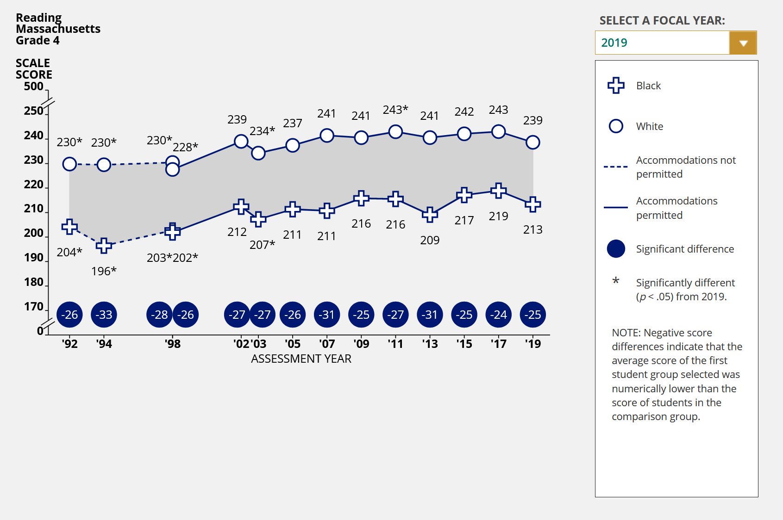
Opportunity gaps – Black and White students
https://www.nationsreportcard.gov/dashboards/achievement_gaps.aspx

Slide 6
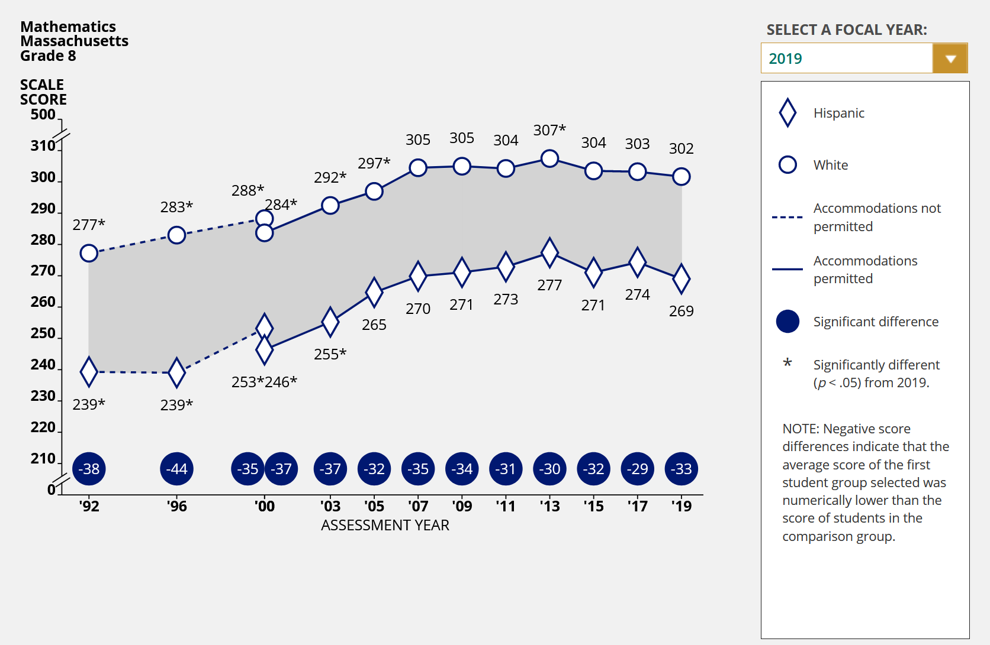
Opportunity gaps – Hispanic and White students
https://www.nationsreportcard.gov/dashboards/achievement_gaps.aspx

Slide 7
Where do we stand as a state?
75%
MA employers report difficulty filling jobs
72%
MA jobs estimated to require a college degree or career certificate
45%
9th graders who go on to earn a
college degree or professional certification
49%
MA Students doing math at grade level
Notes:
Since the 1993 education reforms that MBAE helped design, we have gone from middle of the pack to the state with the best education performance in the country on average
We continue to fall short in two major areas: preparing students with skills needed for career success AND equitable student access to opportunity;
our added rationale for seeking to close the achievement gap is the lack of skilled workers for so many open positions and that efforts to close these persistent gaps produces a much larger talent pool for businesses to choose from; a talent pool that reflects the marketplace that businesses are in.
the bulk of the complaints about the Chapter 70 formula have come from towns on the Cape, particularly because they have great property wealth but it is concentrated in the hands of seasonal property owners so there are real impacts with low income property owners paying a regressively high property tax bill

Slide 8
Actionable Recommendations:
Preparing for the Future of Work with Education Improvements, Investments and Innovation
1) Recover Learning Lost during Pandemic and Accelerate Scaling Up of Best Practices to Close Gaps
2) Pathways for All Students
3) Acquisition of Durable Skills
4) Expansion of Computer Science Instruction/Closing the Digital Divide
5) Innovative Instructional Delivery/Personalized Learning
6) Ensuring Curriculum Alignment
7) Using Federal Relief Dollars Strategically

Slide 9
Estimated impact of the pandemic on students
6 – 9 months
potential learning loss due to poor remote learning*
1 – 2 years
potential lost lifetime earnings*
*McKinsey & Company. 2020. COVID-19 and learning loss – disparities grown and students need help.

Slide 10
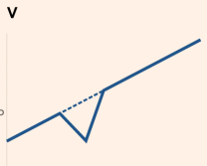
Prioritizing education policy is a critical investment in recovery
The pandemic has exacerbated inequality and threatens to seriously set back progress toward a more inclusive and just society
The status quo likely leads to significant
inequity and stagnation for students
We must accelerate and personalize learning if we are to recover
Notes:
Students:
Up to 3-6% of lifetime earnings (equivalent to 1 to 2 years’ earnings) as a result of lost learning time
Up to 12 months of learning loss as a result of lost learning time
Increased social-emotional strain, mental health issues, potential diminished detection of child abuse
Schools:
Mitigation and adaptation costs estimated at up to 20-30% of normal year budget
Average of 492 in-person/hybrid student/staff cases per week over last 3 weeks, affecting 39% of school districts, though evidence of transmission within schools is limited (DESE estimates about 525,000 students and staff are in-person or hybrid)
Staff emotional/mental health issues
Positive covid cases in schools: https://www.doe.mass.edu/covid19/positive-cases/#weekly-report
Images: Financial Times https://www.ft.com/content/113529d8-cefb-41f1-a61d-cc12b194f685

Slide 11
1.Recovery, Acceleration and Scaling Up
We must recover learning impacted by the pandemic or risk losing a generation of students and future workers.
Strategies:
High-Dosage Tutoring
Acceleration Academies
Learning Pods
We must fully and faithfully implement the Student Opportunity Act using proven practices to close gaps.
Strategies:
Universal Pre-K (3-4 year olds)
Extended Learning Time
Wrap Around Services

Slide 12
2. Create Pathways for All Students
Too many of today’s high school students are in a general track set of low-standards courses, graduating unprepared for college, career or future success.
We must ensure all students are in defined and permeable pathways relevant to their personal goals and ambitions.
Strategies:
Expand Early College and launch P-TECH model
Award high-demand industry-recognized credentials
Expand access to CTE and ensure equitable admissions
Expand the state’s CTI and Innovation Pathway Program
Adopt MassCore as grad requirement and increase AP
Business collaboration to expand work-based learning, mentorships, internships, apprenticeships
Adopt state policies that facilitate pathways in all schools

Slide 13
Pathways policies
https://pathwaysmatter.org/policies/

Slide 14
Expansion of Pathways in Massachusetts
Innovation Pathways - 99 programs at 42 high schools
Early College - 31 designated programs at 42 high schools in partnership with 22 institutions of higher ed
Career Technical Initiative (3 shifts)
CTE Partnership "After Dark" - 25 programs 6 HS partnerships
Adult Technical Training programs –7 programs 23 pathways
Expansion of Ch.74 programs - over 70 programs added in last 5 years
Notes:
Verbally –
about 20% of high school students particpate in Ch.74 programs in MA.
>70 designations in last 5 years (in voc and comp schools)
and 25 After Dark second shift
And 7 adult evening programs & 23 pathways approved

Slide 15
3. Support Student Acquisition of Durable Skills
Durable Skills: Often referred to as soft skills, or employability skills, schools must play a role in helping students acquire and enhance these characteristics that are central to career success and transferable in a highly evolving world of work.
Industries and work sectors poised for future growth are looking for workers that can communicate and collaborate effectively, show leadership and critical thinking skills, and engage in problem solving and planning.
Businesses must be involved and engaged in establishing a list of skills needed and supporting schools in the effort.

Slide 16
https://americasucceeds.org/policy-priorities/durable-skills/durable-skills-research

Slide 17
4. Expansion of Computer Science Instruction
While we live in a state with a thriving tech sector, we have a significant digital literacy gap as 1 in 4 of our high schools don’t offer a single CS course and others offer limited access.
As we enter the future of work, we must recognize that digital literacy skills in the workplace will be as essential as language skills are in life, with this opportunity gap threatening to deny access to higher paying tech jobs to many.
Strategies:
Require computer science in every high school and as a graduation requirement.
Integrate CS fully into the K-8 curriculum.
Invest in training and certification recruitment for a CS teaching workforce.
Ensure a device and connectivity for all.

Slide 18
5.Innovative Instruction-Delivery/Personalization
With new developments in technology, and lessons learned from the pandemic, we have an opportunity to reshape instructional delivery in ways that further personalize learning and better cultivate a generation of entrepreneurs.
New systems of hybrid and remote learning can allow for more flexibility for students and are adaptable to serving adult learners.
In-classroom tech investments can also facilitate assessment of student competencies in real time.
Strategies:
Employ new models of instruction with in-classroom tech. ed, hybrid, remote, blended learning and “flipped classroom” options.
Invest in hardware and software for instruction, training for educators, student assessment and innovative models that move us toward a system focused on competencies, not “seat time.”
Build a system that supports connections between schools and districts, and with higher ed and businesses.

Slide 19
6. Ensuring Curriculum Alignment
Schools, particularly CTE and pathway programs, must ensure regular assessment of programming, in consultation with the business community and Labor/Workforce agencies, to align with evolving labor market needs.
Despite the strength of the state’s vocational schools and the presence of local advisory boards, there is not always a direct connection to high-growth, high-wage careers and credentials.
Strategies:
Audit the state’s vocational/CTE programs for alignment.
Establish a process for a biannual review of labor market needs with business community involvement within the context of aligning it with education systems and a published state list of future jobs and needed competencies.
Continue to develop the state’s longitudinal data system to assess school programming against post-grad success, including wage rates and career placement.

Slide 20
Alignment of credentials to labor market
https://credentialsmatter.org/state-summary/ma/

Slide 21
School District Relief Funding Timeline and Amounts
GEER II
$23 million
ESSER III
$1,658
million
GEER
$50 million
ESSER II
$733
million
Emergency declared
March 2020
ESSER
$193 million
CvRF
$181 million
CRRSAA
December 2020
CARES Act
March 2020
ARPA
March 2021
FY22 SOA Increase
$220 million
For context:
Notes:
CARES = Coronavirus Aid, Relief, and Economic Security
CRRSSA = Coronavirus Reponses and Relief Supplemental Appropriations Act
ARA = American Rescue Act
GEER = Governors Emergency Education Relief Fund
ESSER = Elementary and Secondary School Emergency Relief
CvRF = Coronavirus Emergency Relief Fund

Slide 22
ARPA ESSER Earmarks, State and Districts
State allocation ($182m)
$91 million must be spent on learning loss
$18 million must be spent on summer learning
$18 million must be spent on after school learning
$45 million can be spent flexibly
Local School Districts ($1.66b)
$329 million must be spent on learning loss by school districts
~$1.4 billion can be spent flexibly by districts

Slide 23
7. Using Federal Relief Funds Strategically
This unique funding moment allows for an opportunity we must make the most of in reshaping schools to support students in meeting the future.
State leaders must provide a clear and bold vision for reinvention and innovation.
Funds should be spent as part of a strategic planning effort and not a “menu selection” process.
Funds should accelerate and scale up proven practices while supporting new models to be assessed through investment in the state’s 21st Century Education Trust Fund.
Outcomes to be achieved should be established with progress measured.
State funds should incentivize local funds.
Ensure tech. investments In schools and the closing of Digital Equity Gaps.

Slide 24
Thank you
Ed Lambert, Executive Director

