Slide 1
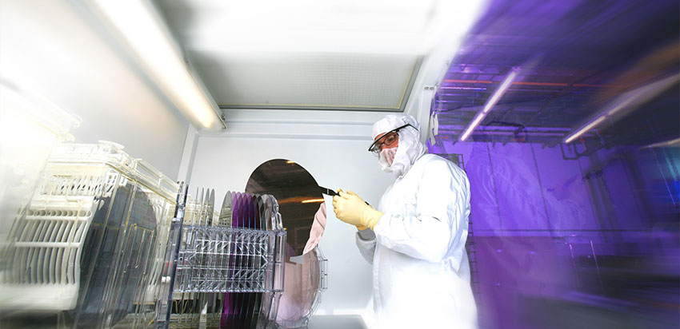
The Advanced Manufacturing Challenge
Between 2000 and 2010, the United States lost one-third of its manufacturing jobs.
Since then, increasingly U.S. firms operated on a system of “innovate here/produce there,” leaving manufacturing, and the quality jobs it offers, behind.
Remaining US manufacturing firms face many challenges
Investing in the right technology at the right time
Configuring operations to maximize productivity
Having the right workforce
The US workforce is at a crossroads
Compete at lowest wages.
Work with high productivity that supports higher wages and personal advancement.
The Future of Work must be high ‘quality’ jobs that support wealth creation.
Notes:
Loss of jobs
Loss of productivity – absolute and relative

Slide 2
The MIT Initiative for Knowledge and Innovation in Manufacturing
Agile Workforce
The IKIM Mission
Foster a thriving domestic manufacturing ecosystem by
educating an agile workforce,
creating resilient innovation,
developing nimble firms, and
proposing transformative policy.
Resilient Innovation
Nimble Firms
Transformative policy

Slide 3
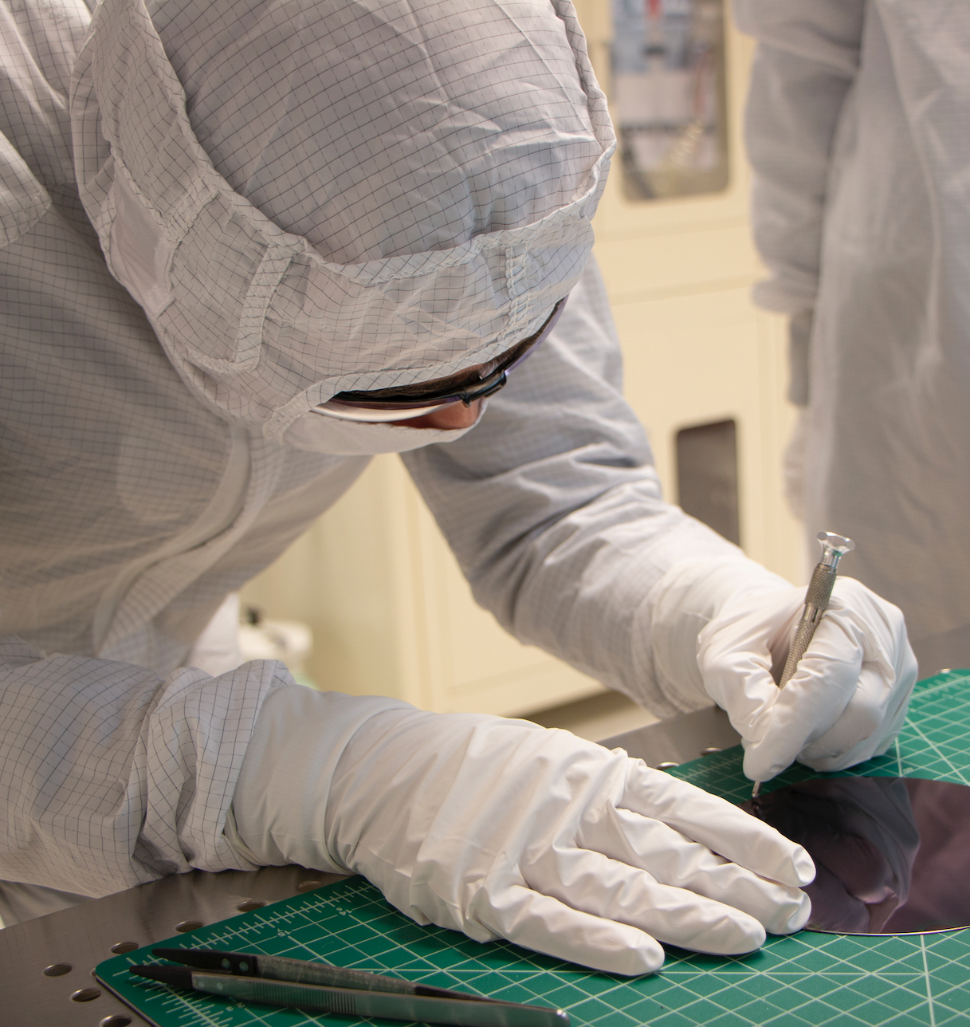
The Advanced Manufacturing Challenge
To be competitive, US Manufacturers will need to…
Become more flexible
produce more variety in smaller lot sizes
Keep up with current technology
Deliver the latest levels of performance
Be innovative
Develop new concepts faster than the competition
Be skilled
Efficiently apply new technology to new products
Be data-centric
Use information to understand the customer and supply base
Be supported by community, education and effective policy
Build Public-Private partnerships
Notes:
Too general, try to articulate specific problems

Slide 4
IKIM Education and Workforce Development
Prepare the advanced manufacturing workforce
Education
Roadmap
Workforce Development
Summer Academy | Online Education | Virtual Lab | TED-Ed
Portfolio
Summer Academy | Online Education | Virtual Lab | TED-Ed
Future Leaders | LEAPs | Test Training | Certification | Design Services
Technical Meetings/Webinars | Education Roadmap | Technology Roadmap
workforce re-skilling
up-skilling
Blended learning: on-site
online
circuit design
hands-on testing
courses
workshops
interactive learning tools

Slide 5
Education Roadmap: Industry Workforce Needs
Interviewed 24+ firms to assess engineer workforce competencies:
3M
Promex
Macom
Broadcom
Facebook
Genalyte
GenXComm
Boeing
Infinera
Intel
Juniper Networks
L3 Harris
Lincoln Labs
Litexel
Lockheed-Martin
RMD
Luxtera/Cisco
Microsoft Azure
Nokia Labs
NVIDIA
Pendar
Phase Sensitive Innovations
Raytheon
TriLumina
Institutions:
AIM Photonics Institute
MIT
Tyndall Institute
RIT
University of Rochester
https://aimphotonics.academy/roadmap/photonics-workforce-roadmap
Key Findings: Photonics PhDs need more cross-training + training in DfM and supply chain analysis
Computer modeling of devices/ circuits/systems (custom, commercial tools)
Cross-training in process or design
Experience in Design for Manufacture, Test, Experiment (yield, reliability, process variation, statistical process control, data science)
Assess production cost, customer constraints
Introductory packaging (mechanical vs optical vs thermal issues)
Application area awareness (processing, packaging, testing options)
Creativity, internal/external communications skills (management, customers)

Slide 6
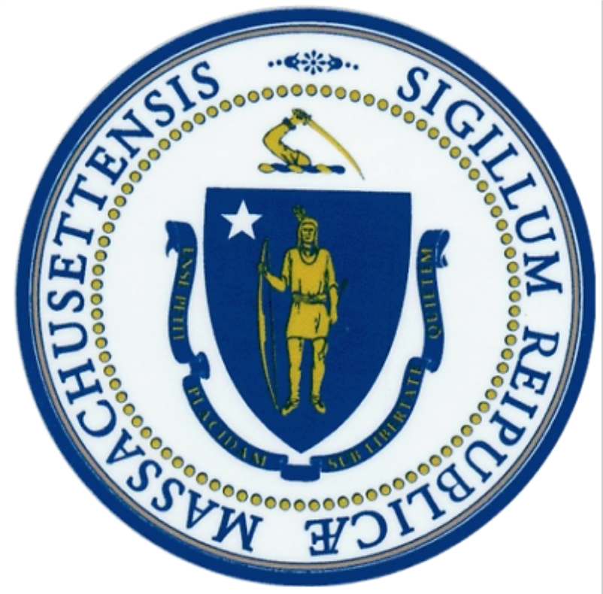
IKIM Massachusetts focus
1) MassBridge
2) U Mass Lowell/Cape Cod Community College technologist program
3) Stonehill/BSU technician certificate program
4) Regional game-based learning project
5) Berkshire Innovation Center collaboration
6) LEAP network
6) NSF collaboration with Springfield Technical Community College
7) Build Back Better EDA opportunity

Slide 7
IKIM Massachusetts focus
Tulip will co-develop digital manufacturing content
PTC is leading an effort to bring together an IKIM company consortium
Peerless Precision advised us on multiple projects
Accurounds, Forward Photonics, IQE, Lincoln Laboratory, Optikos, Plymouth Grating Laboratory
Hired technicians from our first Stonehill/BSU photonics cohort
BAE Systems, Lockheed Martin, Raytheon, Accumet, Bomco, Boston Centerless, Aavid, Crystal Engineering, Custom Machine, Excell Solutions, Innovent Technologies, Sheaumann
Technologist industry advisory board

Slide 8
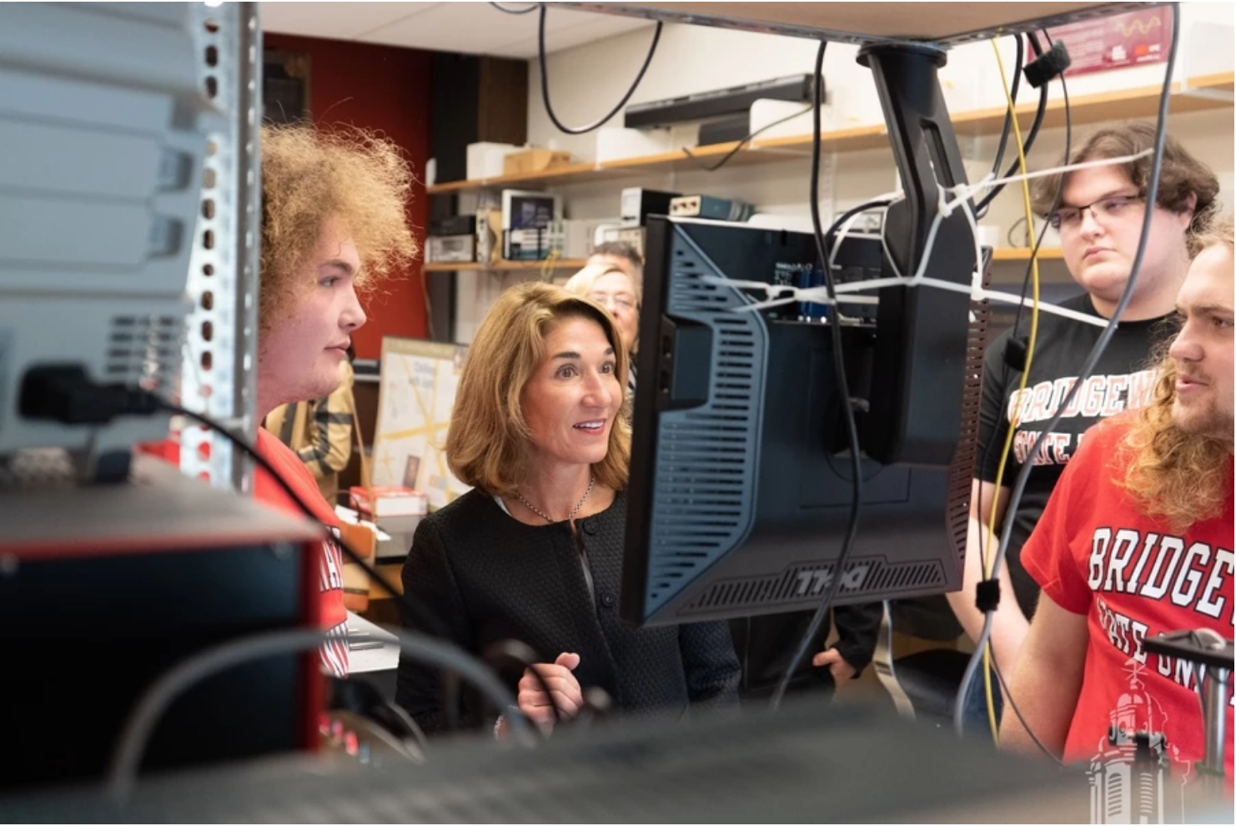
MIT IKIM and the MA Legislature
Community, education and effective policy
Higher productivity that supports higher wages and personal advancement
The Future of Work must be ‘high quality’ jobs that support
personal advancement for our citizens and wealth creation for the Commonwealth.

