Slide 1
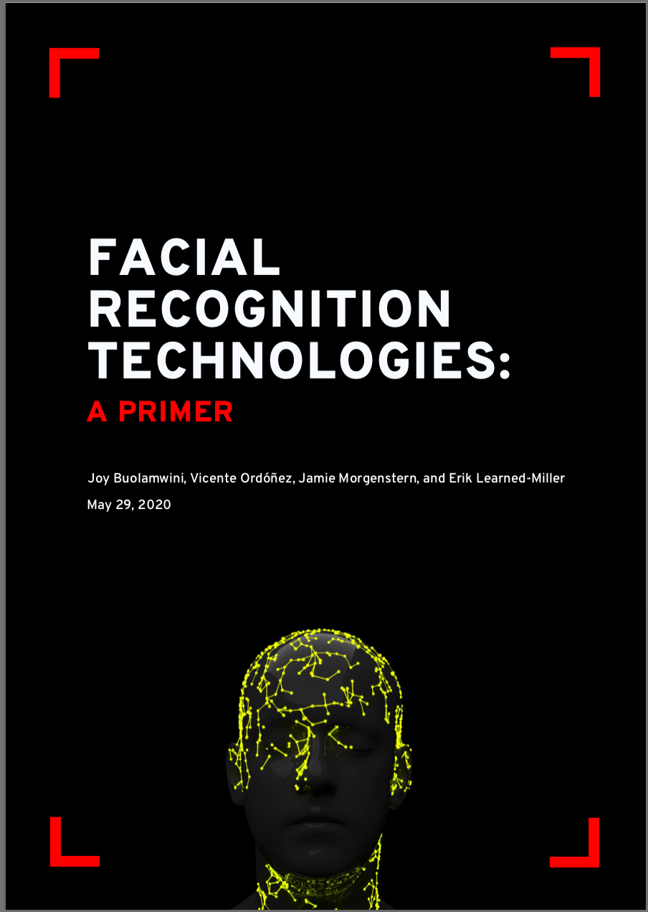
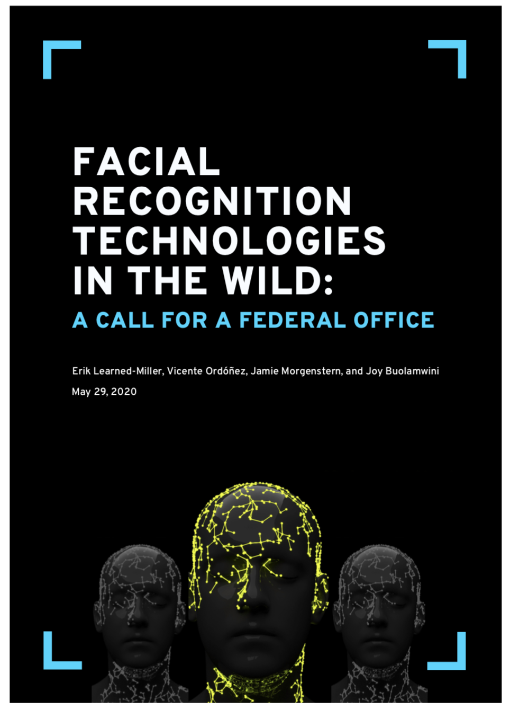
Face Recognition Technology Background for the Massachusetts
Facial Recognition Commission May 21, 2021
Erik Learned-Miller University of Massachusetts, Amherst

Slide 2
A bit about my background
Professor of Computer Science at UMass Amherst since 2004.
Research in face recognition since 2006.
Some contributions to face recognition technology
2007: Developed one of the most widely used benchmarks for face recognition, used to measure face recognition accuracy.
2008: World #1 face recognizer on LFW Face Rec. Benchmark (It has since been surpassed by many others.)
2017: World #1 face detector on FDDB Face Detection Benchmark (This has also been surpassed.)
1989-1995: An engineer in the medical device industry. Interacted a lot with the Food and Drug Administration on medical device regulation.

Slide 3
Outline
How are FR systems developed and what does that imply about their vulnerabilities?
How do the subtle variations in how we pose questions to FR systems affect the interpretation of the answers we get?
How do these subtleties affect the real-world use of FR systems?
Confidence estimates in FR systems. What do they really mean?
Intended use. A lens for understanding many of the problems with FR systems.
How accurate are FR systems?

Slide 4
Outline
How are FR systems developed and what does that imply about their vulnerabilities?
How do the subtle variations in how we pose questions to FR systems dramatically affect the interpretation of the answers we get?
How do these subtleties affect the real-world use of FR systems?
Confidence estimates in FR systems. What do they really mean?
Intended use. A lens for understanding many of the problems with FR systems.
How accurate are FR systems?

Slide 5
How are modern FR systems built? Answer: learning from example...
The computer is given a large “training set” of image pairs. Each pair is either a “match” or a “mismatch”.
The computer tries to guess whether each pair of images is a match or mismatch. After its guess, it is given the correct answer.
The computer tries to find a complex set of “rules” for guessing the answer that allows it to get all of the training pairs correct.

Slide 6
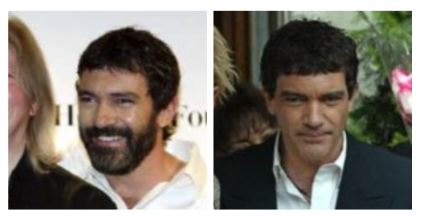
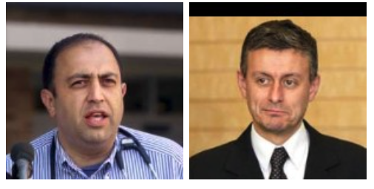
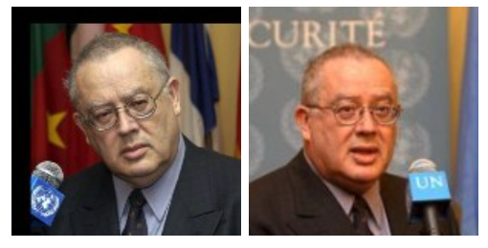
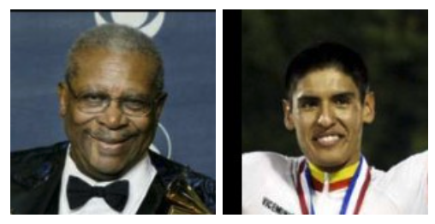
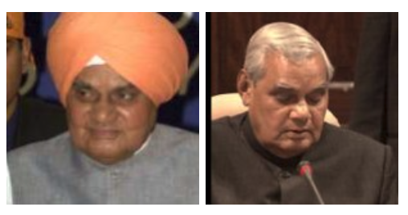
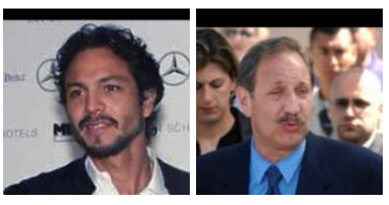
How are modern FR systems built? Training set
“matched pairs”
“mismatched pairs”
...
...

Slide 7
How are modern FR systems built? Training set
The system is finished “training” when it can classify most of the training examples correctly, using the rules that it has developed.
“matched pairs”
“mismatched pairs”
...
...

Slide 8
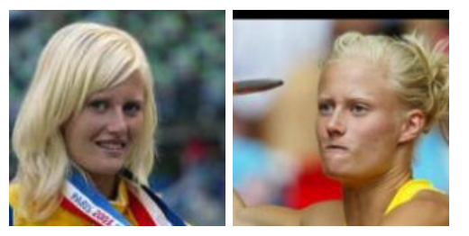
When this system is deployed...
Match or mismatch?

Slide 9
When this system is deployed...
Match or mismatch?
In this example
None of the training images were of women!
None of the training images had people with blond hair!
None of the training images had people with their hair tied up!
Do we really expect the system to do well?

Slide 10
When this system is deployed...
Match or mismatch?
Takeaway #1 In general, modern face recognition systems can only learn about the kinds of people that they are trained on.
In this example
None of the training images were of women!
None of the training images had people with blond hair!
None of the training images had people with their hair tied up!
etc.

Slide 11
Human beings have similar biases: We develop expertise in recognition with experience.
Most human beings are far better at recognizing the kinds of people they have had more exposure to.

Slide 12
Human beings have similar biases: We develop expertise with experience.
Most human beings are far better at recognizing the kinds of people they have had more exposure to.
Takeaway #2 It is often the case that FR systems perform poorly on groups that were underrepresented in their training data. This is a natural consequence of how they are designed.

Slide 13
Outline
How are FR systems developed and what does that imply about their vulnerabilities?
How do the subtle variations in how we pose questions to FR systems affect the interpretation of the answers we get?
How do these subtleties affect the real-world use of FR systems?
Confidence estimates in FR systems. What do they really mean?
Intended use. A lens for understanding many of the problems with FR systems.
How accurate are FR systems?

Slide 14
A bit of terminology
There are many different problems in face recognition. Two of the most common ones are:
Face verification. Are the faces of the same person?
Face identification. Given a “gallery” of people, which person is this?
“Probe”

Slide 15
How a question is asked to a recognition system can have a huge impact on the result.
We are going to examine how slightly different ways of phrasing a face recognition question can lead to dramatically different results.

Slide 16
Question Version 1
Which person in the gallery matches the probe image?
Gallery
Probe
A B C D E

Slide 17
Question Version 1
Which person in the gallery matches the probe image?
Gallery
Probe
A B C D E
Correct Answer: “B”

Slide 18
Question Version 2
Which person in the gallery is most similar to the probe image?
Gallery
Probe
A B C D E

Slide 19
Question Version 2
Which person in the gallery is most similar to the probe image?
Gallery
Probe
A B C D E
Correct Answer: “B”

Slide 20
So far so good...

Slide 21
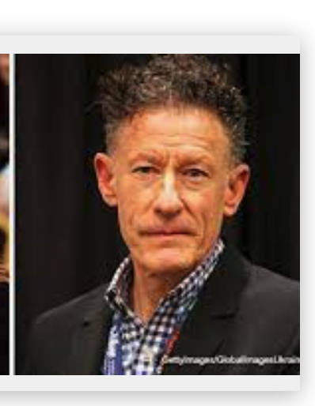
Question Version 1
Which person in the gallery matches the probe image?
Gallery
Probe
A B C D E

Slide 22
Question Version 1
Which person in the gallery matches the probe image?
Gallery
Probe
A B C D E
Correct Answer: “None of the above”

Slide 23
Question Version 2
Which person in the gallery is most similar to the probe image?
Gallery
Probe
A B C D E

Slide 24
Question Version 2
Which person in the gallery is most similar to the probe image?
Gallery
Probe
A B C D E
Correct Answer: “B”. But they are NOT the same person!

Slide 25
Analysis of a common scenario
An investigator wants to identify a suspect.
They submit a photo to a face-recognition system and ask for matches.
Suppose the system returns the message “No Matches Found”.
The investigator hypothesizes that perhaps a correct match was found internally by the system, but the system wasn’t quite confident enough, so it didn’t return a match.
To address this situation, the investigator rephrases the question: “Which person in the gallery looks most like the probe image?” or, alternatively, the investigator reduces the “confidence threshold” required for a match. Now the system returns a match.

Slide 26
Two possible outcomes in this scenario:
One outcome is that the investigator made it easier for the system to find a correct match, and a correct match was found!
However, the other outcome is that the investigator made it easier for the system to find an incorrect match. This could increase the number of FALSE MATCHES!.

Slide 27
Two possible outcomes:
One outcome is that the investigator made it easier for the system to find a correct match, and a correct match was found!
However, the other outcome is that the investigator made it easier for the system to find an incorrect match. This could increase the number of FALSE MATCHES!.
Takeaway #3 In general, there is an
inherent trade-off between
increasing true matches (good!) and increasing false matches (bad!): as you increase one the other also increases.

Slide 28
Outline
How are FR systems developed and what does that imply about their vulnerabilities?
How do the subtle variations in how we pose questions to FR systems dramatically affect the interpretation of the answers we get?
How do these subtleties affect the real-world use of FR systems?
Confidence estimates in FR systems. What do they really mean?
Intended use. A lens for understanding many of the problems with FR systems.
How accurate are FR systems?

Slide 29
A real-world example: disclaimer

Slide 30
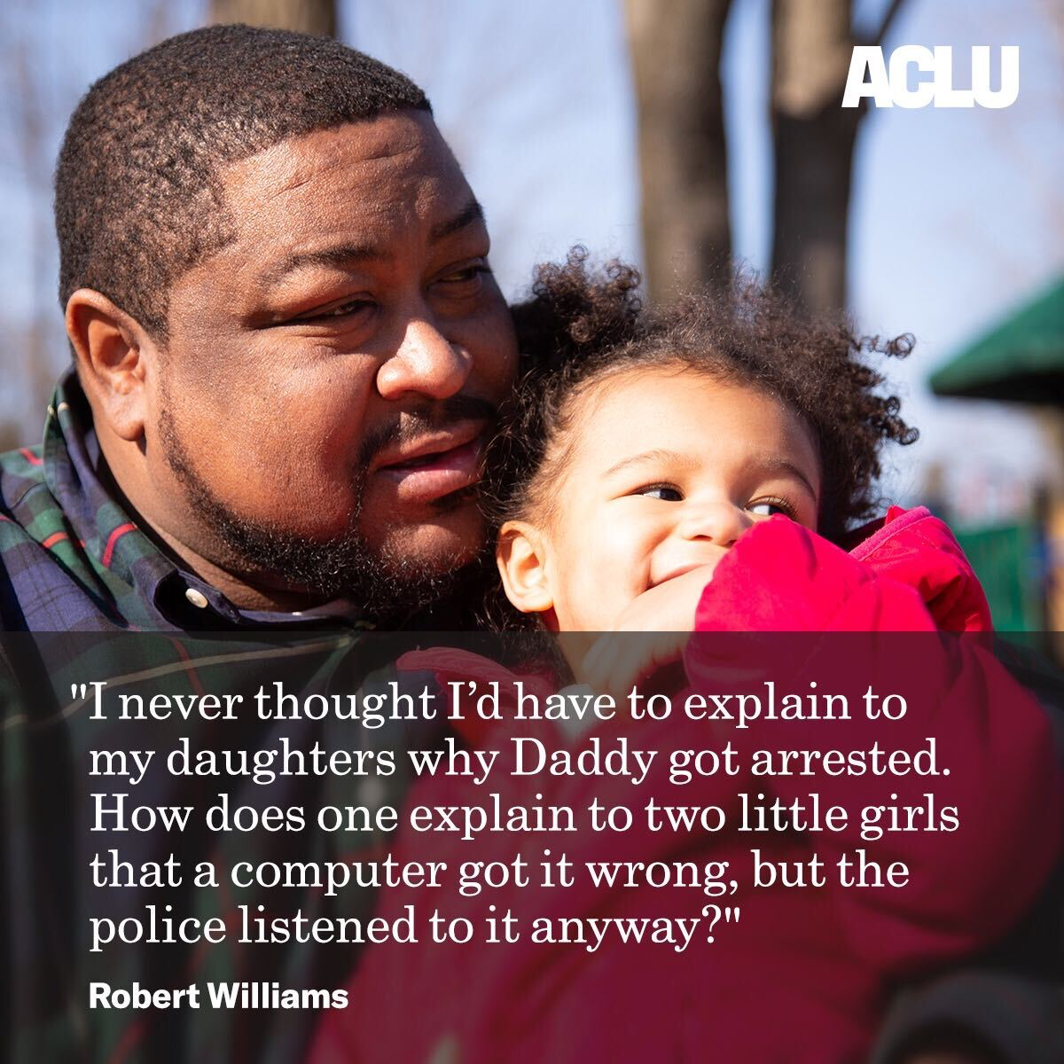
Face recognition gone wrong: A Real-World Example
Robert Williams:
Misidentified by face recognition software
Falsely accused of robbing jewelry store
Arrested in front of his family
Detained for 30 hours
Photo credit: ACLU of Michigan.

Slide 31
Face recognition gone wrong: A Real-World Example
Robert Williams:
Misidentified by face recognition software
Falsely accused of robbing jewelry store
Arrested in front of his family
Detained for 30 hours
Consequences of misidentification:
Risk of escalation during an arrest.
Distrust by employer.
Loss of time/income.
...
Photo credit: ACLU of Michigan.

Slide 32
Let’s look at some details about how this happened

Slide 33
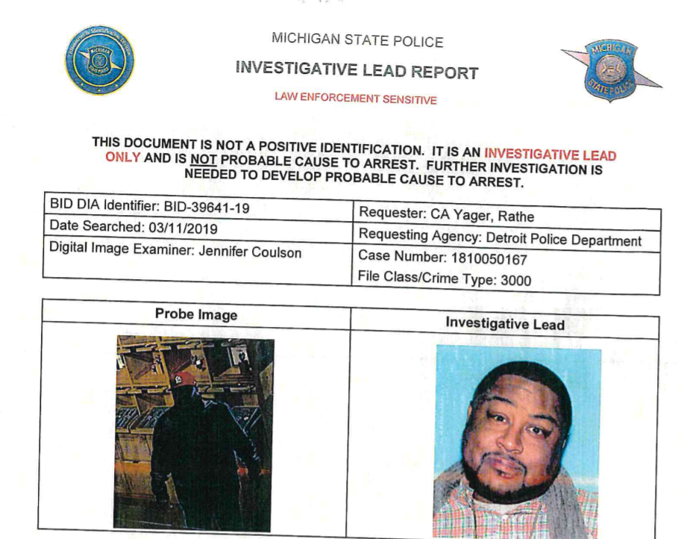
Investigative Lead Report
image credit: NPR.org
Surveillance video from crime scene
Driver’s license

Slide 34
Investigative Lead Report
image credit: NPR.org
Surveillance video from crime scene
Driver’s license

Slide 35
How was the system being used?
It was being used to assess similarity in appearance. The system did NOT claim to have high confidence of a match. It was only saying that this person was “more similar” than other people in the database and that it “could be” a match.
As a result, the investigative lead report emphasized that it was NOT sufficient evidence for an arrest.
Unfortunately, in this case, the need for corroborating evidence was not taken seriously.
One interpretation of this example: The “match” provided by the system was interpreted as a positive ID, despite a number of safeguards in place to try to ensure that it should NOT be interpreted that way.

Slide 36
How was the system being used?
It was being used to assess similarity in appearance. The system did NOT claim to have high confidence of a match. It was only saying that this person was “more similar” than other people in the database.
As a result, the investigative lead report emphasized that it was NOT sufficient evidence for an arrest.
Unfortunately, in this case, the need for corroborating evidence was not taken seriously.
One interpretation of this example: The “match” provided by the system was interpreted as a positive ID, despite a number of safeguards in place to try to ensure that it should NOT be interpreted that way.
Takeaway #4 Despite warnings not to do so, it is not uncommon for people to put too much faith in results returned from face recognition systems.

Slide 37
Outline
How are FR systems developed and what does that imply about their vulnerabilities?
How do the subtle variations in how we pose questions to FR systems dramatically affect the interpretation of the answers we get?
How do these subtleties affect the real-world use of FR systems?
Confidence estimates in FR systems. What do they really mean?
Intended use. A lens for understanding many of the problems with FR systems.
How accurate are FR systems?

Slide 38
Confidence estimates and confidence thresholds
Many face recognition system vendors provide
Confidence levels: an estimate of the probability that a match is correct
Confidence thresholds: a required level of confidence before the system will provide a match.
Some issues:
What do confidence levels mean and are they accurate?
Can they be misinterpreted by well-meaning people? (Hint: yes!)
Are users allowed to adjust confidence thresholds?

Slide 39
What do confidence levels mean?
Suppose we run a face recognition system on 1 million different images. We then collect all of the cases in which the system declared that its confidence was 98%. Suppose there are 100,000 of these cases. How many do we expect to be correct?
Answer: Out of 100,000 images, we expect 98%, or about 98,000, to be correct.
Is this the way confidence levels actually work in practice?
Unfortunately, the answer is NO!
It is an unsolved problem how to produce a confidence level that works as described above. Currently, it is an active area of research and no one has solved the problem!
I have personally seen many face recognition systems produce confidence levels of 100%, and still be wrong!

Slide 40
What do confidence levels mean?
Suppose we run a face recognition system on 1 million different images. We then collect all of the cases in which the system declared that its confidence was 98%. Suppose there are 100,000 of these cases. How many do we expect to be correct?
Answer: Out of 100,000 images, we expect 98%, or about 98,000, to be correct.
Is this the way confidence levels actually work in practice?
Unfortunately, the answer is NO!
Sobering facts about “confidence levels” in face recognition.
It is an unsolved problem how to produce a confidence level that works as described above. Currently, it is an active area of research and no one has solved the problem!
I have personally seen many face recognition systems produce confidence levels of 100%, and still be wrong!
Takeaway #5 Confidence levels produced by face recognition systems are often misleading, and do not mean what one expects them to mean.

Slide 41
Are users allowed to adjust confidence levels in a face recognition system?
In the Amazon “Rekognition” face recognition system, clients were advised to use the system with a certain confidence threshold.
However, in practice, users were free to adjust confidence thresholds as they saw fit. This can lead to the kinds of problems just discussed.
Example: If you don’t get a match when you analyze a face at a given confidence threshold, turn down the confidence threshold until you do get a match. Note: In many systems, this will work even with a blank image!

Slide 42
Outline
How are FR systems developed and what does that imply about their vulnerabilities?
How do the subtle variations in how we pose questions to FR systems dramatically affect the interpretation of the answers we get?
How do these subtleties affect the real-world use of FR systems?
Confidence estimates in FR systems. What do they really mean?
Intended use. A lens for understanding many of the problems with FR systems.
How accurate are FR systems?

Slide 43
Intended use
Each face recognition system is developed for certain conditions. It is engineered, tested, and debugged for a particular application.
A big challenge is to keep users from using the system for an “off-label” use, i.e., a use that was never intended.
Examples:
Intended for passport photos, but used for surveillance camera footage. Level of accuracy in testing will not translate to new scenario.
Intended for use by trained investigators, but used by untrained people.
Intended for organizing personal photo collections, but used for assessing job applicants. Acceptable error rate for low-risk application may be totally unacceptable for high-risk application.
Woody Harrelson example.

Slide 44
Intended use
Each face recognition system is developed for certain conditions. It is engineered, tested, and debugged for a particular application.
A big challenge is to keep users from using the system for an “off-label” use.
Examples:
Intended for passport photos, used for surveillance cameras. Level of accuracy in testing will not translate to new scenario.
Intended for use by trained investigators, used by untrained people.
Intended for organizing personal photo collections, used for assessing job applicants. Acceptable error rate for low-risk application may be totally unacceptable for high-risk application.
Takeaway #6 Many problems with face recogntion systems can be traced to systems being used in a way they were not intended to be used. (This is something that the FDA addresses in their regulation of pharmaceuticals.)

Slide 45
Outline
How are FR systems developed and what does that imply about their vulnerabilities?
How do the subtle variations in how we pose questions to FR systems dramatically affect the interpretation of the answers we get?
How do these subtleties affect the real-world use of FR systems?
Confidence estimates in FR systems. What do they really mean?
Intended use. A lens for understanding many of the problems with FR systems.
How accurate are FR systems?

Slide 46
A few comments on “accuracy”
Many people want to know the answer to the questions:
Are face recognition systems accurate?
What is the accuracy of face recgonition systems? There is no simple answer to these questions!
Face recognition system accuracy depends STRONGLY on all of these factors:
The quality of the input images.
The number of people in the gallery.
The similarity of the people in the gallery.
Whether a system has been trained with people from the target population. By varying these factors, one can EASILY make a system go from 0% to 100% accuracy!

Slide 47
A few comments on “accuracy”
Many people want to know the answer to the questions:
Are face recognition systems accurate?
What is the accuracy of face recgonition systems? There is no simple answer to these questions!
Face recognition system accuracy depends STRONGLY on all of these factors:
The quality of the input images.
The number of people in the gallery.
The similarity of the people in the gallery.
Whether a system has been trained with people from the target population. By varying these factors, one can EASILY make a system go from 0% to 100% accuracy!
Takeaway #7 There is no way to simply characterize the accuracy of a face recognition system in all scenarios. It strongly depends on a number of factors.

Slide 48
Thanks for your attention!

