Slide 1


Special Commission on Continuing Care Retirement Communities Report
Established in Section 29 of Chapter 197 of the Acts of 2024

Slide 2
Table of Contents
Commission Overview
Commission Members, Meetings, and Glossary of Terms
Commission's Findings by Charge
Commission's Recommendations
Letters from Advocates

Slide 3
Commission Overview
The CCRC Commision was established in Section 29 of Chapter 197 of the Acts of 2024, An Act to Improve Quality and Oversight in Long-Term Care.
The Commission was co-chaired by Representative Thomas M. Stanley and Senator Patricia D. Jehlen, Chairs of the Joint Committee on Aging and Independence. Commissioners included industry professionals and administrators, lawmakers, advocates, and CCRC residents.
The Commission met 8 times between April and July 2025, including a public hearing on 6/16/25. All meetings were held virtually on Zoom.
The Commission was required to submit recommendations to the Clerks of the Senate and House of Representatives, the Joint Committee on Aging and Independence, and Senate and House Committees on Ways and Means by August 1st, 2025.

Slide 4
Commission Members
Name | Affiliation
Thomas M. Stanley | House Chair of the Joint Committee on Aging and Independence
Patricia D. Jehlen | Senate Chair of the Joint Committee on Aging and Independence
John J. Ford | Massachusetts Chapter of the National Academy of Elder Law Attorneys
James Freehling | LeadingAge Massachusetts, Inc.
Jean Stringham | Massachusetts Life Care Residents' Association, Inc.
Jessica Costantino | AARP Massachusetts
Lorraine Kermond | Alzheimer's Association
Matt Hollingshead | Massachusetts Assisted Living Association, Inc.
Robin Lipson | Secretary of Executive Office of Aging and Independence
Steve Davis | Department of Public health
Tara Gregorio | Massachusetts Senior Care Association, Inc.
Valerie Frias | Office of the Attorney General
Christine M. Griffin, Esq. | CCRC Resident Appointed by the Governor
Dave VanArsdale | CCRC Resident Appointed by the Governor
Henry DeLima | 1199 SEIU Massachusetts

Slide 5
Commission Meetings
Date | Topic
3/24/25 | Introduction and objective setting
4/8/25 | What are CCRCs? Care contracts, consumer impacts, resident feedback
5/5/25 | Existing regulatory oversight, closing and change of ownership procedures
6/2/25 | Financial viability, entrance fees (including payment and return), advertising practices
6/16/25 | Public hearing
6/23/25 | CCRCs in California, consumer protection
7/7/25 | Opus CCRC model by 2Life, discussing potential recommendations
7/28/25 | Finalizing commission recommendations

Slide 6
Glossary of Terms
Assisted Living Residence (ALR): private residences that offer, for a monthly fee, housing, meals, and personal care services to aging adults who live independently; overseen by Executive Office of Aging & Independence (AGE)
Executive Office of Aging & Independence (AGE): executive agency responsible for addressing the needs of older adults in the Commonwealth
Continuing Care¹: the furnishing to an individual, other than an individual related by consanguinity or affinity to the person furnishing such care, of board and lodging together with nursing services, medical services or other health related services, regardless of whether or not the lodging and services are provided at the same location, pursuant to a contract effective for the life of the individual or for a period in excess of one year
Continuing Care Retirement Community (CCRC)²: also referred to as 'life plan communities'; must provide board and lodging together with nursing services, medical services or other health related services, regardless of whether or not the lodging and services are provided at the same location
Entrance Fee¹: an initial or deferred transfer to a provider of a sum of money or other property made or promised to be made as full or partial consideration for acceptance of a specified individual as a resident in a facility. No part of any fee payable on a periodic basis for board, lodging, medical or other health related services rendered by the provider to a resident shall be considered as constituting an entrance fee. No application charge or other sum payable in addition to such periodic fees, which does not exceed four times such periodic fees, shall be considered as constituting an entrance fee.
¹M.G.L ch.93 § 76
²CCRC Consumer Guide

Slide 7
Glossary of Terms
Entrance Fee Refund²: return of initial entrance fee once a resident leaves the CCRC or dies, minus 1 percent for each month of occupancy
Massachusetts Life Care Residents Association (MLCRA): state-wide, non-profit volunteer organization that represents individual members and resident associations of Continuing Care Retirement Communities
Monthly Fee²: monthly payment for room and board, and/or health related services on top of initial entrance fee
Provider¹: a person undertaking to provide continuing care in a facility that charges an entrance fee
Resident/Consumer¹: an individual entitled to receive continuing care in a facility
Skilled Nursing Facility (SNF)³: a facility or units thereof that provide continuous skilled nursing care and meaningful availability of rehabilitation services and other therapeutic services in addition to the minimum, basic care and services required in 105 CMR 150 for residents who show potential for improvement or restoration to a stabilized condition or who have a deteriorating condition requiring skilled care; overseen by the Department of Public Health
¹M.G.L ch.93 § 76
²CCRC Consumer Guide
³105 CMR 150

Slide 8
Summary of Public Hearing
More than a dozen residents testified in support of resident representation on their individual CCRC's board.
Multiple constituents testified in support of changes to the entrance fee refund, expressing interest in there being a hard deadline when CCRCs need to return the money by.
Commission received testimony in support of a new, clear definition of a CCRC, and/or that CCRCs become certified through AGE so consumers have a strong understanding of what the facility does and doesn't offer.
Multiple residents testified that they were satisfied with their care at their CCRC and enjoyed the peace of mind they have living there.
Commission received testimony from employees and administrators of CCRCs who enjoy working in the industry and feel that it is an important and needed part of the continuum of care.
Commission received testimony in support of endorsing S478, An Act relative to disclosing continuing care retirement community entrance fees.

Slide 9
Findings by Charge

Slide 10
Commission Charge
The commission was charged to study and report on:
Continuing care retirement communities, their care contracts, and their impact on consumers
The financial viability of CCRCs
The payment and return of entrance fees at CCRCs
Statutory and regulatory oversight of CCRCs, including any activities by state agencies to enforce those regulatory requirements
Advertising practices communicated to potential residents and families about CCRCs
Regulatory procedures for the closure or change of ownership of CCRCs
The Commission was also required to:
Submit a report with recommendations, including legislation or regulations necessary to carry out such recommendations, to the Clerks of the House of Representatives and the Senate, the Joint Committee on Aging and Independence and the Senate and House Committees on Ways and Means no later than August 1st, 2025.
Section 29 of Chapter 197 of the Acts of 2024

Slide 11
Overall Findings
CCRCs are a unique model that provide housing, medical care, and social support to residents across the Commonwealth.
Given key metrics, the CCRC industry in Massachusetts is financially robust and in-demand, though it can be financially challenging for CCRCs with SNF units.
CCRC entrance fees are an important aspect that allow communities to invest in capital and manage debt. Many residents and families feel that there needs to be more transparency and a deadline to when entrance fees are refunded.
CCRCs lack a uniform regulatory body.
It can be confusing for consumers to know which communities are CCRCs and which communities are not.
Since CCRCs lack a uniform regulatory body, there is no uniform procedure for the closure of or change of ownership of a CCRC.

Slide 12
Charge I: The commission shall study and report on continuing care retirement communities, their care contracts and their impact on consumers

Slide 13
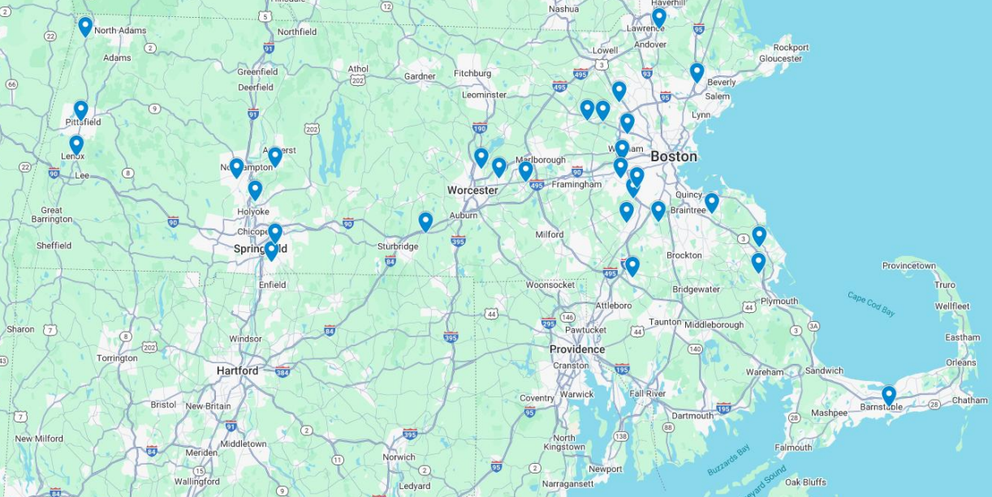
Charge I – Findings
CCRCs are a unique model that provide housing, medical care, and social support to residents across the Commonwealth.
There are 29 total CCRCs registered with AGE in the Commonwealth, 22 of which are non-profits.
CCRCs have been operating in Massachusetts for 40+ years.
More than half of CCRCs are in the greater Boston area.
Map from 4/8 presentation by Elissa Sherman, LeadingAge Massachusetts

Slide 14
Charge I - Findings
Continuing Care Retirement Community (CCRC) Definition:
CCRCs must provide board and lodging together with nursing services, medical services or other health related services, regardless of whether the lodging and services are provided at the same location.
CCRCs must have a contract that is effective for the life of the individual or for a period more than one year.
CCRCs charge an entrance fee. This entrance fee is separate and distinct from any fee payable to the CCRC on a periodic basis for board, lodging, medical or other health related services or an application fee.
Entrance Fee Definition:
An initial or deferred transfer to a provider of a sum of money or other property made or promised to be made as full or partial consideration for acceptance of a specified individual as a resident in a facility. No part of any fee payable on a periodic basis for board, lodging, medical or other health related services rendered by the provider to a resident shall be considered as constituting an entrance fee. No application charge or other sum payable in addition to such periodic fees, which does not exceed four times such periodic fees, shall be considered as constituting an entrance fee.
CCRC Consumer Guide (AGE)
M.G.L. ch. 93 § 76

Slide 15
Charge I - Findings
Overview: CCRCs in Massachusetts
The level of medical services offered by CCRCs varies, as not all offer an assisted living residence (ALR) unit or a skilled nursing facility (SNF) unit.
CCRC occupancy is generally driven by personal consumer choice, rather than medical necessity as is often the case in ALRs or SNFs.
Demand is high for CCRCs with an average occupancy rate of ~ 90% and higher rates for non-profits. This results in lengthy waitlists for consumers.

Slide 16
Charge I - Findings
Residents of CCRCs tend to exhibit greater physical, social, and intellectual wellness compared to older adults in the community at large.
Physical Wellness | Emotional Wellness | Social Wellness | Intellectual Wellness | Spiritual & Vocational Wellness
CCRC residents exhibit better self-reported health and higher levels of physical activity compared to older adults in the community at large. | CCRC residents report higher life satisfaction and better perceptions of aging but experienced more depressive symptoms & less perceived control compared to their counterparts in the community at large. | CCRC residents report more frequent social interactions and lower rates of loneliness compared to older adults in the community at large. | CCRC residents report better self-rated memory and increased participation in intellectual activities compared to older adults in the community at large. | CCRC residents and older adults in the community at large report exhibit similar spiritual and vocational wellness.
The Age Well Study, Mather Institute

Slide 17
Charge I - Findings
Contracts
Minimum contract durations must be greater than one year but are often for the life of an individual
CCRCs operate under 3 types of contracts, with select CCRCs offering multiple contract options to consumers.
 | Type A: Life Care Contract | Type B: Modified Contract | Type C: Fee for Service Contract
Entrance Fee | Higher entrance fees: 0%/50%/90% refunds common | Lower entrance fee: 0%/50%/90% refunds common | Lowest entrance fee: 0%/50%/90% refunds common
Monthly Fee | Lower monthly fees, may be fixed | Varies depending on the facility but tends to be higher monthly fees | Higher monthly fees
Health care services | Unlimited, short-term or long-term | After specified amount of health services are used, residents pay for additional health care services (at a discounted rate or a full per diem rate). | Must be paid out of pocket

Slide 18
Charge I - Findings
CCRCs are required to submit the following information in their disclosure to new residents:
The name and business address of the provider and a statement of whether the provider is a partnership, corporation, or other type of legal entity.
The names of the officers, directors, trustees, or managing or general partners of the provider and a description of each such person's occupation with the provider.
A description of the business experience of the provider in the operation or management of similar facilities and of the manager of the facility if the facility will be managed on a day-to-day basis by an organization other than the provider.
A statement as to whether or not the provider is, or is affiliated with, a religious, charitable or other nonprofit organization; the extent of the affiliation, if any, the extent to which the affiliate organization will be responsible for the financial and contract obligations of the provider, and the provision of the federal Internal Revenue Code, if any, under which the provider or affiliate is exempt from the payment of income tax.
M.G.L. ch. 93 § 76

Slide 19
Charge I - Findings
CCRCs are required to submit the following information in their disclosure to new residents:
5. The location and description of the physical property or properties of the facility, existing or proposed; and to the extent proposed, the estimated completion date or dates, whether or not construction has begun and the contingencies subject to which construction may be deferred.
6. Certified financial statements of the provider, including (a) a balance sheet as of the end of the most recent fiscal year and (b) income statements for the three most recent fiscal years of the provider or such shorter period of time as the provider shall have been in existence. If the provider's fiscal year ended more than ninety days prior to the date the application is filed, interim financial statements as of a date not more than ninety days prior to such filing shall be included, but need not be certified.
7. If the operation of the facility has not yet commenced, a statement of the anticipated source and application of the funds used or to be used in the purchase or construction of the facility.
M.G.L. ch. 93 § 76

Slide 20
Charge II: The commission shall study and report on the financial viability of CCRCs

Slide 21
Charge II – Findings
Given key metrics, the CCRC industry in Massachusetts is financially robust and in-demand, though it can be financially challenging for CCRCs with SNF units.
Occupancy rate:
A high occupancy rate indicates financial strength and security.
A high occupancy rate is considered to be between 92% and 96%.
The financial industry, including lenders and investors, consider the occupancy rate of a CCRC to be the most important financial metric.
Days of cash on hand:
Days of cash on hand is a financial metric that indicates how long a company can cover its operating expenses using its available cash.
If a CCRC has 720 days of cash on hand, this indicates that it is a financially strong community, as they can operate for 720 days without taking in new money.

Slide 22
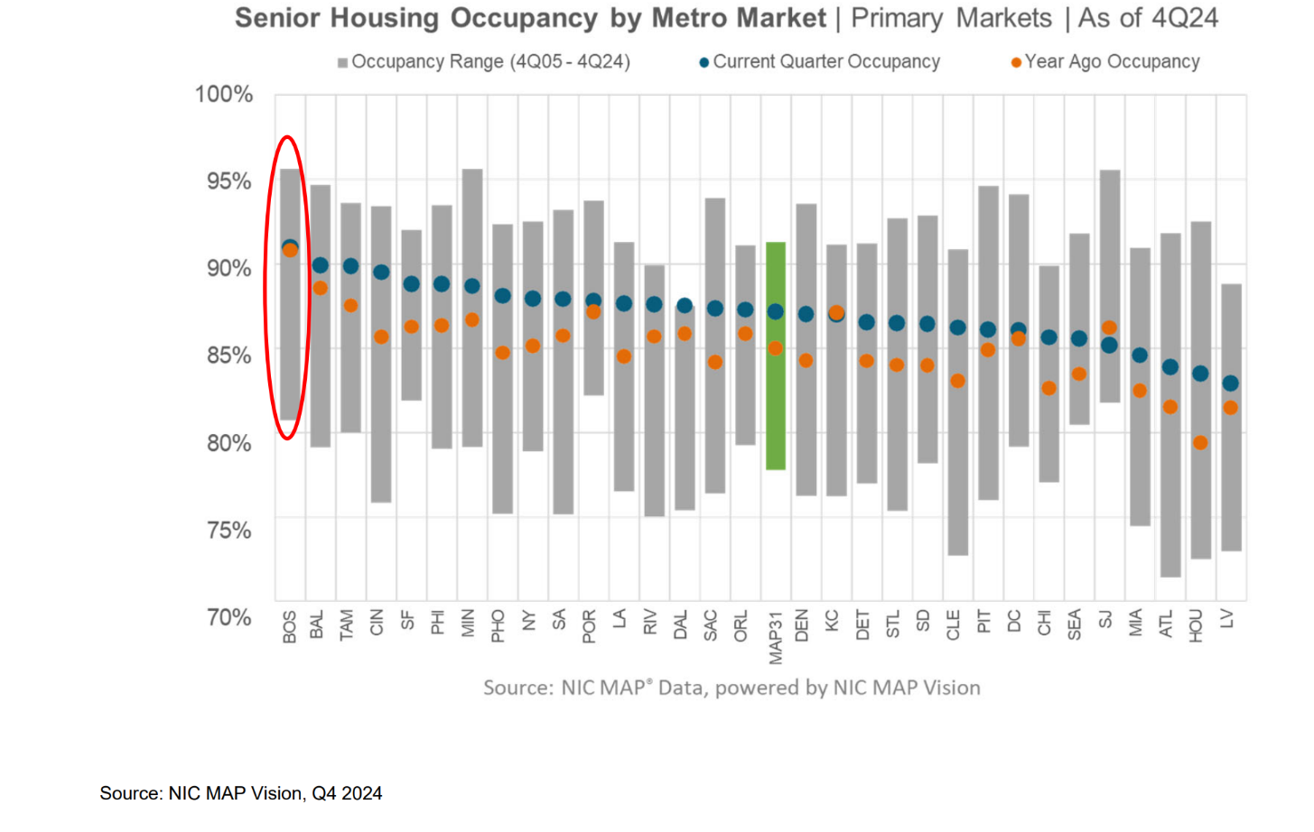
Charge II - Findings
Occupancy Rates
The Greater Boston market is one of the most highly occupied markets in the United States.
This graph indicates that supply hasn't kept up with demand. Most CCRCs have long waitlists, and there is a need to build more communities.
Graph from 6/2 presentation by Keith Robertson, Ziegler

Slide 23
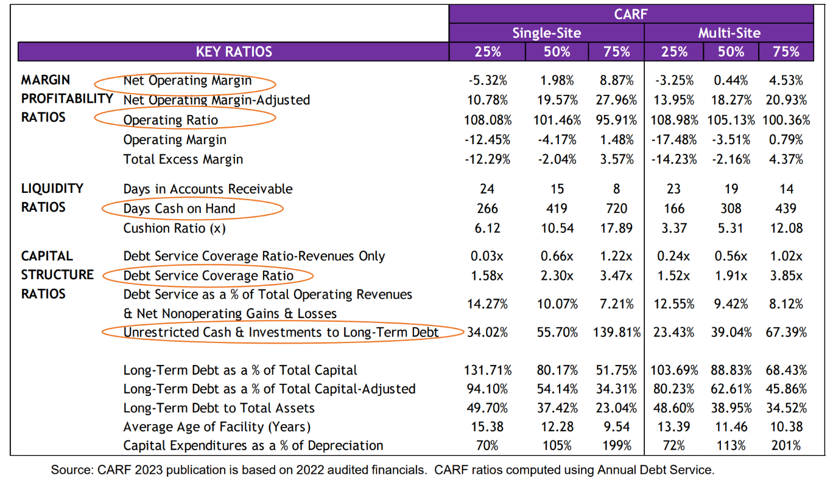
Charge II - Findings
Days of Cash on Hand
The table to the right includes several financial ratios that can be used to determine a CCRC's financial standing.
For a single-site CCRC:
The 25th percentile has 266 days of cash on hand.
The 50th percentile has 419 days of cash on hand.
The 75th percentile has 720 days of days of cash on hand.
Table from 6/2 presentation by Keith Robertson, Ziegler

Slide 24
Charge II - Findings
Days of Cash on Hand
The table to the right includes several financial ratios that can be used to determine a CCRC's financial standing.
For a multi-site CCRC:
The 25th percentile has 166 days of cash on hand.
The 50th percentile has 308 days of cash on hand.
The 75th percentile has 439 days of cash on hand.
Table from 6/2 presentation by Keith Robertson, Ziegler

Slide 25
Charge II - Findings
CCRCs with a SNF Unit
CHIA collects financial data about SNFs, including SNF units within CCRCs. The data comes from nursing home cost reports that MassHealth uses for rate renewal processes.
In 2022, 11 SNF units within CCRCs were operating with a negative profit margin. In 2023, the number decreased to 8 SNF units.
This suggests that it may be more financially challenging for CCRCs with SNF units to operate and speaks to the high cost of operating a SNF.

Slide 26
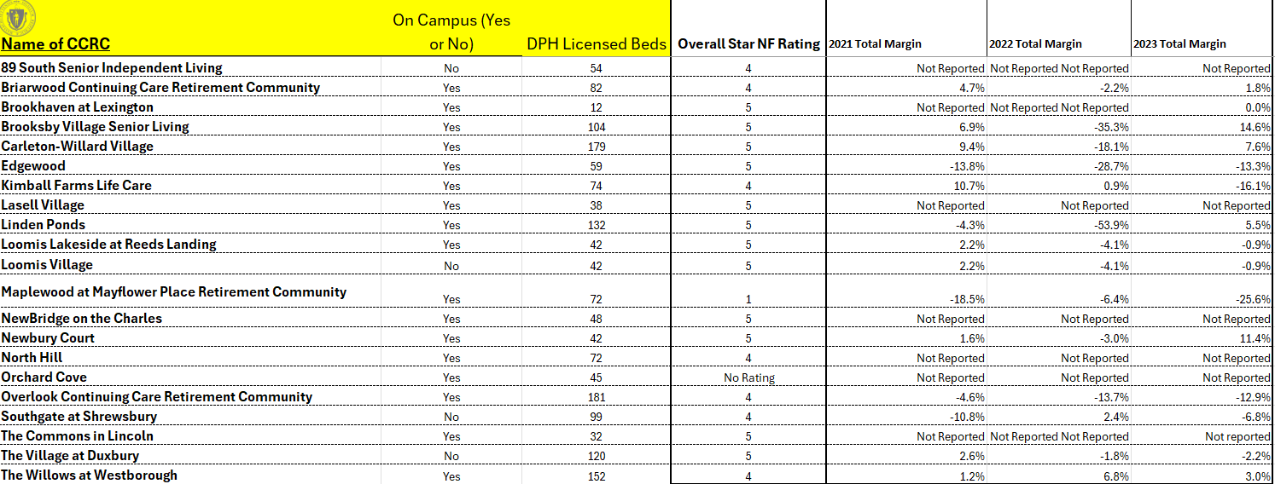
Charge II - Findings
Table from CHIA: CCRCS with a SNF unit in Massachusetts

Slide 27
Charge III: The commission shall study and report on the payment and return of entrance fees at CCRCs

Slide 28
Charge III - Findings
CCRC entrance fees are an important aspect that allow communities to invest in capital and manage debt. Many residents and families feel that there needs to be more transparency and a deadline to when entrance fees are refunded.

Slide 29
Charge III - Findings
CCRCs require entrance fees for all residents. The amount of the entrance fee can depend on the contract type signed by the resident.
 | Type A: Life Care Contract | Type B: Modified Contract | Type C: Fee for Service Contract
Entrance Fee | Higher entrance fees: 0%/50%/90% refunds common | Lower entrance fee: 0%/50%/90% refunds common | Lowest entrance fee: 0%/50%/90% refunds common
Monthly Fee | Lower monthly fees, may be fixed | Varies depending on the facility but tends to be higher monthly fees | Higher monthly fees
Health care services | Unlimited, short-term or long-term | After specified amount of health services are used, residents pay for additional health care services (at either a discounted rate or a full per diem rate). | Must be paid out of pocket

Slide 30
Charge III - Findings
Most CCRCs have long waitlists for incoming residents, which means residents and their families receive their entrance fee refund in a timely manner.
However, some CCRC residents and their families have reported that it has taken months or in some rare cases, years, for their entrance fee to be refunded. The refunds are returned when the unit is reoccupied, so if a resident was occupying a less desirable unit, they may wait longer than other residents for their refund. Residents may also experience long wait times during times of crisis, such as recessions or pandemics.

Slide 31
Charge III - Findings
CCRCs use the entrance fee funds for several purposes:
Capital improvements to the facility.
In contract types A and B, it can be used as a pre-payment for future healthcare services.
It can be used to pay down debt or enhance liquidity.
Incoming entrance fees from new residents are used to refund the former resident and/or their family when they have moved out or have passed away.
Amenities to the facility, including operating expenses.
Some CCRC providers argue that if they are required to refund an entrance fee before a unit has been re-occupied, it could jeopardize the community and the current residents living there and that a strict deadline for the entrance fee could stifle the development of new CCRCs.

Slide 32
Charge IV: The commission shall study and report on statutory and regulatory oversight of CCRCs, including any activities by state agencies to enforce regulatory requirements

Slide 33
Charge IV - Findings
CCRCs lack a uniform regulatory body.
If a CCRC features a Skilled Nursing Facility (SNF) component, the Department of Public Health (DPH) has oversight over the nursing unit.
If a CCRC includes an Assisted Living Residence (ALR) that is advertised independently from the Life Plan, the Executive Office of Aging and Independence (AGE) has oversight over the ALR.
Commission members expressed concern that some CCRCs may advertise "supportive care" rather than "assisted living" to bypass AGE oversight.
Independent Living units in a CCRC do not have a regulatory body overseeing them.

Slide 34
Charge IV - Findings
AGE requires for CCRCs to submit a copy of the following information within 30 days of marketing of the facility begins:
the disclosure statement required under subsection (b) to be delivered to the persons with whom the contract for continuing care is to be entered;
the contracts for continuing care to be entered into by the provider under subsection (c) with a person who will occupy a living unit in a continuing care facility; and
any available advertising or promotional material to be used in conjunction with such marketing effort.
M.G.L. 93 § 76

Slide 35
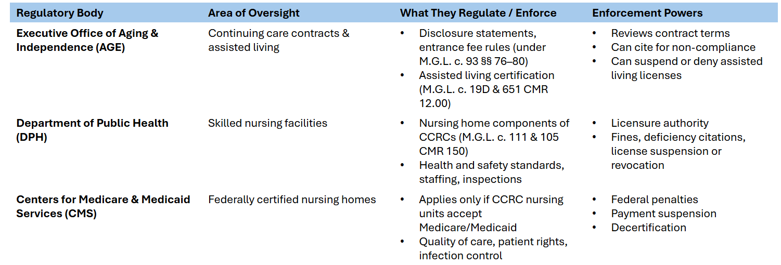
Charge IV - Findings

Slide 36
Charge IV - Findings
Attorney General's Office and Chapter 93A Protections
Chapter 93A enables the Attorney General to take legal action against unfair or deceptive conduct by businesses operating in the Commonwealth.
Residents of CCRCs can file complaints about misleading marketing or contract violations. Potential enforcement powers include investigations, civil enforcement actions, and consumer complaint resolutions.

Slide 37
Charge V: The commission shall study and report on advertising practices communicated to potential residents and families about CCRCs

Slide 38
Charge V - Findings
It can be confusing for consumers to know which communities are CCRCs and which communities are not.
According to M.G.L. 93 § 76, "continuing care" is defined as the furnishing to an individual, other than an individual related by consanguinity or affinity to the person furnishing such care, of board and lodging together with nursing services, medical services or other health related services, regardless of whether or not the lodging and services are provided at the same location, pursuant to a contract effective for the life of the individual or for a period in excess of one year.
This means that CCRCs have to offer more than one type of care, but they don't have to offer the full continuum: independent units, assisted living units and SNF units. For example, some CCRCs may not have SNF units on campus but provide both independent and assisted units. Providers on the Commission also noted that their residents have a strong desire to stay in independent living as long as possible and there are new programs that allow residents to receive assisted living and skilled nursing care in their units.

Slide 39
Charge V - Findings
M.G.L. 93 § 76 defines "marketing" as including but not limited to the establishment of a waiting list, acceptance of money, property or other consideration or distribution of marketing brochures by the provider.
CCRCs are required to provide the following information to AGE:
the disclosure statement required under subsection (b) to be delivered to the persons with whom the contract for continuing care is to be entered;
the contracts for continuing care to be entered into by the provider under subsection (c) with a person who will occupy a living unit in a continuing care facility; and
any available advertising or promotional material to be used in conjunction with such marketing effort.
AGE is required make such information available to the public in a manner which shall allow residents and prospective residents to make informed choices regarding the selection of a provider, packages of services and coverage and care alternatives.

Slide 40
Charge V - Findings
Some communities that feature independent living may advertise themselves as a CCRC, which can be confusing for consumers.
The Executive Office of Aging and Independence maintains a CCRC Consumer Guide, which has guiding questions for residents and their families to ask to fully understand what the facility offers and what contract they are entering.
Industry representatives have asserted that CCRCs with high occupancy and long waitlists generally do not need to advertise themselves.

Slide 41
Charge VI: The commission shall study and report on regulatory procedures for the closure or change of ownership of CCRCs.

Slide 42
Charge VI - Findings
Since CCRCs lack a uniform regulatory body, there is no uniform procedure for the closure of or change of ownership of a CCRC.

Slide 43
Charge VI - Findings
If there is a closure or change of ownership for a SNF unit within a CCRC, the CCRC will follow the procedure for a closure or change of ownership of a SNF regulated by DPH.
Closure procedure:
The facility must notify DPH and those impacted by the closure or their intent to close at least 120 days before the proposed date.
A public hearing will be scheduled at least 90 days before the proposed date.
DPH will review and approve the closure plan.
The facility will work with residents to find alternative placements.
Change of ownership procedure:
The prospective owner must submit a notice of intent to DPH and those impacted 90 days in advance.
A public hearing will be scheduled at least 45 days before the proposed change.
105 CMR 153.00

Slide 44
Charge VI - Findings
If there is a change of ownership for an ALR unit within a CCRC, the CCRC will follow the procedure for a change of ownership of an ALR regulated by AGE.
Change of ownership procedure:
Any person or entity who intends to acquire a 25% or greater interest in an ALR must apply for certification to AGE at least 30 days prior to the transfer of ownership.
If AGE receives the correct documents at least 30 days in advance, the applicant will be deemed temporarily certified, until AGE approves or denies their application.
When a transfer of ownership happens, it is within the Secretary's discretion to conduct a full or partial compliance review.
651 CMR 12.00

Slide 45
Charge VI - Findings
The below includes changes made to closures or changes in ownership for ALRs in Chapter 197 of the Acts of 2024. The regulations are currently in development by AGE.
ALRs:
Lowers the ownership disclosure during the certification process from 25% to 5%
Chapter 197 of the Acts of 2024

Slide 46
Charge VI - Findings
The below includes changes made to closures or changes in ownership for SNFs in Chapter 197 of the Acts of 2024. The regulations are currently in development by DPH.
Chapter 197 of the Acts of 2024
SNFs:
During the suitability review for a new facility or a new owner, DPH will now consider:
the criminal or civil litigation history of the applicant, potential transferee, or management company
the financial capacity of the applicant, potential transferee, or management company
the history of applicant, potential transferee, or management company in providing quality long-term care in the Commonwealth
the history of applicant, potential transferee, or management company in providing quality long-term care outside the Commonwealth
Additionally, the law updates the definition of “owner” and expands the scope of oversight into management functions by including management companies. It also requires DPH to notify the Legislature within 3 business days of being notified of a long-term care facility’s decision to close.

Slide 47
Recommendations

Slide 48
Consensus
The CCRC Commission defines consensus as no stated opposition to any of the recommendations discussed.

Slide 49
Recommendations
The CCRC Commission came to a consensus on the following recommendations:
Pass S.478, the disclosure bill, to increase transparency for consumers around the entrance fee refund
Update AGE's consumer guide

Slide 50
Recommendation I
The CCRC Commission endorses and recommends passage of S478 to increase transparency for consumers around the entrance fee refund.
S478, An Act relative to disclosing continuing care retirement community entrance fees, would require CCRCs to give prospective residents a separate document that clearly states:
The amount of the entrance fee to be refunded to the resident under the provider's contract
The terms, conditions and explanation of the process by which the provider will make such refund to the resident after the resident leaves the facility or passes away

Slide 51
Recommendation II
The CCRC Commission recommends that AGE's consumer guide be updated.
Recommend for AGE to collaborate with LeadingAge MA, MLCRA, Massachusetts Senior Care Association, Massachusetts Assisted Living Association, and AARP on updating the consumer guide.
Require AGE to update the consumer guide annually.
Require that the consumer guide include a list of known CCRCs in the Commonwealth.
Require that CCRCs give prospective residents access to the consumer guide.

Slide 52
Other Recommendations Considered
The CCRC Commission recommends further discussion on other recommendations considered, such as:
A mandate that each CCRC board include not less than one resident member with voting rights.
The resident board member would be chosen by the residents of each CCRC.

Slide 53
Other Recommendations Considered
The CCRC Commission recommends further discussion on other recommendations considered, such as:
Recommending that CCRC boards hold an open meeting each year.
The open meeting will be an opportunity for residents and family members to have their opinions and concerns heard by their respective CCRC's board.

Slide 54
Other Recommendations Considered
The CCRC Commission recommends further discussion on other recommendations considered, such as:
Recommending changes to how CCRCs refund their entrance fees, including:
A sequential model, meaning that residents/families would receive their refund in the order of when they left the unit.
An interest model, meaning that the CCRC would pay interest to the resident or their family each month until the unit is re-occupied.
A blanket 1-year deadline, meaning that the CCRC would be required to issue the refund within 1 year of the resident leaving the unit.

Slide 55
Other Recommendations Considered
The CCRC Commission recommends further discussion on other recommendations considered, such as:
Recommending changes to how CCRCs are defined in the statute, including:
Recommending that AGE certify or register CCRCs, so consumers have a clear picture of which facility is a CCRC, and which facility is not a CCRC.
Requiring that all CCRCs offer the entire continuum of care. Currently, CCRCs are required to offer more than one type of care.

Slide 56
Letters Received From Advocates

Slide 57
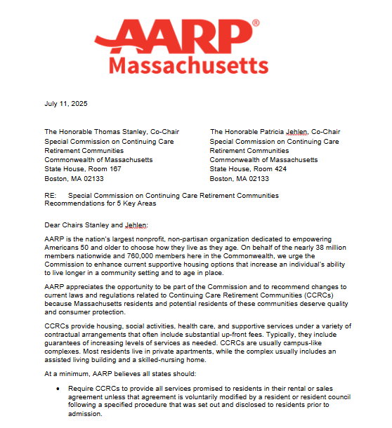
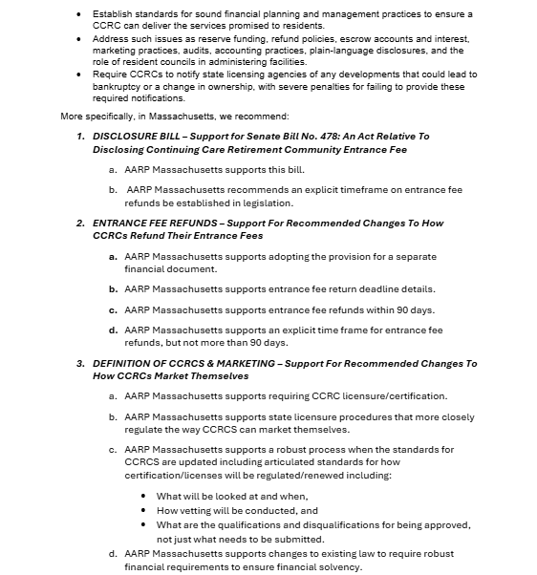
AARP Massachusetts 1/3

Slide 58
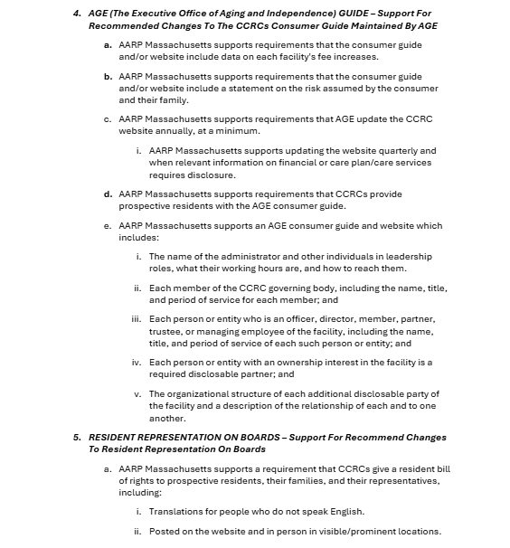
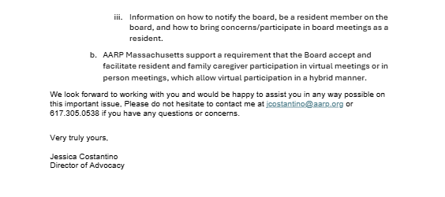
AARP Massachusetts 2/3

Slide 59
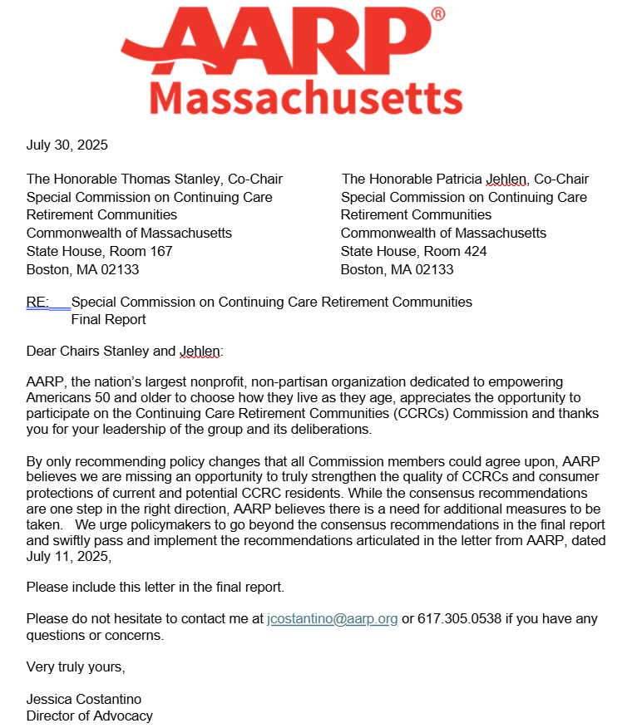
AARP Massachusetts 3/3

Slide 60
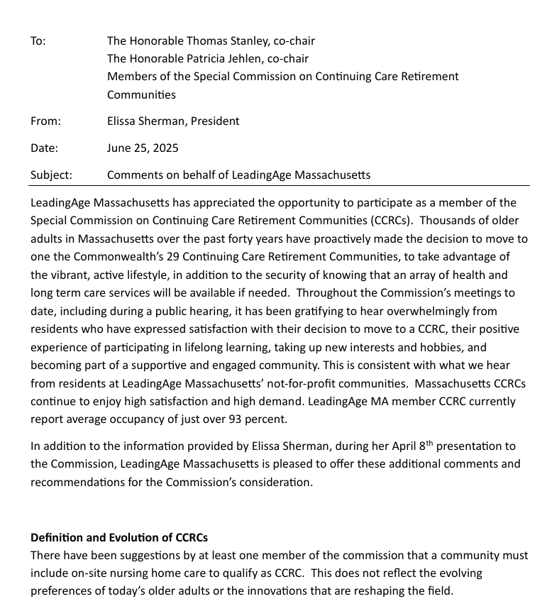
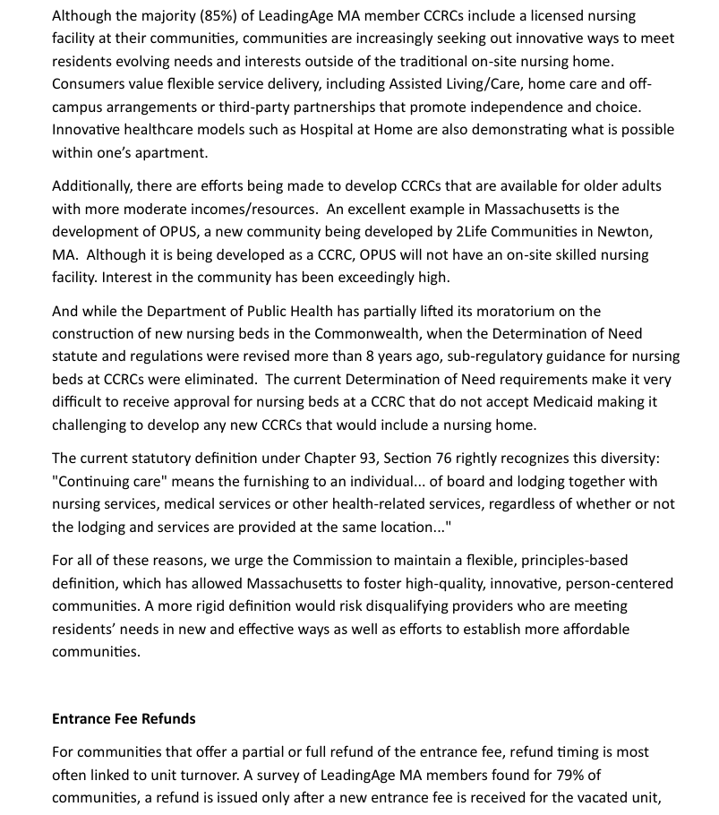
LeadingAge Massachusetts 1/3

Slide 61
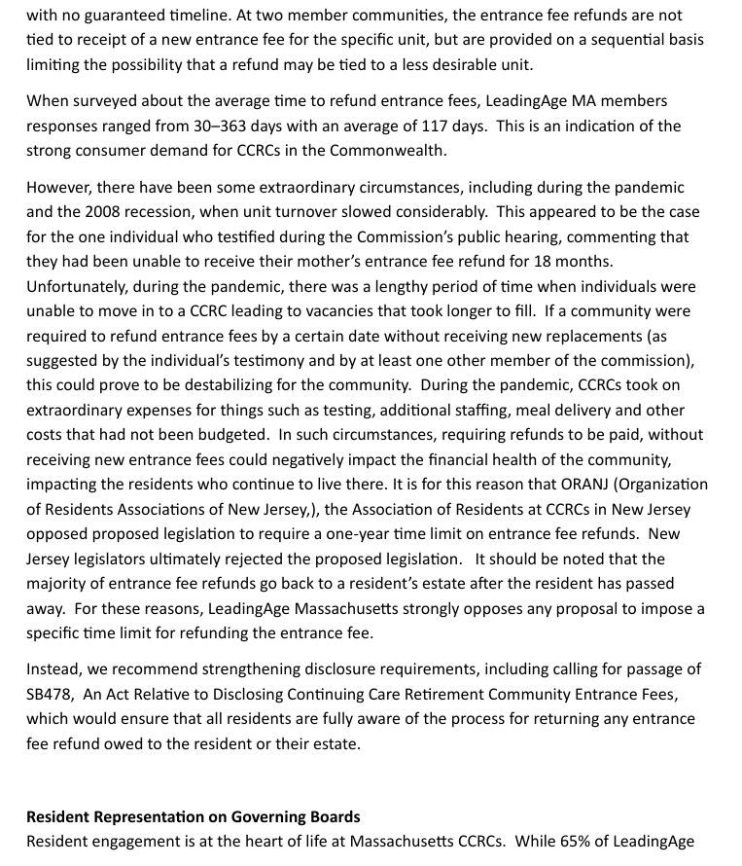
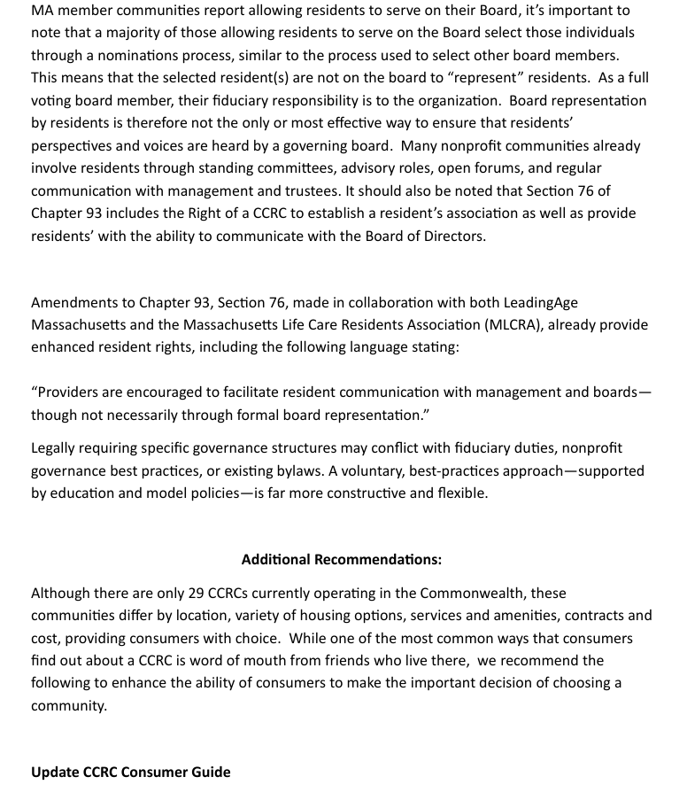
LeadingAge Massachusetts 2/3

Slide 62
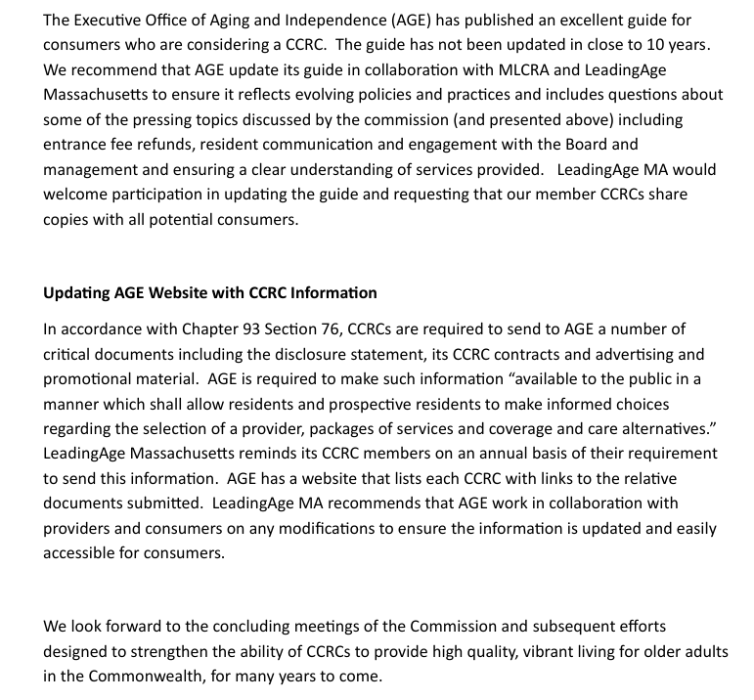
LeadingAge Massachusetts 3/3

Slide 63
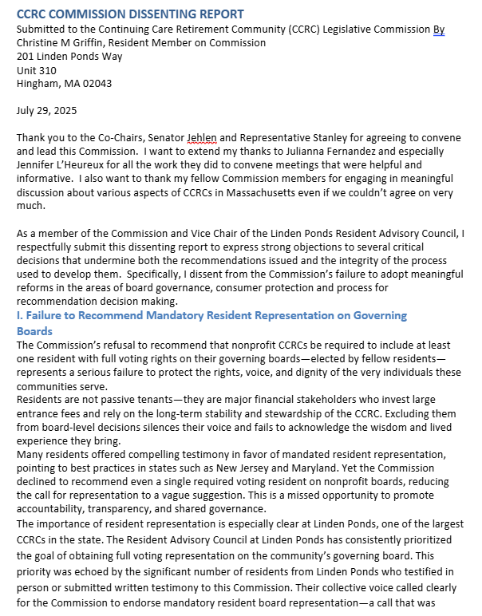
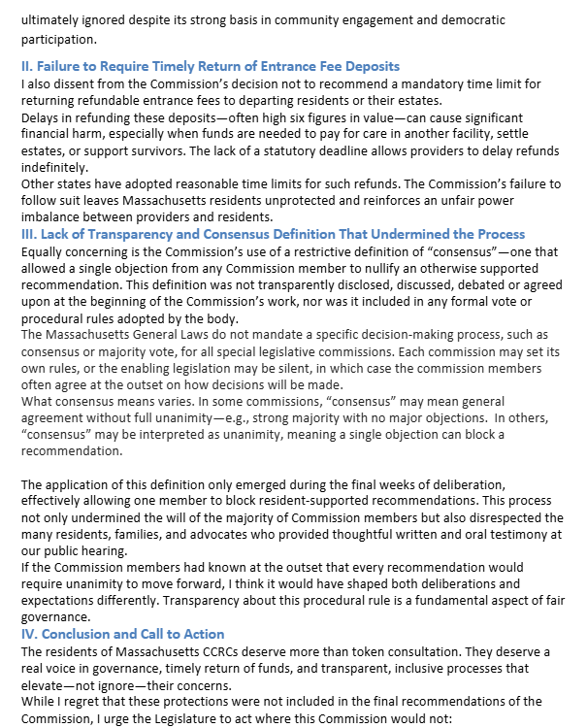
Christine M. Griffin, CCRC Resident and Commission Member 1/2

Slide 64
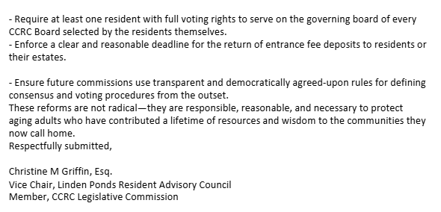
Christine M. Griffin, CCRC Resident and Commission Member 2/2

Slide 65
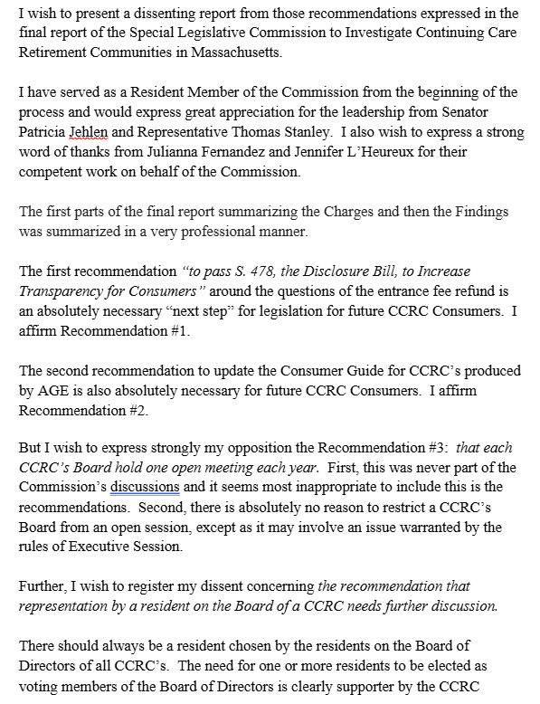
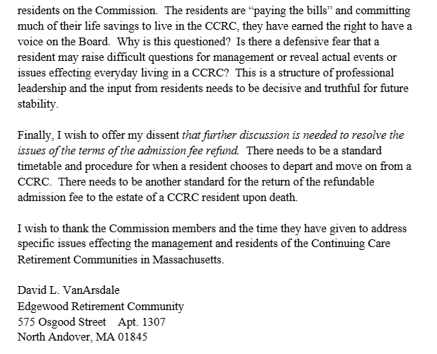
David L. VanArsdale, CCRC Resident and Commission Member

Slide 66
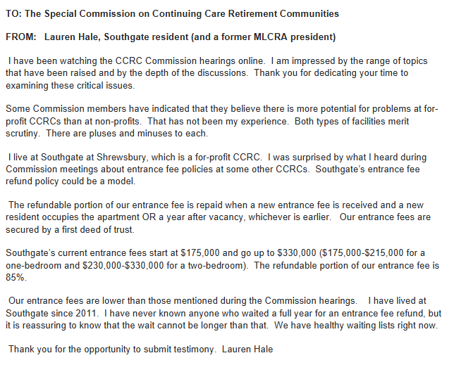
Lauren Hale, CCRC Resident and Former MLCRA President

Slide 67
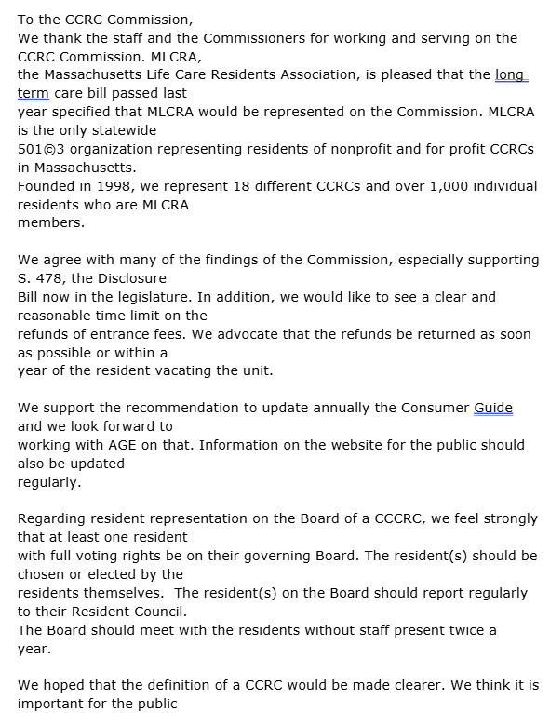
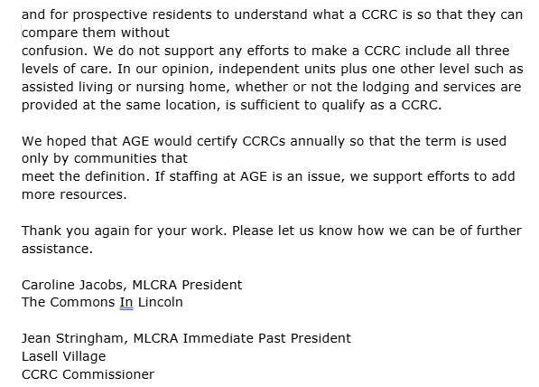
Jean Stringham and Caroline Jacobs, MLCRA

Slide 68
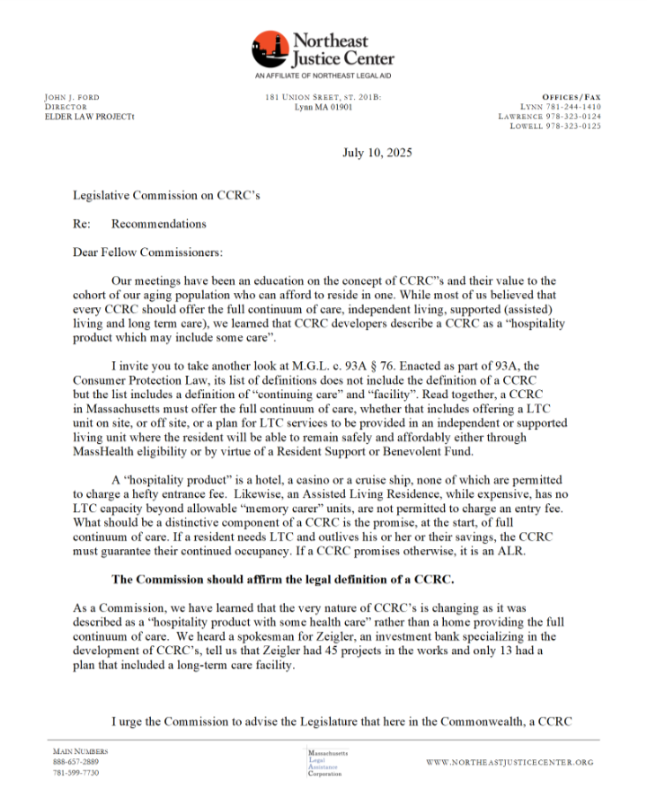
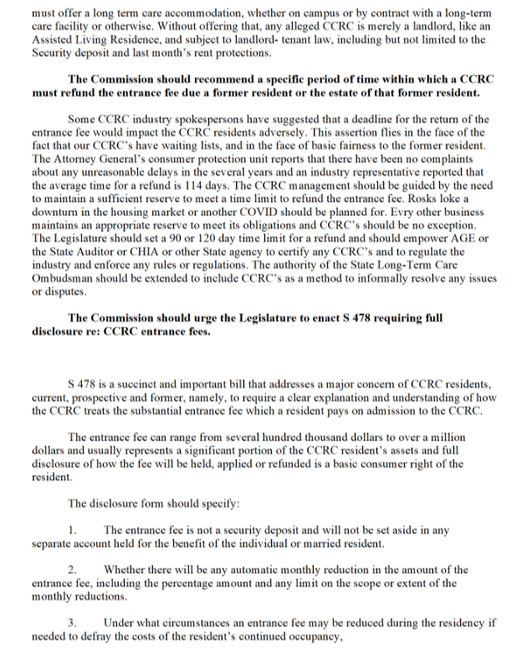
John Ford, Northeast Justice Center 1/4

Slide 69
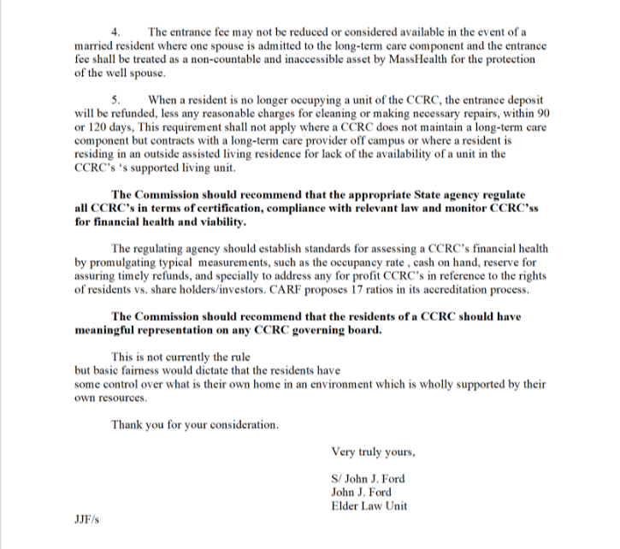
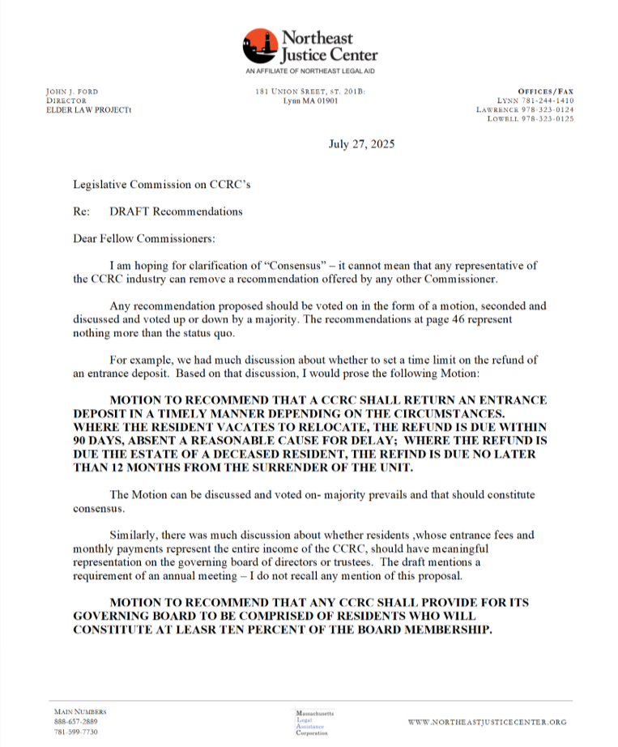
John Ford, Northeast Justice Center 2/4

Slide 70
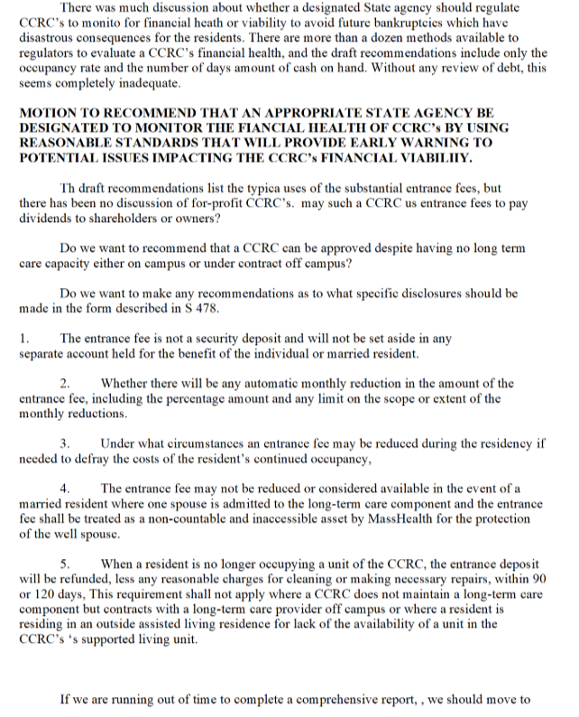

John Ford, Northeast Justice Center 3/4

Slide 71
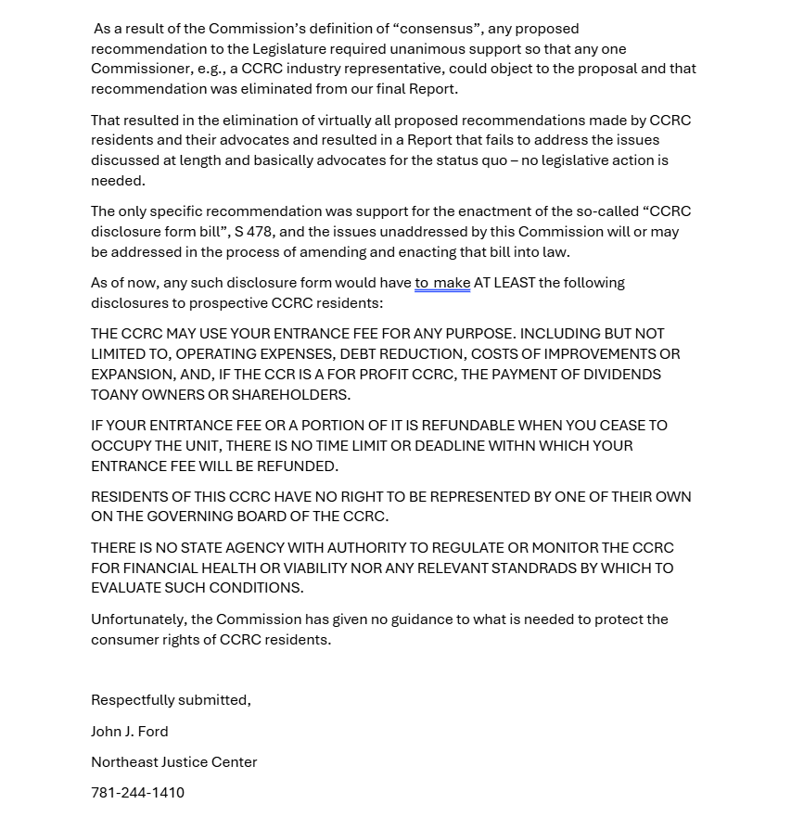
John Ford, Northeast Justice Center 4/4

