Slide 1

Special Legislative Commission on Correctional Consolidation and Collaboration
December 12, 2025

Slide 2
PLS is the sole statewide legal aid program for people in custody. We were founded in 1972 to protect the civil rights of incarcerated people. We have 11 attorneys to support the legal needs of about 13,000 incarcerated people in the Commonwealth.
While PLS responds to requests for advice and guidance from clients and their families on many issues, our work is focused on five key priorities critical to our clients:
Health Care
Staff Assaults
Conditions of Confinement
Solitary Confinement
Racial Equity in Corrections

Slide 3
Key Issues
Operational decisions have created escalating costs without clear need and have not delivered improved results.
Correctional system is used to provide services that are inappropriate/ineffective in a correctional setting (medical, mental health, substance use).
Culture is often punitive in nature and undermines rehabilitative mission.
Little coordination in spaces that could reduce spending and improve outcomes.

Slide 4
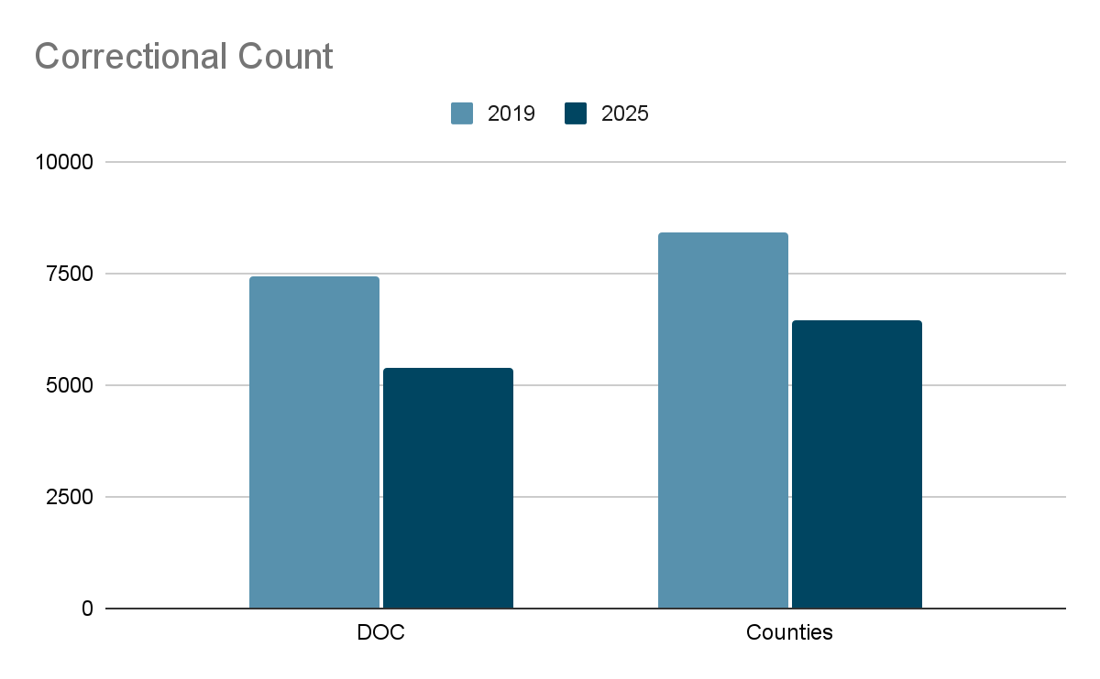
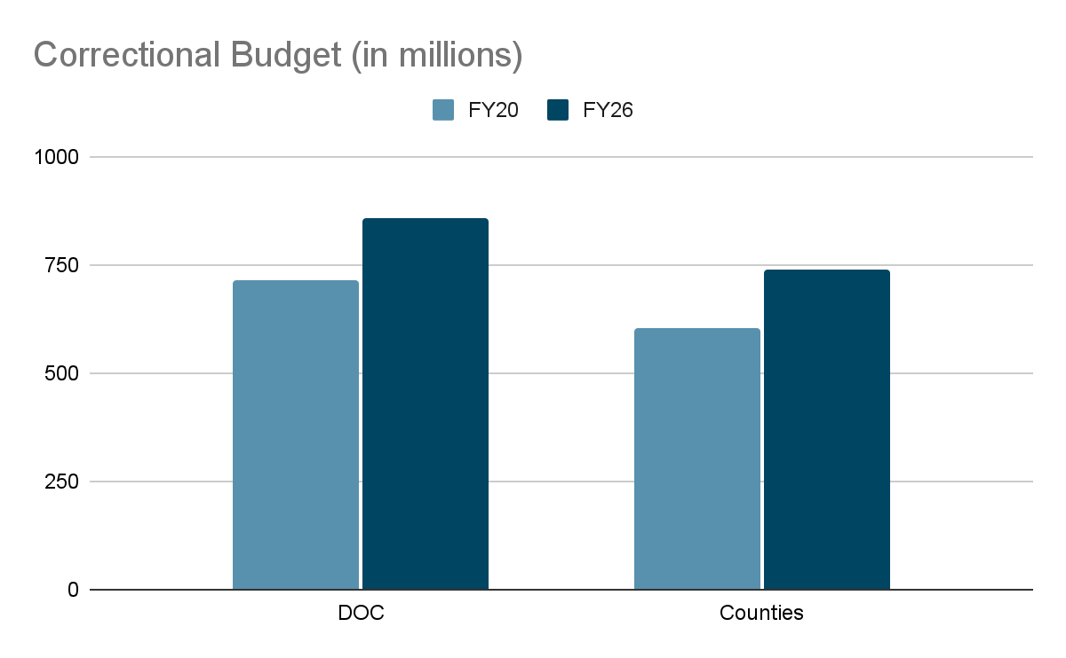
Correctional Spending
Roughly 30% reduction in DOC
Roughly 25% reduction in Counties
Roughly 17% increase at DOC
Roughly 19% increase in Counties

Slide 5
Correctional Spending
2019
$96,262/yr
Per prisoner
2025
$158,956/yr
Per prisoner
65%

Slide 6
Correctional Spending
Total staff per prisoner (all corrections)
2019
0.74 Staff/prisoner (11,822 for 15,833 prisoners)
2025
0.92 Staff/prisoner (10,947 for 11,866 prisoners)
Source: The Annual Survey of Public Employment & Payroll Aggregated by State and Government Sector, 2003-2024 / The Marshall Project | Observable

Slide 7
Correctional Spending
Stated Reasons for increase
Inflation
Population still in custody is more complex/more expensive to address
Facilities costs have increased because of maintenance issues
Increase in programming
PLS’s evaluation of increase:
Substantial misclassification leads to overusing most expensive housing/facilities
Overusing overtime
Overuse of specialty housing/restrictive housing
Misuse of tools to reduce population

Slide 8
Misclassification
2861 People are over-classified
 | Security level set by objective points |  | Security level decided by DOC
 | # of individuals | % | # of individuals | %
Minimum or below | 3,386 | 65% | 525 | 10%
Medium | 959 | 19% | 3924 | 76%
Maximum | 826 | 16% | 722 | 14%
Total | 5,171 | 100% | 5,171 | 100%
MA DOC Classification Scored Level and Facility Final Level for 12/1/2024, obtained by public records request, https://drive.google.com/file/d/1KIcGFM5HCprfeZMdxBIbRfa5WP5MYarb/view?usp=drive_link

Slide 9
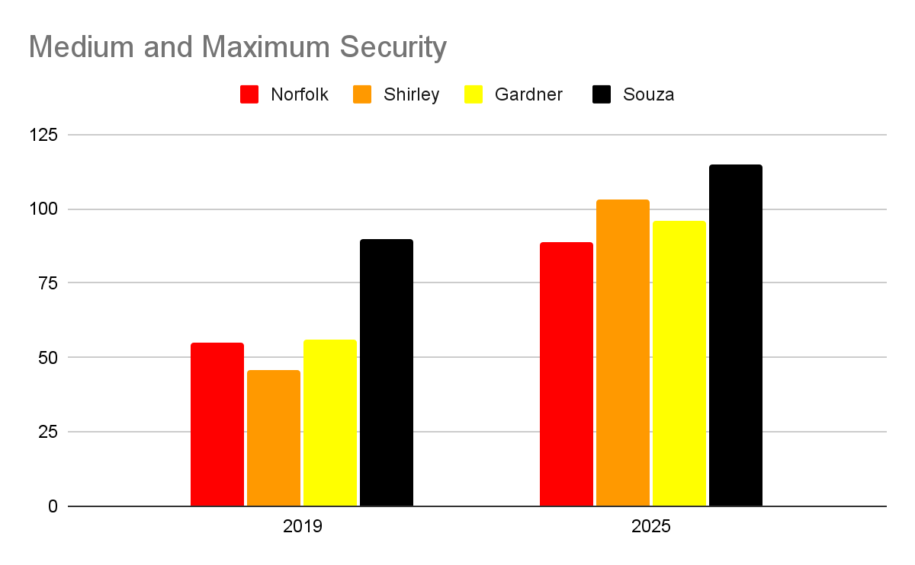
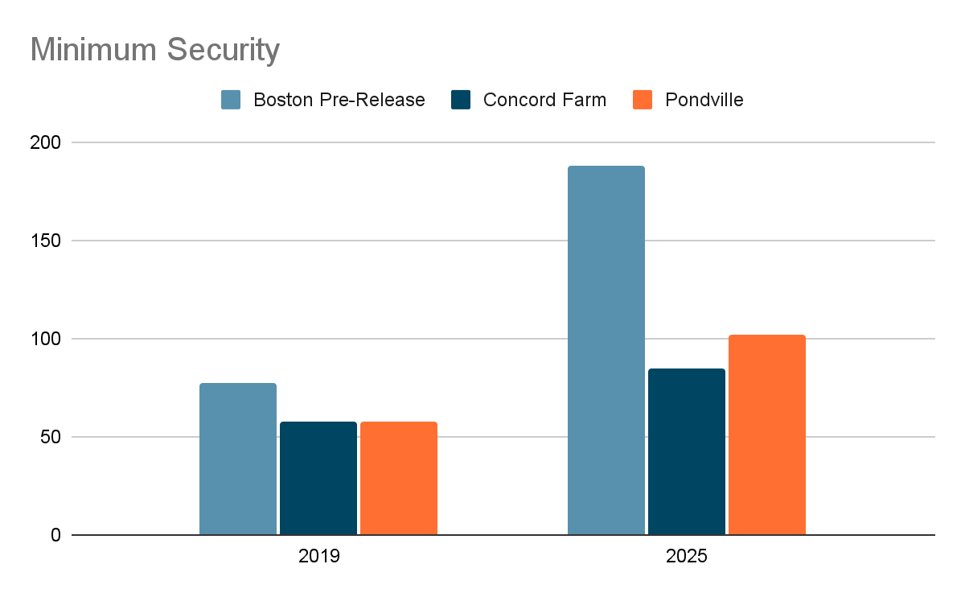
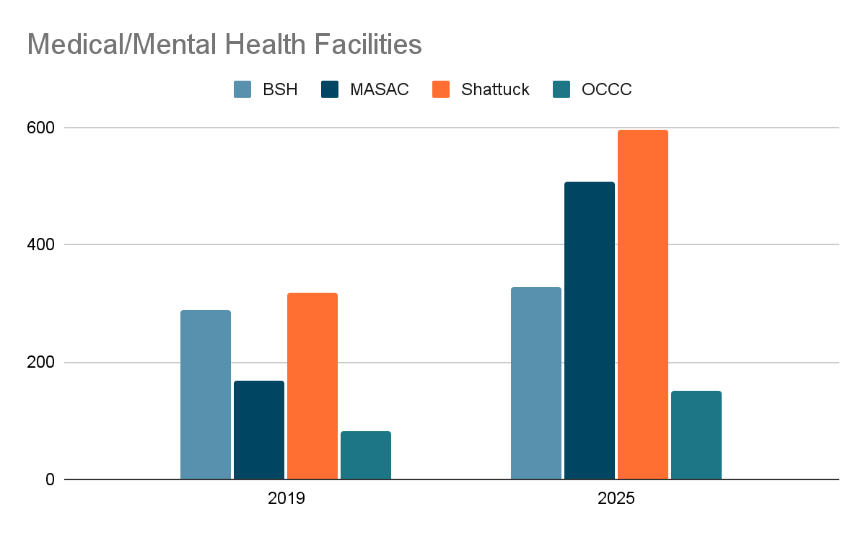
Misclassification Costs: cost per prisoner per year
DOC Annual Report FY20
DOC FAQs, July 2025: How many inmates are incarcerated in the DOC

Slide 10
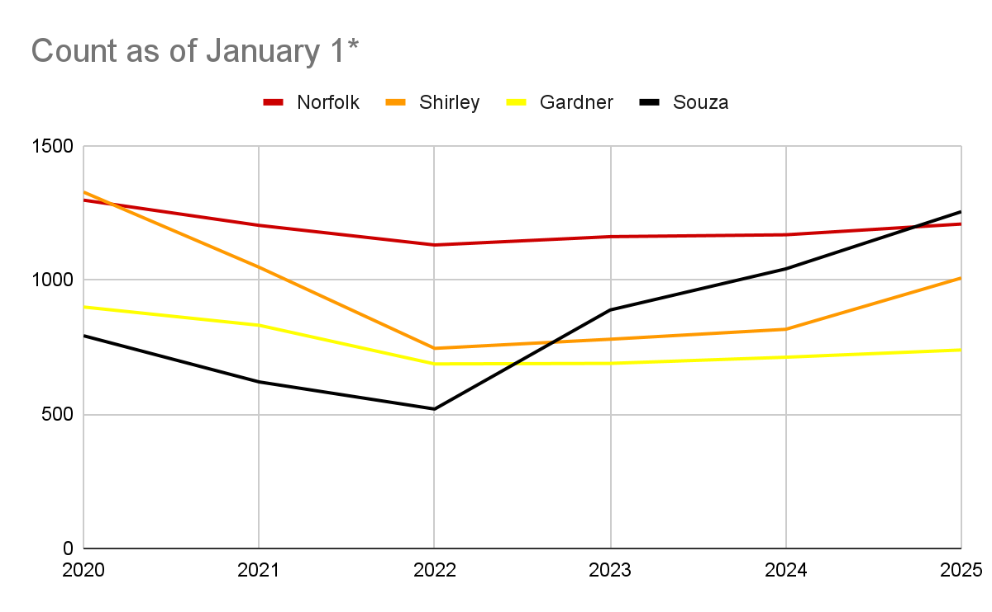
Misclassification: growth in SBCC population
*2025 numbers are from November 3
DOC COVID-19 Institution Cell Housing Dashboard | Mass.gov

Slide 11
Misclassification: Issues with SBCC
Most restrictive facility
Most limited programming access
Most issues with violence
No access to self-improvement groups
Most expensive of non-specialized facilities to run because of staff ratios, restrictive nature, and frequent lockdowns
Souza-Baranowski became the intake center for DOC when MCI-Cedar Junction closed during Covid.

Slide 12
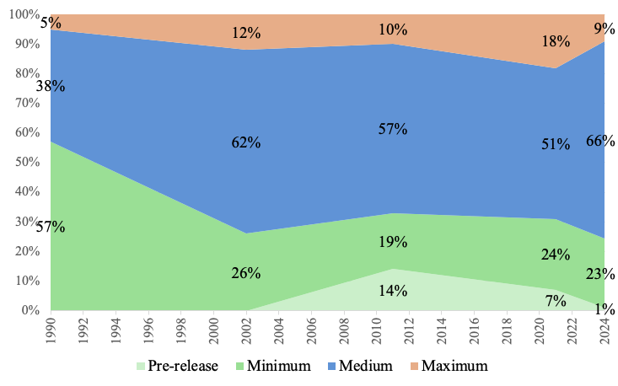
Limited Step-Down
MA DOC Custody Population Releases between 2023-2024, obtained by public records request, https://drive.google.com/file/d/1kb-9Izf73EHnDujFpVVlkl1zL0NuWCn1/view?usp=drive_link.

Slide 13
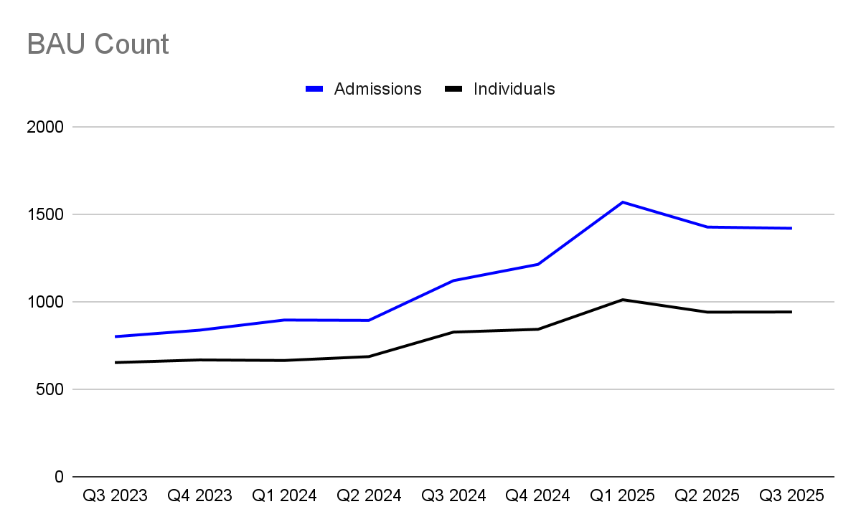
Overuse of Specialty Housing Units/Segregation
MA DOC BAU QTR REPORT | Tableau Public

Slide 14
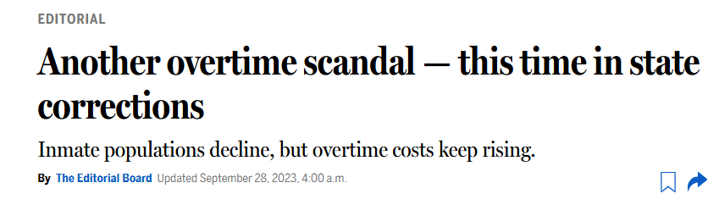
Correctional Costs: Staffing

Slide 15
Failure to use tools to reduce count
Deaths in DOC since CJRA created Medical Parole:
266
Percentage of those deaths recorded as “expected”:
50% (140)
Medical Parole Petitions filed by DOC/Vendor:
12
Medical Parole Petitions Granted by DOC:¹
80
Percentage of Medical Parole Petitions Granted:
12%
Most common causes of death:²
Covid, Infection, Chronic Disease, Cancer
1: As of August 2023
2: Kler et al. BMC Public Health (2025) 25:2465, https://doi.org/10.1186/s12889-025-23692

Slide 16
Outcomes are not better now
Brutality Allegations
Diggs settlement this fall
Mental Health Treatment Issues
Staffing issues with clinicians
Limited/ ineffective SUD treatment
DOJ settlement
Suicides
4 suicides in DOC in 6 weeks this fall
1 suicide attempt
1 suicide this summer
Medical Treatment
Linsenmeir settlement
Hepatitis C litigation with Essex County
Limited medical parole

Slide 17
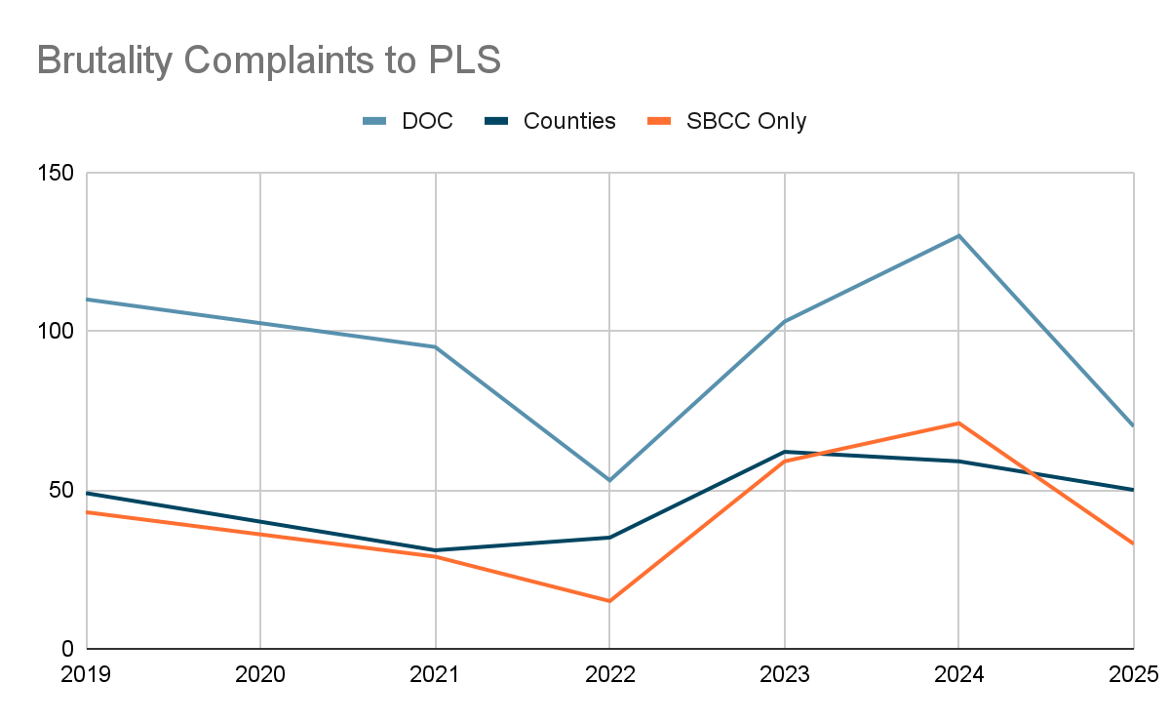
Complaints of staff violence

Slide 18
Recommendations
Address punitive culture - Designed in Dignity program with Vera
Physical Plant issues are not core complaint for prisoners, nor is capacity
Address unnecessary security culture overriding classification and medical/treatment recommendations
Ensure consistent, across-the-board access to programming and meaningful out-of-cell time¹
Release most at-risk prisoners/least likely to be threat to public safety under medical parole and other tools
Support substance-use disorder treatment and other mental health disorders in more appropriate settings
1: The state auditor’s report covering 2022-24 found as its first finding that Sheriffs had not coordinated on programs and services with similar outcomes.

Slide 19
Spaces for Collaboration
Better coordination with counties to provide step-down pathway
Collective negotiation to lower phone costs for Sheriffs
Standardize routine medical treatment across systems (same drugs, etc)
Coordinate with Parole to ensure programming/classes on tablets are recognized, and that prisoners aren’t punished for not being able to access programming
Better reentry coordination with Community Justice Resource Centers which already receive state funding

Slide 20
Questions from the Commission?
Dave Rini
drini@plsma.org

