Slide 1
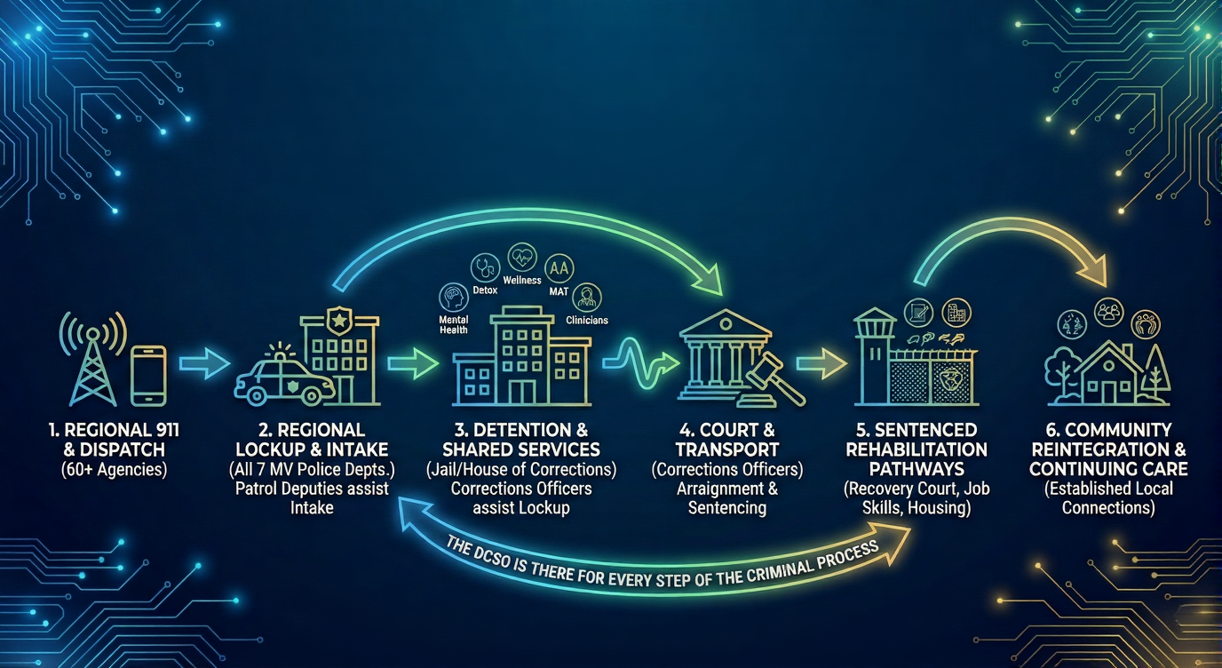

DUKES COUNTY SHERIFF’S OFFICE:
INTEGRATED & ENCOMPASSING SERVICE
EFFICIENCY THROUGH ADAPTABILITY:
Shared Staffing, Seamless Transitions, and Holistic Support at Every Step
COMMITMENT TO COMMUNITY SAFETY AND REHABILITATION
Notes:
Our jurisdiction is considered rural, and geographically isolated from the mainland relying on an unreliable ferry service which does not operate 24/7.
The uniqueness of the Dukes County Sheriff’s Office includes the fact that we are there for all community members. Each member of our staff is a community member with individual investment to the betterment of the community. We have stewardship over the health and well being of each individual. Our schools, businesses, local infrastructure and community partners rely on us to assist individuals who stumble, struggle, and sometimes offend. It is our responsibility and our local investment in the community which allows us to ensure these individuals can get back on their feet and once again be apart of our local community. The sheriff’s office completes this mission at every step of the way including:
Prevention – Through the use of programming in the schools such as health relationships, L.E.A.D., Domestic and Sexual Violence awareness initiatives along with school safety planning, and civilian response to active shooter courses, the DCSO has a vast array of crime prevention initiatives.
Arrest – The DCSO Regional Lockup is there for every single arrest on Martha’s Vineyard, providing mental health services if needed, and ensure booking, processing, and holding of pre-arraignment offenders or Protective Custody detainees. This is all done within DPH compliance for Police Lockups, and PREA compliance.
Pre-Trial – The DCSO maintains programming for our pre-trial detainee which is also available to our HOC inmates. This includes education, vocation, HiSet, MAT among several hundred online programming opportunities for our incarcerated population.
Sentenced – Our Sentenced inmates receive several rehabilitative programs to prepare them for re-entry
Re-entry – Our inmates are guided through the re-entry process and connected with local services, organizations, and community partners to assist them with housing, mental health, treatment, and sustainability planning for work and resiliency to help than transition back into society.
Continual Follow-up – Through Community Reintegration

Slide 2
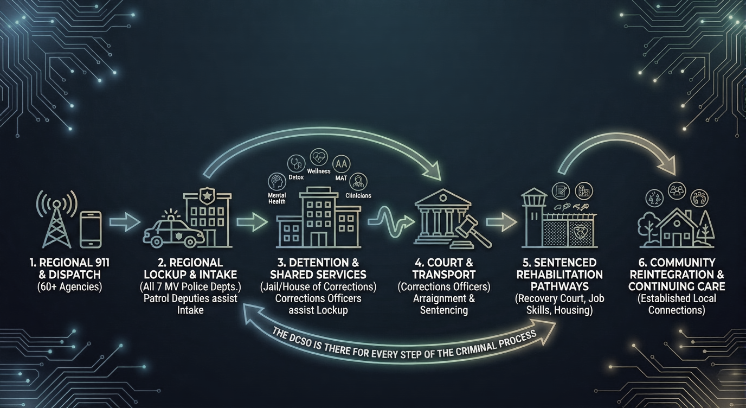

DUKES COUNTY SHERIFF’S OFFICE:
INTEGRATED & ENCOMPASSING SERVICE
Dispatch for over 60 agencies
Service over 60,000 calls per year
Field over 2000 911 calls
EFFICIENCY THROUGH ADAPTABILITY:
Shared Staffing, Seamless Transitions, and Holistic Support at Every Step
COMMITMENT TO COMMUNITY SAFETY AND REHABILITATION

Slide 3
Process between 500 and 800 arrests per year
6 Island Municipal Police Departments, MSP, Tribe
Only Sheriff’s Office able to accept PC’s under MGL 111B
Functions as Edgartown District and Superior Court Lockup
No other available alternatives in local infrastructure
DUKES COUNTY SHERIFF’S OFFICE:
INTEGRATED & ENCOMPASSING SERVICE
Dispatch for 66 agencies
Service over 31,000 calls per year
Field over 6,500 Emergency 911 calls per year
EFFICIENCY THROUGH ADAPTABILITY:
Shared Staffing, Seamless Transitions, and Holistic Support at Every Step
COMMITMENT TO COMMUNITY SAFETY AND REHABILITATION
Notes:
We also operate a Regional Emergency Communications Center who dispatches for 66 agencies on the island. We average around 31,000 calls per year including 6500 911 calls. Off island departments are responsible for dispatching their own police fire and ambulance units. Currently, there is no local call taking infrastructure to take 911 calls, and no dispatchers anywhere on Martha’s vineyard besides at our RECC. Any consolidation would place heavy burdens on local departments, requiring increased budgets, hiring etc. Most of the regional benefit of efficiency would be lost.

Slide 4
Symbiotic Relationship between Jail / HOC and Lockup through Shared Staffing
All programming (MAT, Mental Health, Detox) shared between Jail, HOC and Lockup)
Pinnacle of efficiency
Process between 500 and 800 arrests per year
6 Island Municipal Police Departments, MSP, Tribe
Only Sheriff’s Office able to accept PC’s under MGL 111B
Functions as Edgartown District and Superior Court Lockup
No other available alternatives in local infrastructure
DUKES COUNTY SHERIFF’S OFFICE:
INTEGRATED & ENCOMPASSING SERVICE
Dispatch for over 60 agencies
Service over 60,000 calls per year
Field over 2000 911 calls
EFFICIENCY THROUGH ADAPTABILITY:
Shared Staffing, Seamless Transitions, and Holistic Support at Every Step
COMMITMENT TO COMMUNITY SAFETY AND REHABILITATION

Slide 5
Process between 500 and 800 arrests per year
6 Island Municipal Police Departments, MSP, Tribe
Only Sheriff’s Office able to accept PC’s under MGL 111B
Functions as Edgartown District and Superior Court Lockup
No other available alternatives in local infrastructure
DUKES COUNTY SHERIFF’S OFFICE:
INTEGRATED & ENCOMPASSING SERVICE
EFFICIENCY THROUGH ADAPTABILITY:
Shared Staffing, Seamless Transitions, and Holistic Support at Every Step
COMMITMENT TO COMMUNITY SAFETY AND REHABILITATION
Notes:
The Dukes County Sheriff’s Office operates the only police holding cells on Martha’s Vineyard. We maintain a Regional Lockup for the Edgartown District, Probate and Superior courts, the 6 towns, and any other state or local law enforcement agencies seeking to make an arrest on Martha’s Vineyard. We are effectively able to maintain Protective Custody Detainees under MGL Ch. 111B Section 8, and integrate with the courts to provide holding services for civil commitments, along with temporary mental health commitments under Chapter 123 Section 12 and 35.
This is all done utilizing existing facilities which foster a regional benefit, and support an increasing need for regional collaboration.

Slide 6
Symbiotic Relationship between Jail / HOC and Lockup through Shared Staffing
All programming (MAT, Mental Health, Detox) shared between Jail, HOC and Lockup)
Pinnacle of efficiency
DUKES COUNTY SHERIFF’S OFFICE:
INTEGRATED & ENCOMPASSING SERVICE
EFFICIENCY THROUGH ADAPTABILITY:
Shared Staffing, Seamless Transitions, and Holistic Support at Every Step
COMMITMENT TO COMMUNITY SAFETY AND REHABILITATION
Process between 500 and 800 arrests per year
6 Island Municipal Police Departments, MSP, Tribe
Only Sheriff’s Office able to accept PC’s under MGL 111B
Functions as Edgartown District and Superior Court Lockup
No other available alternatives in local infrastructure

Slide 7
Symbiotic Relationship between Jail / HOC and Lockup through Shared Staffing
All programming (MAT, Mental Health, Detox) shared between Jail, HOC and Lockup)
Pinnacle of efficiency
DUKES COUNTY SHERIFF’S OFFICE:
INTEGRATED & ENCOMPASSING SERVICE
EFFICIENCY THROUGH ADAPTABILITY:
Shared Staffing, Seamless Transitions, and Holistic Support at Every Step
COMMITMENT TO COMMUNITY SAFETY AND REHABILITATION
Notes:
Currently our Regional Lockup creates a symbiotic relationship with our Jail and House of Corrections. Our staff is borrowed from Jail and HOC duties and placed in our Regional lockup.

Slide 8
DUKES COUNTY SHERIFF’S OFFICE:
INTEGRATED & ENCOMPASSING SERVICE
EFFICIENCY THROUGH ADAPTABILITY:
Shared Staffing, Seamless Transitions, and Holistic Support at Every Step
The same Corrections Officers Provide on-island and off-island transportation
Corrections Officers may conduct video arraignments at the request of the court
DCSO works with recovery court to divert eligible inmates away from the criminal justice system
Post arraignment and pre-trial inmates receive the same services beginning the rehabilitation process as early as possible
COMMITMENT TO COMMUNITY SAFETY AND REHABILITATION

Slide 9
DUKES COUNTY SHERIFF’S OFFICE:
INTEGRATED & ENCOMPASSING SERVICE
EFFICIENCY THROUGH ADAPTABILITY:
Shared Staffing, Seamless Transitions, and Holistic Support at Every Step
The same Corrections Officers Provide on-island and off-island transportation
Corrections Officers may conduct video arraignments at the request of the court
DCSO works with recovery court to divert eligible inmates away from the criminal justice system
Post arraignment and pre-trial inmates receive the same services beginning the rehabilitation process as early as possible
COMMITMENT TO COMMUNITY SAFETY AND REHABILITATION

Slide 10
DUKES COUNTY SHERIFF’S OFFICE:
INTEGRATED & ENCOMPASSING SERVICE
Sentenced Inmates begin with local support systems
All staff have community buy in for rehabilitation
EFFICIENCY THROUGH ADAPTABILITY:
Shared Staffing, Seamless Transitions, and Holistic Support at Every Step
The same Corrections Officers Provide on-island and off-island transportation
Corrections Officers may conduct video arraignments at the request of the court
DCSO works with recovery court to divert eligible inmates away from the criminal justice system
Post arraignment and pre-trial inmates receive the same services beginning the rehabilitation process as early as possible
COMMITMENT TO COMMUNITY SAFETY AND REHABILITATION
Notes:
he Dukes County Sheriff’s Office provides comprehensive healthcare services, including medical and mental health care, with regular visits from mental health social workers for adjustment, check-ins, and skill-building. We work with community providers to secure appointments prior to release, ensuring continuity of care and a smooth transition back into the community. By coordinating with local healthcare organizations, we help individuals access primary care, mental health services, substance use treatment, and other necessary medical support immediately upon their release, reducing gaps in care and promoting overall well-being.
The Dukes County Sheriff’s Office is able to provide a safe space for the LGBTQI population. We have a small population that is mostly free of violence and is exceptionally accepting of individuals regardless of their differences.

Slide 11
Sentenced Inmates begin with local support systems
All staff have community buy in for rehabilitation
Notes:
Substance use and behavioral health programs include peer-led recovery support groups such as Alcoholics Anonymous (AA) and Narcotics Anonymous (NA). In addition to group support, individuals also have access to one-on-one peer recovery coaching, providing personalized guidance and encouragement throughout their recovery journey.
Additionally, medical and reentry staff lead the 14-session SUCCEED (Substance Use and a Chronic Condition Engagement and Education) program, which equips individuals with the knowledge and skills to manage substance use and co-occurring chronic conditions effectively. The SUCCEED program also addresses trauma, providing participants with tools and strategies to understand and cope with past traumatic experiences
Education and job training opportunities include GED and literacy programs to help individuals earn a high school diploma or improve literacy skills, preparing them for employment post-release. Work release programs allow eligible sentenced individuals to work in the community while serving their sentence, fostering job readiness, financial stability, and a smoother reintegration process.
To support housing and reentry, case managers and medical staff collaborate to assist individuals in securing housing, employment, and healthcare upon release. The office connects individuals to transitional housing options, including halfway houses, shelters, and supportive housing programs, ensuring they have stable living arrangements as they reintegrate into the community.

Slide 12
DUKES COUNTY SHERIFF’S OFFICE:
INTEGRATED & ENCOMPASSING SERVICE
Recidivism compared to DOC / Other counties
Local Community Connections for continued treatment
Job and housing opportunities
EFFICIENCY THROUGH ADAPTABILITY:
Shared Staffing, Seamless Transitions, and Holistic Support at Every Step
COMMITMENT TO COMMUNITY SAFETY AND REHABILITATION
Notes:
Due to the small island community, the office maintains strong relationships with local providers to facilitate a seamless handoff back into the community. Our team has an in-depth understanding of the island’s unique resources, ensuring individuals are connected to the specific services available locally. We collaborate closely with healthcare providers, mental health professionals, substance use treatment programs, housing organizations, and employment services that are tailored to the island’s needs. This localized approach allows us to provide more personalized and effective support, ensuring individuals have direct access to the most relevant and accessible resources as they transition back into the community.

Slide 13
DUKES COUNTY SHERIFF’S OFFICE:
INTEGRATED & ENCOMPASSING SERVICE
Recidivism compared to DOC / Other counties
Local Community Connections for continued treatment
Job and housing opportunities
EFFICIENCY THROUGH ADAPTABILITY:
Shared Staffing, Seamless Transitions, and Holistic Support at Every Step
COMMITMENT TO COMMUNITY SAFETY AND REHABILITATION

