Slide 1
Massachusetts State Senate Census Hearing: Massachusetts Population Trends February 10, 2025 Susan Strate, Senior Manager Population Estimates Program UMass Donahue Institute

Slide 2
UMass Donahue Institute Population Estimates Program
Mission: To ensure that the population estimates and counts produced by the U.S. Census Bureau for Massachusetts are as accurate and up-to-date as possible.
Funded through line item to the Secretary of the Commonwealth’s Office
State liaison and data inputs to the Population Division of the U.S. Census Bureau
Population estimates and projections
Census data evaluation, summary, and dissemination
Decennial Census support and preparation
Link to our website

Slide 3
Massachusetts Population Trends with a focus on the components of population change, especially immigration

Slide 4
Robust Count in Census 2020

Slide 5
Massachusetts Resident Population and 10-Year Percent Change 1930-2020
2020 Census, Massachusetts population increased by 482,288 to 7,029,917.
On par with the U.S. average of 7.4%
Highest growth in the Northeast States (average 4.1% growth)
The highest percentage growth the state has experienced since the 1960s.
The final Census 2020 resident pop count came in 136,343 higher than the Bureau’s V2020 estimate of 6,893,574.
Source Data: U.S. Census Bureau, Change in Resident Population of the 50 States, the District of Columbia, and Puerto Rico: 1910 to 2020, April 26, 2021

Slide 6
What's happened since?

Slide 7
Massachusetts Population April 1, 2020 - July 1, 2024
MA grew by 105,448 people from Census 2020 to July 1, 2024, or 1.5%.
NST-EST2025-ALLDATA. U.S. Census Bureau, Population Division. Release date: January 27, 2026
Notes:
After a small dip from April 1 to July 1, 2020, MA continued a relatively strong growth trajectory through 2024. In the post COVID period, deaths were abating, births were rebounding, and immigration was increasing.

Slide 8
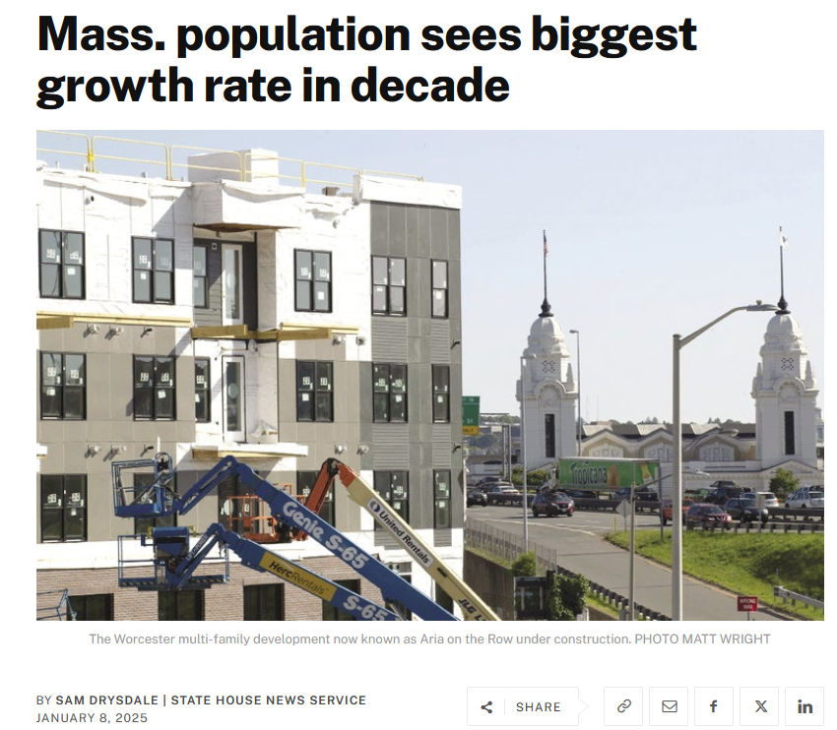
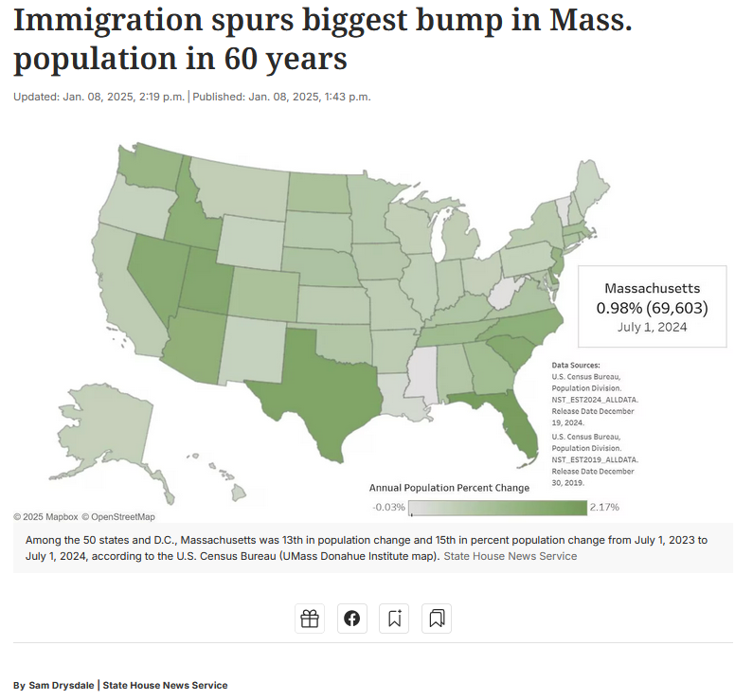

Massachusetts Population April 1, 2020 - July 1, 2024
Last Year’s News
Massachusetts Summary of U.S. Census Bureau Vintage 2024 Population Estimates, UMass Donahue Institute, December 19, 2024

Slide 9
Massachusetts Population April 1, 2020 - July 1, 2024
Last Year’s News:
In the V2024 estimates, the Massachusetts population grew significantly from July 1, 2023, to 2024, benefiting largely from the Census Bureau’s adjustment to the immigration estimates in the V2024 series
State population increased by 69,603 over the year, representing a percentage increase of just under 1.0% (0.985%)
The largest annual percentage increase that Massachusetts had experienced in over a decade, since the 2012-2013 annual increase also rounded to 1%.
Numbers wise, 2023 to 2024 saw the largest population increase in Massachusetts in 60 years.
The state population was estimated to have increased by 104,000 persons at the tail end of the “Baby Boom” in 1964.
Massachusetts Summary of U.S. Census Bureau Vintage 2024 Population Estimates, UMass Donahue Institute, December 19, 2024

Slide 10
Massachusetts Population April 1, 2020 - July 1, 2025
MA grew by 120,972 people since Census 2020, or 1.7%.
Modest growth from July 1, 2024 to July 1, 2025
15,524 over the year, or 0.2%.
NST-EST2025-ALLDATA. U.S. Census Bureau, Population Division. Release date: January 27, 2026

Slide 11
What changed?

Slide 12
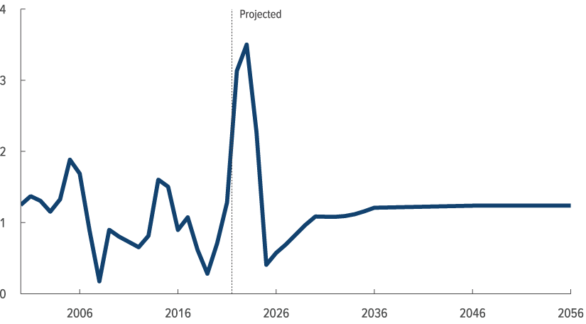
Congressional Budget Office Estimate of Net International Migration out to 2056 for the U.S.
“CBO estimates that net immigration declined after 2023, to 410,000 people in 2025. In CBO’s projections, net immigration rises steadily through 2030 and then grows more slowly through 2036 because of declining net immigration of INA nonimmigrants (such as students and temporary workers). From 2037 to 2056, net immigration is projected to average 1.2 million people per year (close to the average of 1.1 million people per year seen from 1990 to 2021).”
Millions of People
The Demographic Outlook: 2026 to 2056, Congressional Budget Office January 2026 https://www.cbo.gov/publication/61994

Slide 13
Massachusetts Estimated Net International Migration by Year and Vintage, 2021 - 2023
UMass Donahue Institute. Source: U.S. Census Bureau, Population Division, NST-EST2023-ALLDATA, December 19, 2023; U.S. Census Bureau, Population Division, NST-EST2024-ALLDATA, December 19, 2024, NST-EST2025-ALLDATA, January 27, 2026

Slide 14
Massachusetts Estimated Net International Migration by Year and Vintage, 2021 - 2024
UMass Donahue Institute. Source: U.S. Census Bureau, Population Division, NST-EST2023-ALLDATA, December 19, 2023; U.S. Census Bureau, Population Division, NST-EST2024-ALLDATA, December 19, 2024, NST-EST2025-ALLDATA, January 27, 2026

Slide 15
Massachusetts Estimated Net International Migration by Year and Vintage, 2021 - 2025
UMass Donahue Institute. Source: U.S. Census Bureau, Population Division, NST-EST2023-ALLDATA, December 19, 2023; U.S. Census Bureau, Population Division, NST-EST2024-ALLDATA, December 19, 2024, NST-EST2025-ALLDATA, January 27, 2026

Slide 16
“Components of Change”

Slide 17
Components of Population Change
Census Population Count 2020
+ Births 2020-2025
- Deaths 2020-2025
+ Net Domestic Migration (migration within the U.S.) 2020-2025
+ Net International Migration (Immigration – Emigration) 2020-2025
+ Change in Group Quarters Populations 2020-2025
----------------------------------------------------------------------------------------
Population Estimate 2025

Slide 18
Massachusetts Components of Population Change 2000-2025
UMass Donahue Institute. Source Data: ST-2000-7; CO-EST2010-ALLDATA; and NST-EST2025-ALLDATA, U.S. Census Bureau Population Division.
Note that the Census Bureau provides only 3 months of component estimates for years 2010 and 2020. These years are excluded from the time-series chart above.
Notes:
Note that in the components of change trends charts we omit decennial years 2010 and 2020. For Decennial years the US Census Bureau releases only 3-months worth of components – the period between April 1 (the decennial count date) and July 1 (the reference date for all Post-Census estimates)

Slide 19
Massachusetts Components of Population Change 2000-2025
UMass Donahue Institute. Source Data: ST-2000-7; CO-EST2010-ALLDATA; and NST-EST2025-ALLDATA, U.S. Census Bureau Population Division.
Note that the Census Bureau provides only 3 months of component estimates for years 2010 and 2020. These years are excluded from the time-series chart above.

Slide 20
Focus: Births and Fertility Rates

Slide 21
Fertility Rates are decreasing over time in most age groups
20 to 24
40 to 44
15 to 19
*Fertility Rate is the number of births divided by the number of females in the age cohort multiplied by 1,000
Centers for Disease Control and Prevention, National Center for Health Statistics. National Vital Statistics

Slide 22
Massachusetts Population by Age and Year
“Baby Boomers”
Age groups are not static.
It’s important to look at when the MA population is passing through the “high-fertility” age cohorts.

Slide 23
Massachusetts Population by Age and Year

Slide 24
Population Cohorts and Peak Fertility Age in MA
Peak fertility cohort, 30-34
In 2025, the Millennial generation is aged 28-43, with a median age of about 34.
U.S. Census Bureau, Population Division: SC-EST2024-AGESEX-25

Slide 25
Population Cohorts and Peak Fertility Age in MA
10 years later, 20-24 pop is aged 30-34
In 2035, the Millennial generation is will be aged 38-53, with a median age of about 44.
There is currently no “next wave” coming up behind them.
U.S. Census Bureau, Population Division: SC-EST2024-AGESEX-25

Slide 26
Population Cohorts and Peak Fertility Age in MA
20 years later, 10-44 pop is aged 30-34
There is currently no “next wave” coming up behind them.
U.S. Census Bureau, Population Division: SC-EST2024-AGESEX-25

Slide 27
Massachusetts Components of Population Change 2000-2025
UMass Donahue Institute. Source Data: ST-2000-7; CO-EST2010-ALLDATA; and NST-EST2025-ALLDATA, U.S. Census Bureau Population Division.
Note that the Census Bureau provides only 3 months of component estimates for years 2010 and 2020. These years are excluded from the time-series chart above.
Notes:
Note that in the components of change trends charts we omit decennial years 2010 and 2020. For Decennial years the US Census Bureau releases only 3-months worth of components – the period between April 1 (the decennial count date) and July 1 (the reference date for all Post-Census estimates)

Slide 28
Child Population (0 to 4 years old) is falling
Percent of the Total Population 0 to 4, 2000 to 2050
Projected Decline of 0 to 4 Population
UMass Donahue Institute V2024 Long-Term Population Estimates May 6, 2024

Slide 29
Declining Immigration Will Reduce Future Births
ACS IPUMS analysis by UMDI

Slide 30
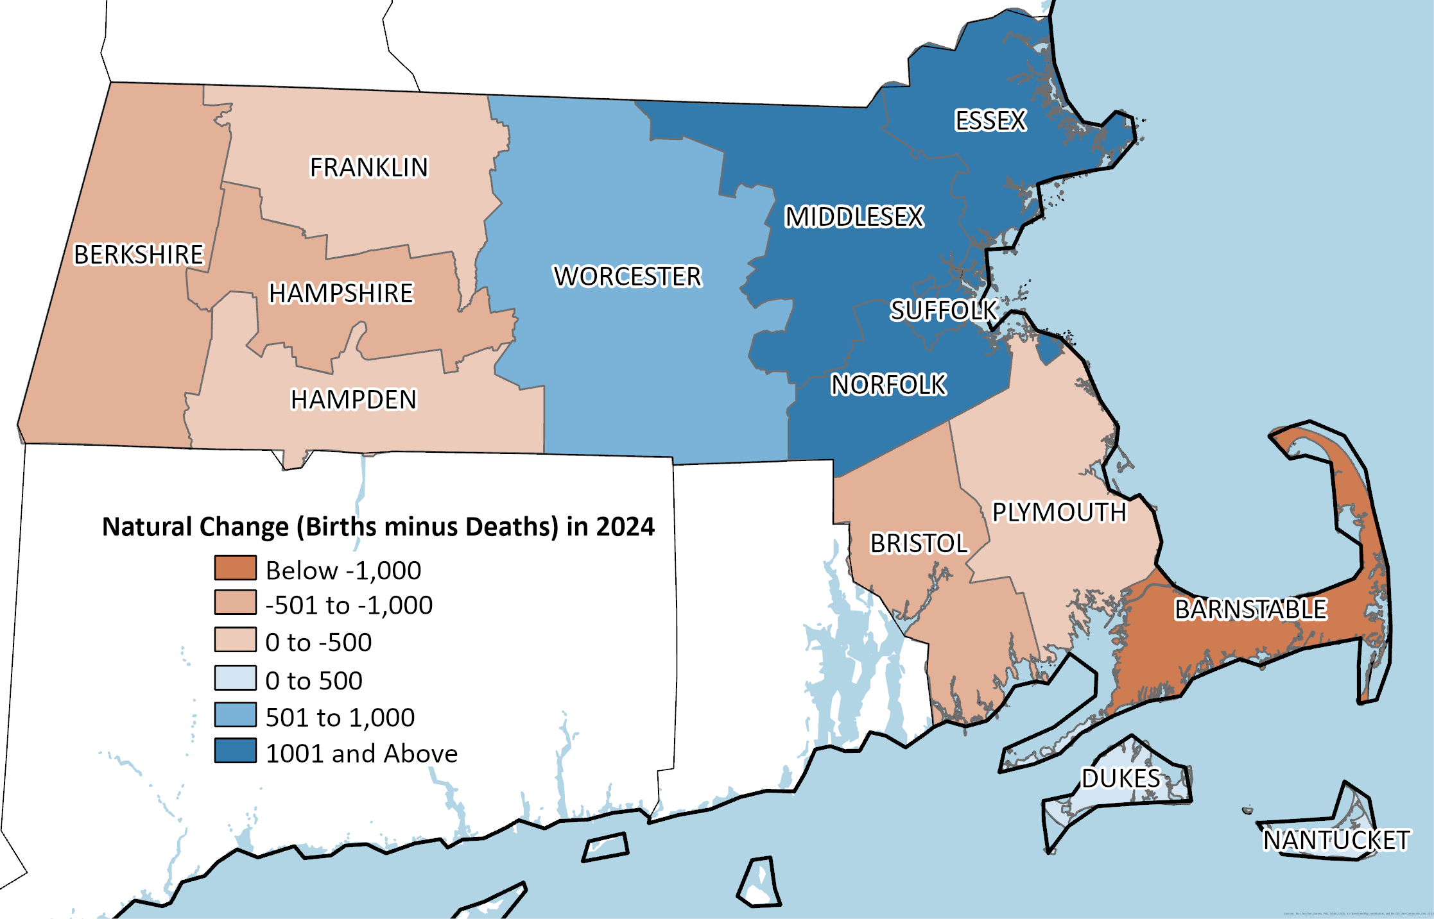
Half of Massachusetts counties saw more deaths than births in 2024, concentrated in Western Mass and the Cape
Annual Estimates of the Resident Population: April 1, 2020 to July 1, 2024 (CO-EST2024-alldata), U.S. Census Bureau, Population Division, March 13, 2025.

Slide 31
Focus: Aging Population

Slide 32
Our population is aging
Median Age, Massachusetts and the United States 2000, 2010, 2020, and 2024
Year | 2000 | 2010 | 2020 | 2024
Massachusetts | 36.6 | 39.1 | 39.8 | 40.1
United States | 35.4 | 37.2 | 38.5 | 39.1
Median age increase of 3.5 years from 2000 to 2024 for Massachusetts and 3.7 years for the United States
U.S. Census Bureau, Population Division Annual Estimates of the Resident Population by Sex and Selected Age Groups
Notes:
Annual Estimates of the Resident Population by Sex and Selected Age Groups for the United States: April 1, 2000 to July 1, 2009 (NC-EST2009-01 & NC-EST2009-02). Source: Population Division, U.S. Census Bureau. Release Date: June 10, 2010; and Annual Estimates of the Resident Population for Selected Age Groups by Sex for the United States, States, Counties, and Puerto Rico Municipios: April 1, 2010 to July 1, 2019. (NC-EST2020-AGESEX-RES & CC-EST2020-AGESEX-25). U.S. Census Bureau, Population Division. Release Date: June 17, 2021; and Annual County and Puerto Rico Municipio Resident Population Estimates by Selected Age Groups and Sex: April 1, 2020 to July 1, 2024 (CC-EST2024-AGESEX). U.S. Census Bureau, Population Division. Release Date: June 26, 2025."

Slide 33
The percent of total population 65 and over is increasing…
Percent of Total Population 65 and Over 2000, 2010, and 2020
Geography | 2000 | 2010 | 2020
Massachusetts | 13.5% | 13.8% | 17.5%
United States | 12.4% | 13.0% | 16.8%
U.S. Census Bureau, Census 2000, 2010, 2020, Demographic Profile; UMass Donahue Institute V2024 Long-Term Population Estimates May 6, 2024

Slide 34
…and will continue to increase
Percent of Total Population 65 and Over, 2000 to 2050
Projected Growth of 65+ Population
UMass Donahue Institute V2024 Long-Term Population Estimates May 6, 2024

Slide 35
And so will the Percent of 85 and Over Population
Percent of Total Population 85 and Over 2000 to 2050
UMass Donahue Institute V2024 Long-Term Population Estimates May 6, 2024

Slide 36
Massachusetts’s growth in our 65+ age groups will far exceed growth in our working age population through 2050
2020 Population
2050 Population Projections
Male
Female
Male
Female
UMass Donahue Institute MassDOT Vintage 2022 Population Projections. November 2022. (UMDI-DOT V2022).
Notes:
Most population growth is forecast for 65+ (more than doubling from 2010-2030) whereas the 0-15, 16-24 and 45-54 cohorts will shrink (single digit percent change)

Slide 37
Old-Age Dependency Ratio
Number of elderly dependents per 100 working-age individuals
Based on UMDI V2024 Population Projections

Slide 38
Focus: Migration

Slide 39
Massachusetts Components of Population Change 2000-2025
UMass Donahue Institute. Source Data: ST-2000-7; CO-EST2010-ALLDATA; and NST-EST2025-ALLDATA, U.S. Census Bureau Population Division.
Note that the Census Bureau provides only 3 months of component estimates for years 2010 and 2020. These years are excluded from the time-series chart above.
Notes:
Note that in the components of change trends charts we omit decennial years 2010 and 2020. For Decennial years the US Census Bureau releases only 3-months worth of components – the period between April 1 (the decennial count date) and July 1 (the reference date for all Post-Census estimates)

Slide 40
Massachusetts Components of Population Change 2000-2025
UMass Donahue Institute. Source Data: ST-2000-7; CO-EST2010-ALLDATA; and NST-EST2025-ALLDATA, U.S. Census Bureau Population Division.
Note that the Census Bureau provides only 3 months of component estimates for years 2010 and 2020. These years are excluded from the time-series chart above.

Slide 41
Massachusetts Estimated Net Domestic Migration by Year and Vintage, 2021 - 2025
UMass Donahue Institute. Source: U.S. Census Bureau, Population Division, NST-EST2023-ALLDATA, December 19, 2023; U.S. Census Bureau, Population Division, NST-EST2024-ALLDATA, December 19, 2024, NST-EST2025-ALLDATA, January 27, 2026

Slide 42
State to State Migration Flows for Massachusetts
Inflow to Massachusetts from Other States, 2024
Outflow from Massachusetts to Other States, 2024
Rank | State | Estimate
1 | New York | 18,697
2 | Rhode Island | 15,235
3 | California | 13,810
4 | New Hampshire | 11,286
5 | Florida | 10,580
6 | Connecticut | 9,936
7 | Maine | 6,746
8 | New Jersey | 6,536
9 | Texas | 6,191
10 | Pennsylvania | 5,490
Rank | State | Estimate
1 | Florida | 21,834
2 | New Hampshire | 20,310
3 | New York | 17,862
4 | California | 15,720
5 | Connecticut | 11,612
6 | Rhode Island | 11,568
7 | Texas | 9,454
8 | Maine | 6,723
9 | Pennsylvania | 5,948
10 | North Carolina | 5,343
U.S. Census Bureau, 2024 American Community Survey 1-year estimates and 2024 Puerto Rico Community Survey 1-year estimates

Slide 43
Massachusetts regularly sees more domestic outmigration, especially from ages 25 to 34
Massachusetts Domestic In- and Outmigration by Age Group in 2022
How to get younger?
Stem the flow of Out-movers in the younger age cohorts, especially 25-34
U.S. Census Bureau, American Community Survey Public Use Microdata Sample via IPUMS. UMDI Calculations.
Notes:
Recent Trends in Domestic Migration to and from Massachusetts Prepared by the UMass Donahue Institute’s Economic and Public Policy Research Group in collaboration with the Massachusetts Executive Office of Labor and Workforce Development, Department of Economic Research
In-movers and out movers

Slide 44
Focus: Immigration

Slide 45
Massachusetts has the sixth highest proportion of foreign-born residents in the nation
Foreign Born as Percentage of Total Population, All States, 2024
U.S. Census Bureau, American Community Survey, 2024 1-Year Estimates. Via Social Explorer, table A06001

Slide 46
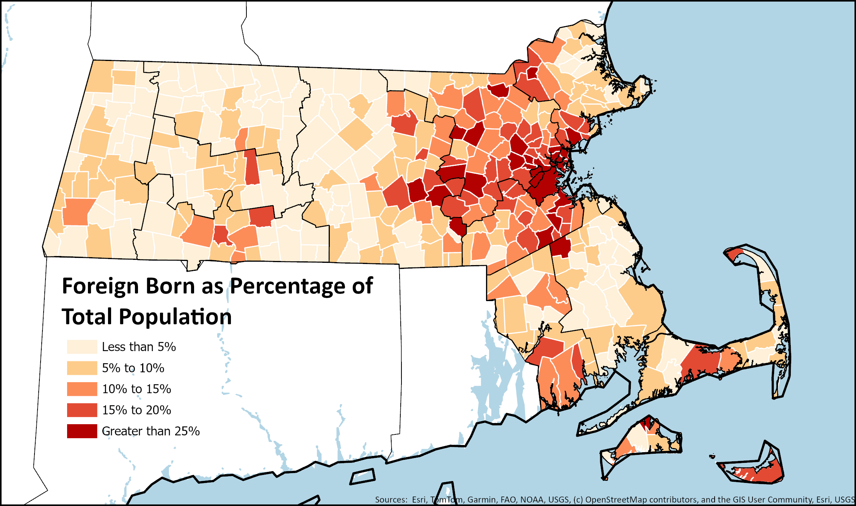
Massachusetts immigrants mainly live in Greater Boston, with some clusters in Pioneer Valley and South Coast/Cape & Islands
Foreign Born as Percentage of Total Population for Massachusetts Towns and Cities, 2023
U.S. Census Bureau, American Community Survey 5-Year Estimates, 2019-2023

Slide 47
Massachusetts was third in the nation for per capita H1B visas in 2024
H1B Visas (Initial and Continuing Approvals) Per 1,000 Residents, 2024
Department of Homeland Security US Citizenship and Immigration Services. U.S. Census Bureau Population Estimates. UMDI analysis
Notes:
The H-1B is a foreign worker visa in the United States that allows U.S. employers to hire foreign workers in so-called specialty occupations.

Slide 48
Immigrants in Massachusetts are more likely to have a graduate degree than native born residents
Educational Attainment by Foreign Born Status in Massachusetts, 2024
U.S. Census Bureau, American Community Survey, 2024 1-Year Estimates. Table B06009

Slide 49
Foreign-born 2023 migrant population is younger than the U.S. born population in Massachusetts
Age Profile of Massachusetts Residents in 2023 based on Residence One Year Ago (ROYA)
ACS PUMS 2019-2023, IPUMS Online Data Analysis System
Notes:
Steven Ruggles, Sarah Flood, Matthew Sobek, Daniel Backman, Grace Cooper, Julia A. Rivera Drew, Stephanie Richards, Renae Rogers, Jonathan Schroeder, and Kari C.W. Williams. IPUMS USA: Version 16.0 [dataset]. Minneapolis, MN: IPUMS, 2025. https://doi.org/10.18128/D010.V16.0

Slide 50
Native-born labor force has grown only 6% since 1990. Foreign-born labor force nearly tripled through 2024
Native- and Foreign-Born Labor Force Growth in Massachusetts, 1990-2024 (Indexed to 1990)
U.S. Census Bureau, Decennial Census (1990, 2010, & 2020); American Community Survey, 1-Year Estimates (2015, 2021-2024)
Notes:
Foreign born labor responsible for 76 percent of the growth in the overall labor force since 1990.
Year Native Born Labor Force Foreign Born Labor Force
1990 2,928,669 333,194
2010 2,916,146 620,732
2015 3,020,596 681,978
2020 3,052,622 759,952
2021 3,053,329 813,639
2022 2,903,863 767,622
2023 3,062,414 852,159
2024 3,109,540 893,447

Slide 51
Massachusetts Components of Population Change 2000-2025
UMass Donahue Institute. Source Data: ST-2000-7; CO-EST2010-ALLDATA; and NST-EST2025-ALLDATA, U.S. Census Bureau Population Division.
Note that the Census Bureau provides only 3 months of component estimates for years 2010 and 2020. These years are excluded from the time-series chart above.

Slide 52
International immigration has fallen at the start of the second Trump Administration
International Migration Rates for Massachusetts and the United States, 2001-2025 (Excluding Census Years)
U.S. Census Bureau, Population Estimates Program; co-est2009-alldata, co-est2019-alldata, NST-EST2025-ALLDATA
Note that the Census Bureau provides only 3 months of component estimates for years 2010 and 2020. These years are excluded from the time-series chart above.
Notes:
2025 data is from July 2024 – June 2025, i.e. half of the last year of the Biden admin., half of the first year of the Trump admin.

Slide 53
Massachusetts Components of Population Change 2000-2025
UMass Donahue Institute. Source Data: ST-2000-7; CO-EST2010-ALLDATA; and NST-EST2025-ALLDATA, U.S. Census Bureau Population Division.
Note that the Census Bureau provides only 3 months of component estimates for years 2010 and 2020. These years are excluded from the time-series chart above.

Slide 54
Consequences

Slide 55
Population Change and Total Migration 2000-2025
UMass Donahue Institute. Source Data: ST-2000-7; CO-EST2010-ALLDATA; and NST-EST2025-ALLDATA, U.S. Census Bureau Population Division.
Note that the Census Bureau provides only 3 months of component estimates for years 2010 and 2020. These years are excluded from the time-series chart above.

Slide 56
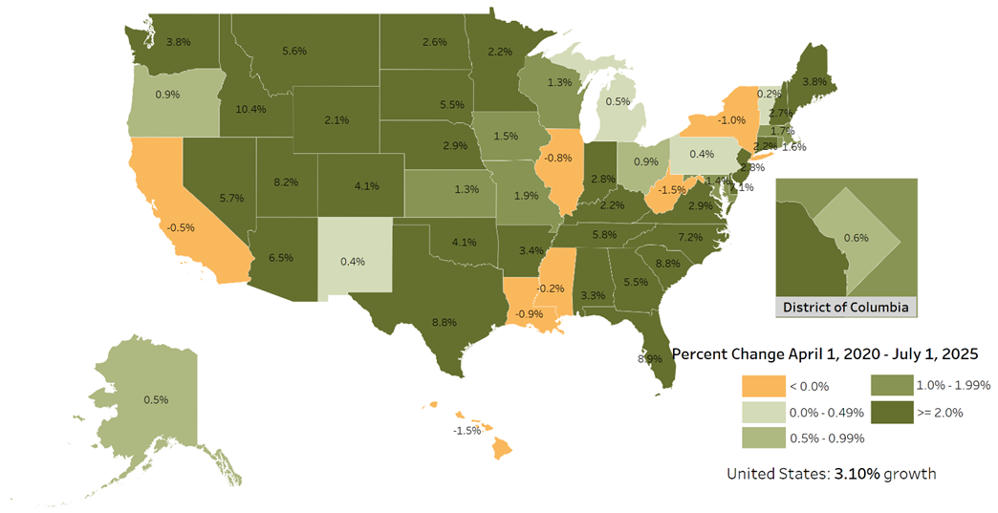
Cumulative Percent Change in Population, April 1, 2020 to July 1, 2025
Cumulatively since the 2020 Census, Massachusetts has gained population along with seven other Northeast States, with New York being the only state to have lost population since 2020.
Gain of 1.7%.
UMass Donahue Institute. Source data: NST-EST2025-POPCHG2020-2025. U.S. Census Bureau Population Division. January 27, 2026.

Slide 57
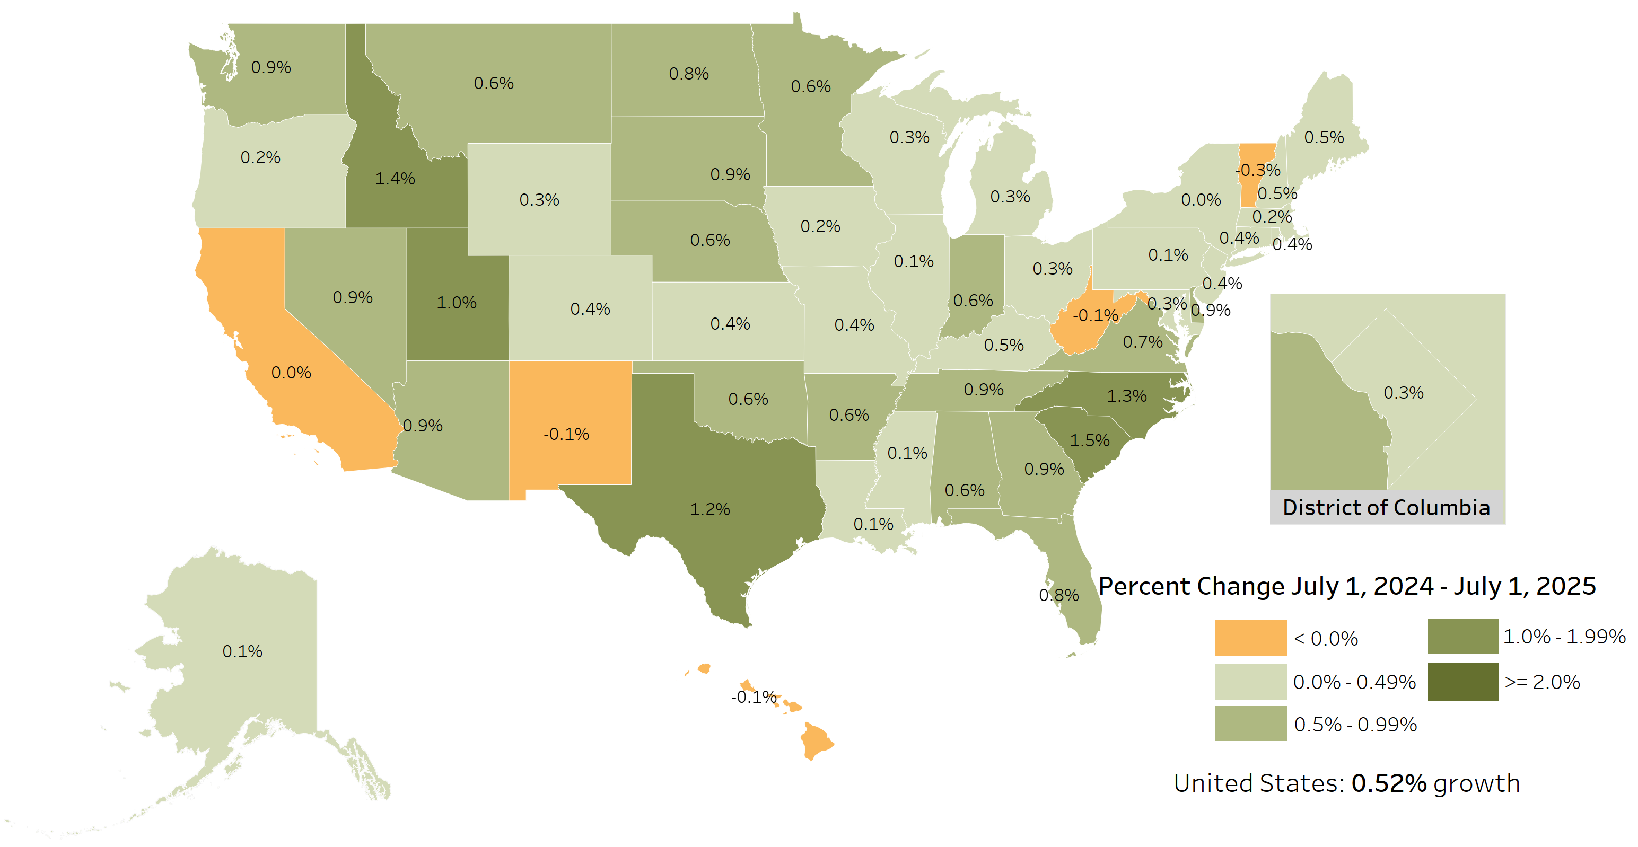
Losing Rank: Annual Percent Change in Population, July 1, 2024 to July 1, 2025
Nationally, Massachusetts ranked 27th in total population change, down from 13th last year.
39th in percent population change, down from 15th last year.
Source data: NST-EST2025-POPCHG2020-2025. U.S. Census Bureau Population Division. January 27, 2026.

Slide 58
Relative to other U.S. states

Slide 59
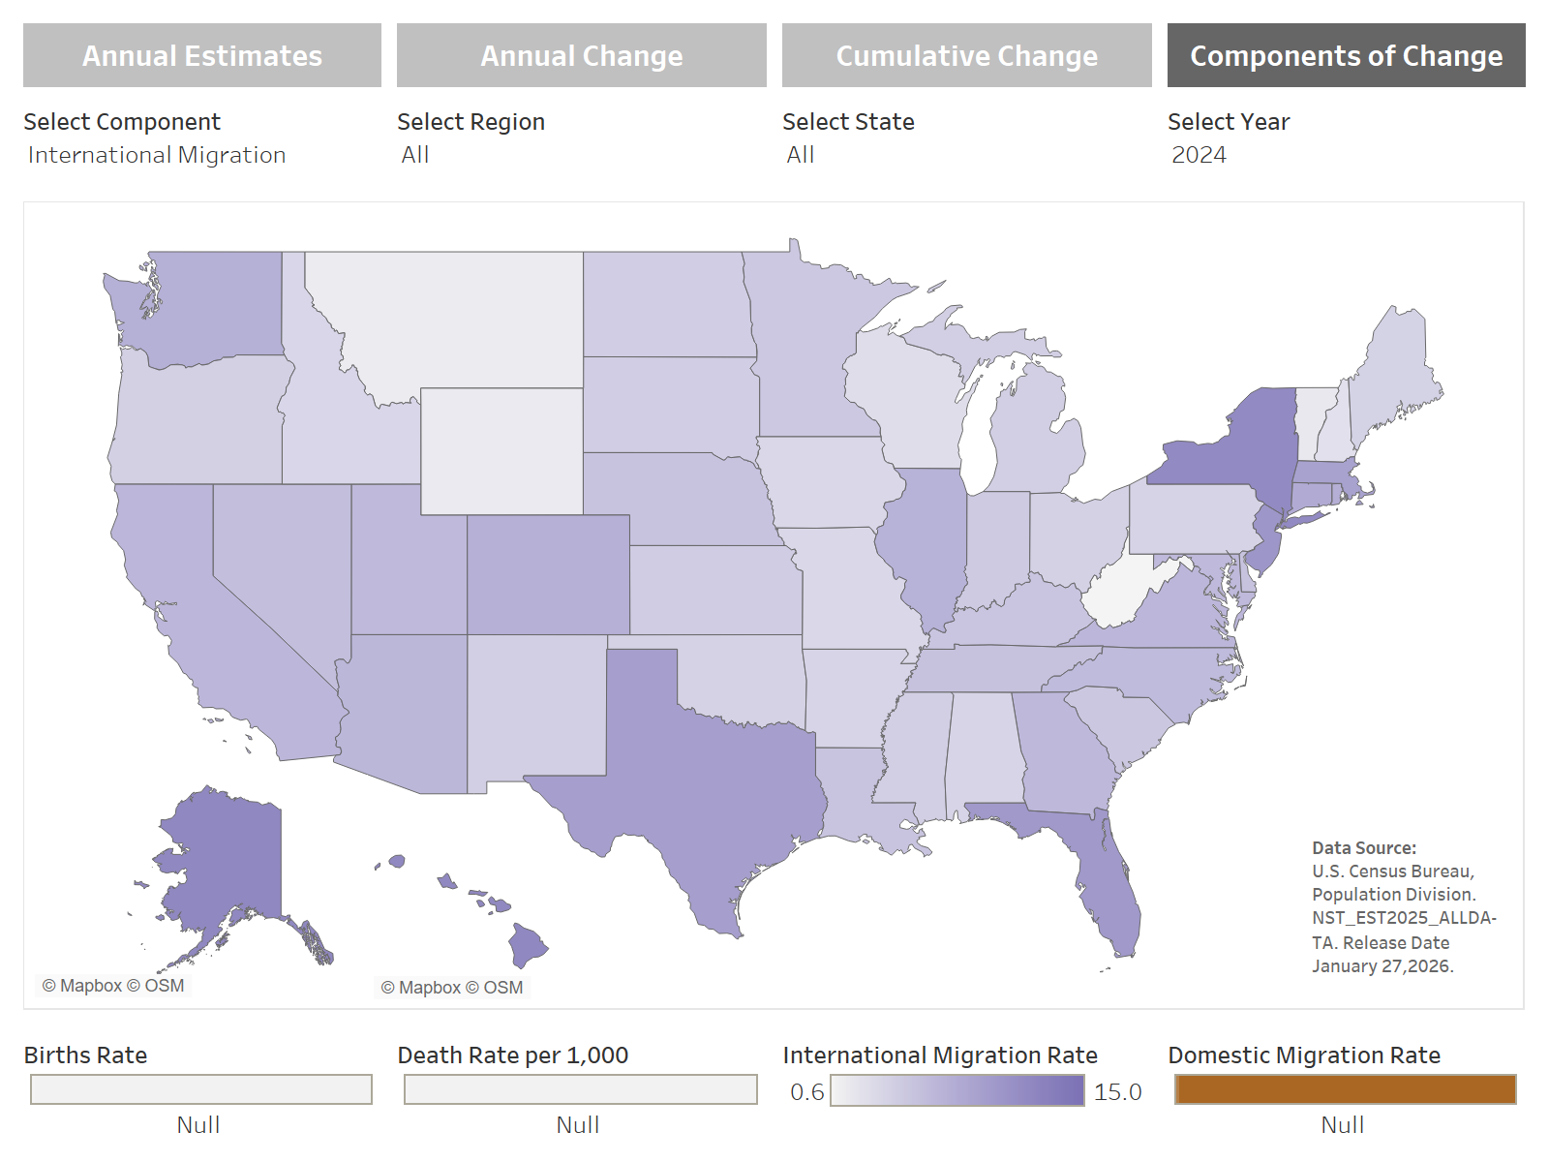
Rate of Net International Migration, 2024
*Rate per 1,000 residents
https://donahue.umass.edu/business-groups/economic-public-policy-research/massachusetts-population-estimates-program/population-estimates-by-massachusetts-geography/by-state

Slide 60
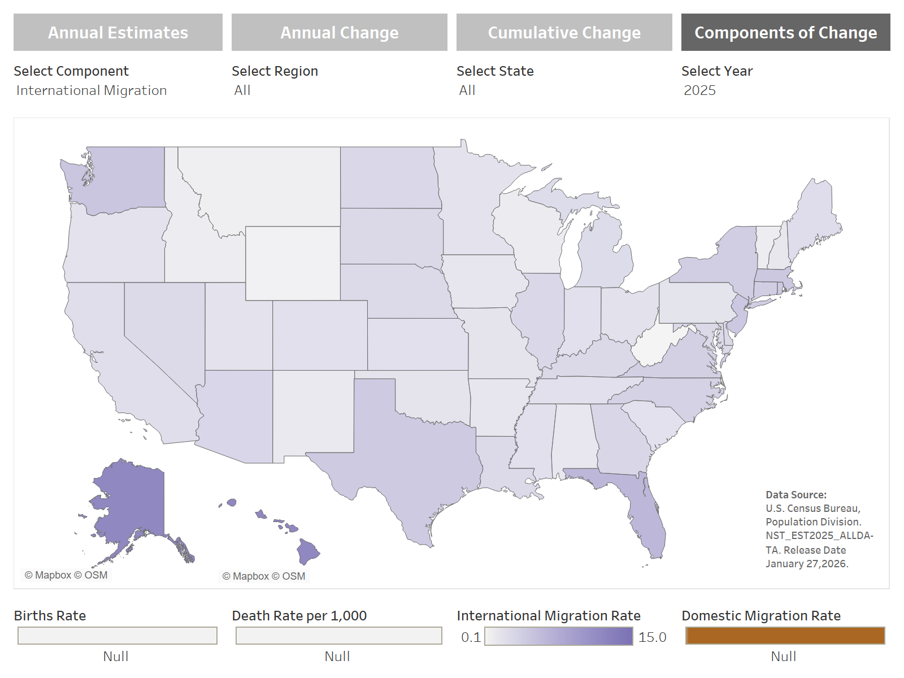
Rate of Net International Migration, 2025
*Rate per 1,000 residents
https://donahue.umass.edu/business-groups/economic-public-policy-research/massachusetts-population-estimates-program/population-estimates-by-massachusetts-geography/by-state

Slide 61
Net International Migration by State, 2025
States With Highest Net International Immigration Rates, 2025 |  | States With the Highest Net International Immigration, 2025
State | Rate of Net International Immigration | Ranking
Florida | 7.6 | 1
Washington | 5.8 | 2
District of Columbia | 5.7 | 3
Massachusetts | 5.6 | 4
New Jersey | 5.6 | 5
Rhode Island | 5.3 | 6
Texas | 5.3 | 7
New York | 4.8 | 8
Connecticut | 4.8 | 9
Virginia | 4.6 | 10
North Carolina | 4.2 | 11
Georgia | 3.8 | 12
Arizona | 3.7 | 13
North Dakota | 3.5 | 14
Illinois | 3.5 | 15
South Dakota | 3.4 | 16
Kentucky | 3.4 | 17
Hawaii | 3.3 | 18
Delaware | 3.3 | 19
Nebraska | 3.3 | 20
Maryland | 3.3 | 21
Nevada | 3.2 | 22
Louisiana | 3.2 | 23
Michigan | 3.0 | 24
Maine | 2.9 | 25
State | Net International Immigrants | Ranking
Florida | 178,674 | 1
Texas | 167,475 | 2
California | 109,278 | 3
New York | 95,634 | 4
New Jersey | 53,064 | 5
North Carolina | 46,890 | 6
Washington | 46,202 | 7
Illinois | 44,752 | 8
Georgia | 42,579 | 9
Virginia | 40,436 | 10
Massachusetts | 40,240 | 11
Michigan | 30,706 | 12
Ohio | 28,505 | 13
Arizona | 28,219 | 14
Pennsylvania | 26,921 | 15
Maryland | 20,503 | 16
Tennessee | 17,990 | 17
Indiana | 17,852 | 18
Connecticut | 17,534 | 19
Kentucky | 15,709 | 20
Colorado | 15,356 | 21
Louisiana | 14,900 | 22
South Carolina | 12,930 | 23
Missouri | 12,665 | 24
Minnesota | 12,486 | 25
UMass Donahue Institute. Source U.S. Census Bureau Population Division NST_EST2025_ALLDATA. Release Date January 27, 2026. Rates per 1,000 average population. State rankings include District of Columbia.

Slide 62
Net International Migration by State, 2025
States With Lowest Net International Immigration Rates, 2025 |  | States With the Lowest Net International Immigration, 2025
State | Rate of Net International Immigration | Ranking
West Virginia | 0.1 | 51
Wyoming | 0.4 | 50
Montana | 0.8 | 49
Vermont | 1.0 | 48
Idaho | 1.1 | 47
Wisconsin | 1.2 | 46
New Mexico | 1.4 | 45
New Hampshire | 1.7 | 44
Alabama | 1.7 | 43
Arkansas | 1.8 | 42
Iowa | 1.8 | 41
State | Net International Immigrants | Ranking
West Virginia | 244 | 51
Wyoming | 258 | 50
Vermont | 623 | 49
Montana | 899 | 48
Alaska | 1,959 | 47
Idaho | 2,148 | 46
New Hampshire | 2,403 | 45
North Dakota | 2,810 | 44
New Mexico | 2,879 | 43
South Dakota | 3,183 | 42
Delaware | 3,473 | 41
UMass Donahue Institute. Source U.S. Census Bureau Population Division NST_EST2025_ALLDATA. Release Date January 27, 2026. Rates per 1,000 average population. State rankings include District of Columbia.

Slide 63
Net International Immigration as a Percent of Population Change, 2011-2020
State | Population Change 2010 to 2020 | 2011 to 2020 Immigration | Share of 2010 to 2020 Population Growth Driven by Immigration
Florida | 2,736,877 | 1,176,364 | 43.0%
California | 2,284,267 | 966,666 | 42.3%
Texas | 3,999,944 | 854,732 | 21.4%
New York | 823,147 | 717,364 | 87.1%
Massachusetts | 482,288 | 382,377 | 79.3%
New Jersey | 497,100 | 317,226 | 63.8%
Virginia | 630,369 | 296,238 | 47.0%
Pennsylvania | 300,321 | 286,870 | 95.5%
Washington | 980,741 | 251,045 | 25.6%
Illinois | -18,124 | 245,230 | N/A
Maryland | 403,672 | 212,722 | 52.7%
Georgia | 1,024,255 | 206,647 | 20.2%
Michigan | 193,691 | 196,527 | 101.5%
Ohio | 262,944 | 193,937 | 73.8%
North Carolina | 903,905 | 183,827 | 20.3%
Arizona | 759,485 | 156,791 | 20.6%
Connecticut | 31,847 | 143,872 | 451.8%
Minnesota | 402,569 | 122,973 | 30.5%
Indiana | 301,726 | 106,538 | 35.3%
Colorado | 744,518 | 95,443 | 12.8%
Tennessee | 564,735 | 82,602 | 14.6%
Missouri | 165,986 | 72,443 | 43.6%
Wisconsin | 206,732 | 67,138 | 32.5%
South Carolina | 493,061 | 63,087 | 12.8%
Oregon | 406,182 | 61,147 | 15.1%
Top 25 States:
2011-2020
Total Net Immigration
Count Estimate
(Population Change 2010-2020)
÷
Total Net Immigrants
(2011-2020)
UMass Donahue Institute. Source U.S. Census Bureau Population Division NST_EST2020_ALLDATA. Release Date May 2021.

Slide 64
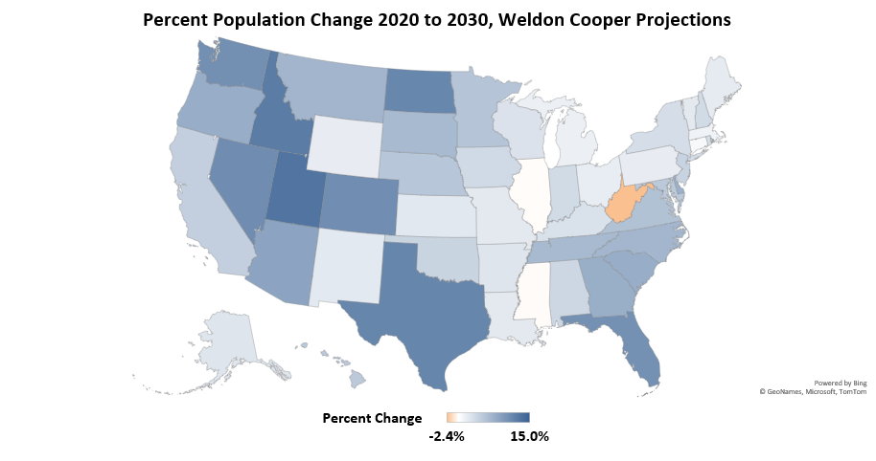
U.S. States Predicted Percent Population Change, 2020 to 2030
University of Virginia, Weldon Cooper Center for Public Service. (2024). National and 50-State Population Projections. Retrieved from https://coopercenter.org/national-population-projections

Slide 65
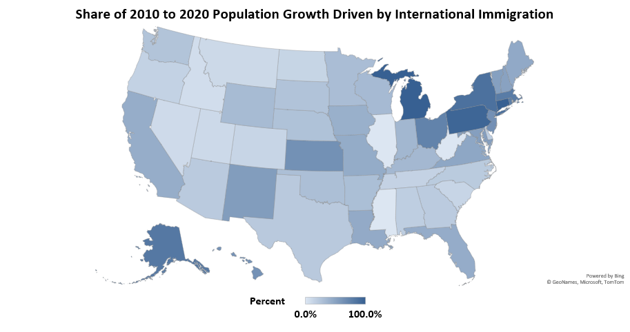
Share of 2010 to 2020 Population Growth Driven by International Immigration
UMass Donahue Institute. Source U.S. Census Bureau Population Division NST_EST2020_ALLDATA. Release Date May 2021

Slide 66
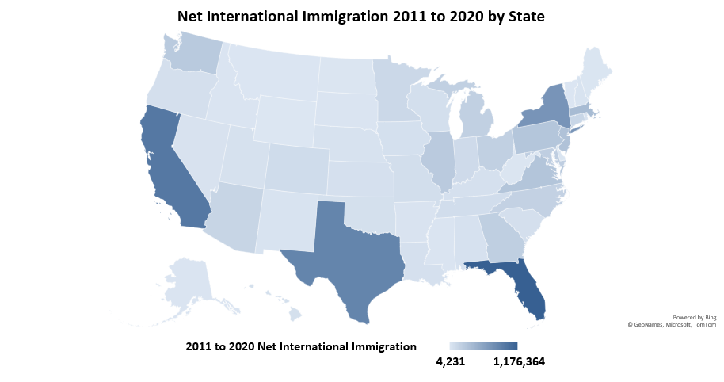
Net International Immigration 2011 to 2020 by State
UMass Donahue Institute. Source U.S. Census Bureau Population Division NST_EST2020_ALLDATA. Release Date May 2021.

Slide 67
Census Estimates Release Schedule
Population Detail | Date of Next Release (Expected) | Latest Estimate Available
National and State population and demographic components of population change; population age 18+ | December 2026 (7/1/2026 data) | 7/1/2025
County population and demographic components of population change | March 2026 (7/1/2025 data) | 7/1/2024
Metropolitan and micropolitan statistical area population | March 2026 (7/1/2025 data) | 7/1/2024
City and town (incorporated place and minor civil division) population | May 2026 (7/1/2025 data) | 7/1/2024
State population by age, sex, race, and Hispanic origin | June 2026 (7/1/2025 data) | 7/1/2024
County population by age, sex, race, and Hispanic origin | June 2026 (7/1/2025 data) | 7/1/2024
https://www.census.gov/programs-surveys/popest/about/schedule.html

Slide 68
Migration Trends in the EOHLC Projections Series

Slide 69
UMDI V2024_H2 Projection Series: Period of Migration
Scenario 1: Crisis as Usual & Scenario 2: A Sense of Normalcy
International Migration 2011 to 2018 period
5-year average: 204,443
1-year average: 40,889
UMass Donahue Institute. Source Data: ST-2000-7; CO-EST2010-ALLDATA; and NST-EST2025-ALLDATA, U.S. Census Bureau Population Division.
Note that the Census Bureau provides only 3 months of component estimates for years 2010 and 2020. These years are excluded from the time-series chart above.

Slide 70
UMDI V2024_H1 Projection Series: Period of Migration
Scenario 3: “Competing and Growing”
International Migration 2010 to 2020 period
5-year: 191,189
1-year average: 38,274
Domestic Migration 2010 to 2020 period
5-year average -96,944
1-year average: -19,389
UMass Donahue Institute. Source Data: ST-2000-7; CO-EST2010-ALLDATA; and NST-EST2025-ALLDATA, U.S. Census Bureau Population Division.
Note that the Census Bureau provides only 3 months of component estimates for years 2010 and 2020. These years are excluded from the time-series chart above.

Slide 71
UMDI V2024_H3 Projection Series: Period of Migration
Scenario 4: “Ready for What Comes”
International Migration 2010 to 2020 period
5-year: 191,189
1-year average: 38,274
Scenario adds additional immigrant population to each new launch population in 2025 to 2045*
Domestic Migration 2010 to 2020 period
5-year average -96,944
1-year average: -19,389
Scenario retains 2,500 would-be domestic outmigrants per year from 2025 to 2050, or 12,500 over a 5-year period*
UMass Donahue Institute. Source Data: ST-2000-7; CO-EST2010-ALLDATA; and NST-EST2025-ALLDATA, U.S. Census Bureau Population Division.
Note that the Census Bureau provides only 3 months of component estimates for years 2010 and 2020. These years are excluded from the time-series chart above.
Notes:
*2020 to 2025 period EA shelter pops by EOHLC over and above 2010 to 2019. after 2025 CBO over and above the 2010 to 2019 period
*Domestic outmigrants retained distributed based off home sales data around the state. Final step is in state east to wet migration, but that doesn’t impact the overall domestic migration figure, just shifts within the state, same 2,500 per year

Slide 72
Scenario 4: Ready for What Comes
Increase in Immigration over 2010-2019 Baseline by Period in CBO Immigration Estimates
Period | Percent Increase over 2010-2019 average
Baseline | 5-year average 191,189 1-year average: 38,274
2021-2025 | 14,620 (5-year)
2026-2030 | 36%
2031-2035 | 22%
2036-2040 | 23%
2041-2045 | 25%
2046-2050 | 26%
Projected Immigration Estimates Sources
Baseline Immigration Levels | US Census Bureau Net International Migration 2010 to 2019
2021-2026 | Estimation of Additional Migrant families based on State's emergency assistance program (EA) shelter applicants using shelter resident language and green card status statistics.
2026-2050 | US Census Bureau Net International Migration 2010 to 2019 increased by the Congressional Budget Office immigration projections that are over and above immigration in years 2011 to 2020

Slide 73
Thank you!
For additional information:
sstrate@donahue.umass.edu
mmflanagan@donahue.umass.edu

