Slide 1

Tour of the Special Commission on Correctional Consolidation and Collaboration (SCCCC)
Sheriff Peter J. Koutoujian
Friday, March 6, 2026

Slide 2

What We Will Cover Today
Our Population
Our Core Functions
Our Physical Plant

Slide 3

Population

Slide 4
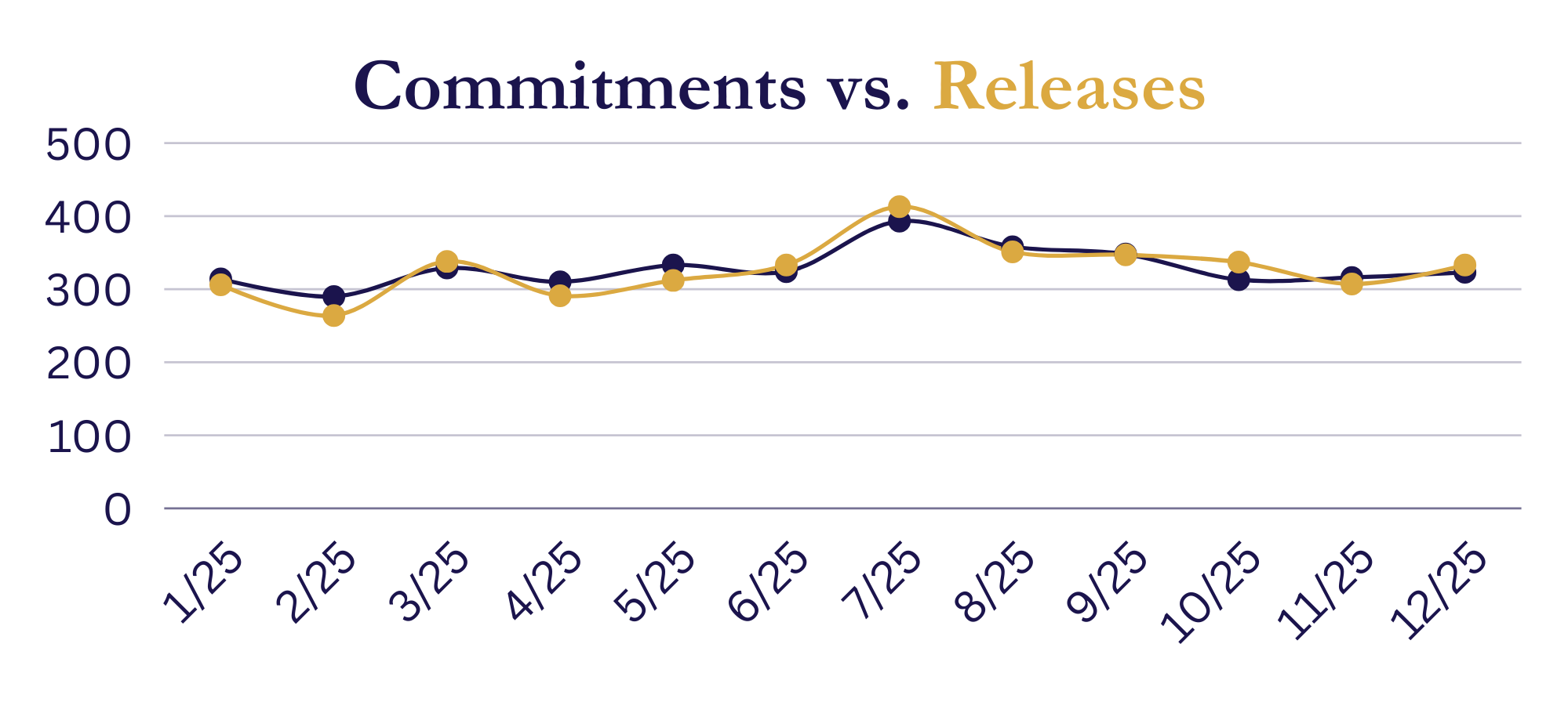
2025 Pre-Trial
2025 Sentenced
2025 Safekeeps
2,637 commitments
458 commitments
855 commitments

Slide 5
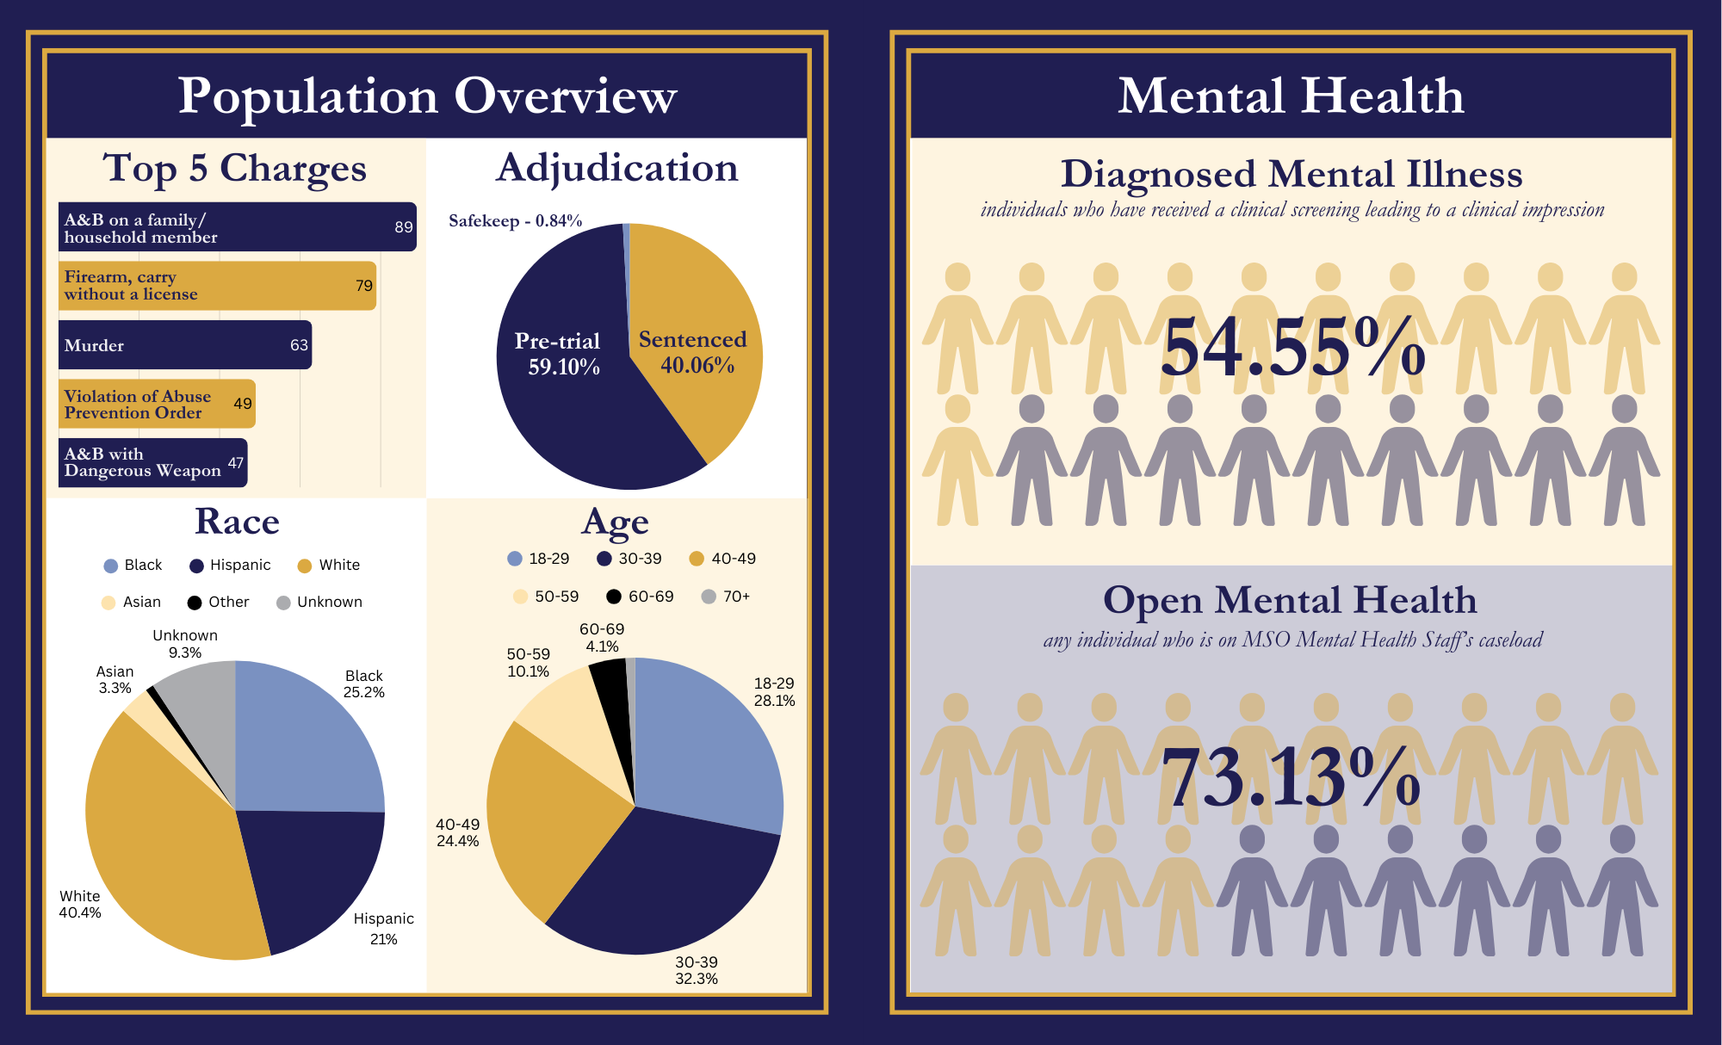

Slide 6


Slide 7
The Churn of Those We Serve
Pre-trial Detainees – Average Length of Stay is 51.69 days. However…
25% of pre-trial folks were here for 2 days
• 50% of pre-trial folks were here for 12 days
• 75% of pre-trial folks were here for 56 days
Sentenced Inmates – Average Length of Stay is 248.36 days. However…
• 25% of sentenced folks were here for 94 days
• 50% of sentenced folks were here for 182 days
• 75% of sentenced folks were here for 353 days
Safekeep Holds – Average Length of Stay is 1.34 days

Slide 8
Core Functions

Slide 9
Court Transportation
FY25
FY26 to Date (8 Months)
Total Miles Traveled: 298,128
Number of Locations Visited: 6,600
Total Gallons of Fuel Used: 23,475
Total Miles Traveled: 235,615
Number of Locations Visited: 4,745
Total Gallons of Fuel Used: 17,022

Slide 10
Medication Assisted Treatment
FY25
FY26 to Date (8 Months)
Doses Administered: 50,195
Total Enrollments: 624
Cost Incurred: $2,287,526
Doses Administered: 30,432 (52,170 year-end projection)
Total Enrollments: 422 (723 year-end projection)
Cost Projection: $2,821,270

Slide 11
No-Cost Call Communications
FY25
FY26 to Date (8 Months)
Calls Made: 1,202,737
Minutes Logged: 14,721,958
eMessages Sent: 1,584,734
Video Visits Conducted: 9,842
Cost Incurred: $1,338,961.19
Calls Made: 987,127
Minutes Logged: 12,409,516
eMessages Sent: 1,152,477
Video Visits Conducted: 7,599
Cost Incurred: $1,141,383.64

Slide 12
Mutual Aid Efforts
NEMLEC
MTC
CCC
WAU
Task Forces
Northeastern Massachusetts Law Enforcement Council
Comprised of 68 agencies in Essex & Middlesex, any can request aid of NEMLEC
117 callouts in FY25
Armed & barricaded suspects, missing suicidal individuals, large crowd control, crisis negotiation
Mobile Training Center
Available at request of agencies, trains officers in de-escalation, communication, use of force
Trained 1,375 officers from 40 agencies in 2025
Community Command Center
Available to 54 communities for planned and emergency events
Requested by agencies for assistance during large scale public gatherings
Warrant Apprehension Unit
Mix of MSO and municipal PD officers
Made 478 arrests in 2025
Judicial warrants for nearly 1,400 felonies, 850 misdemeanors
24 fugitives located and returned at request of Middlesex DA’s Office
Limited scope and engagement
Currently assist on Mass State Police human trafficking initiative and regional narcotics task force

Slide 13
Physical Plant

Slide 14
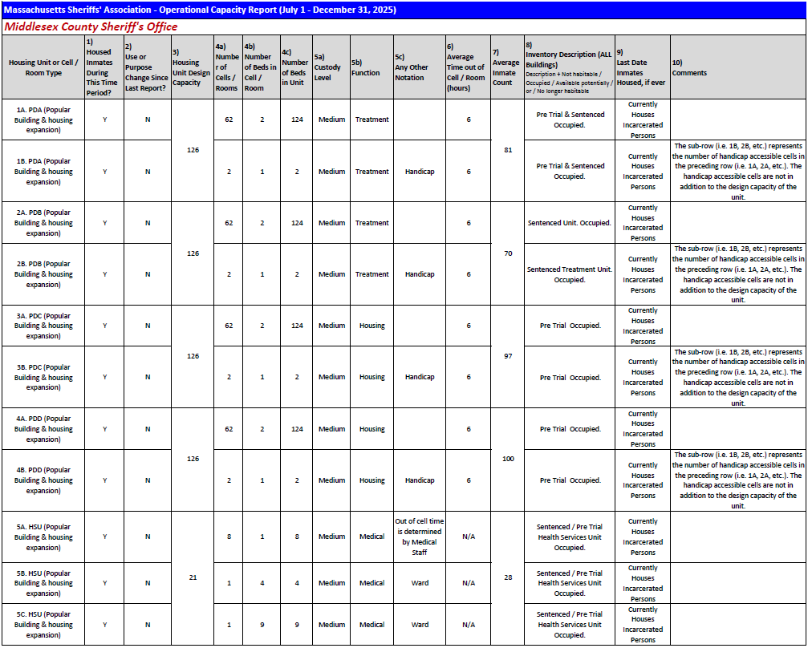
Operational Capacity Report (1/3)

Slide 15
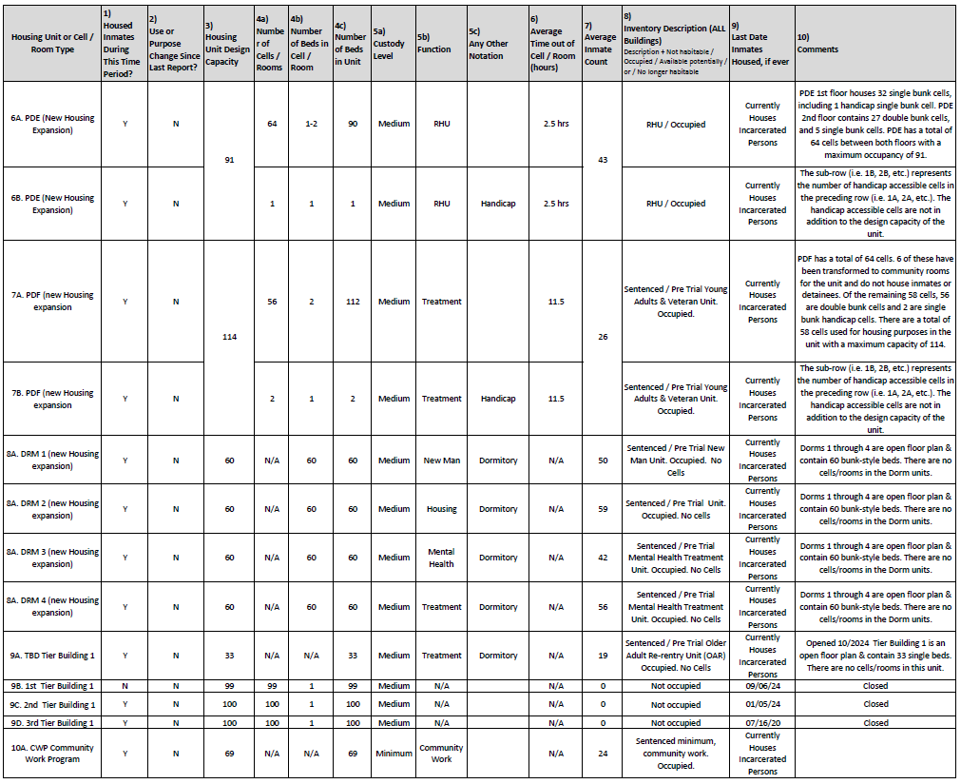
Operational Capacity Report (2/3)

Slide 16
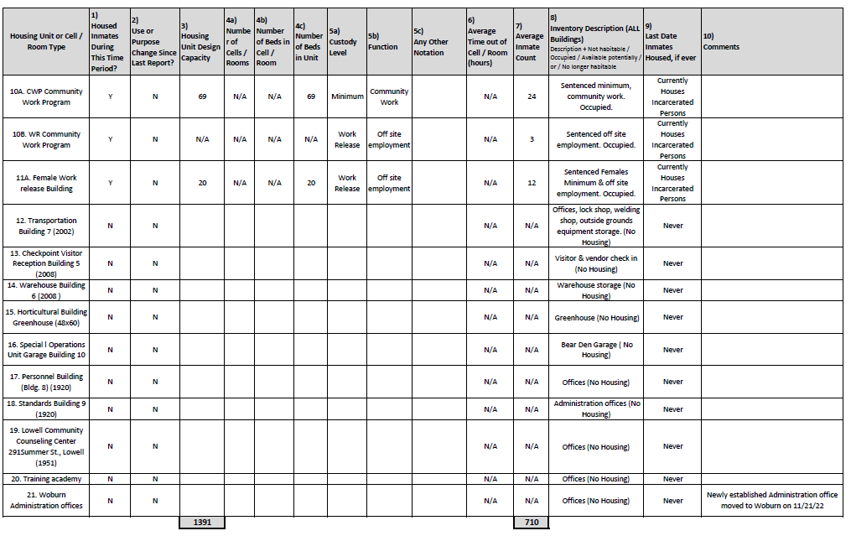
Operational Capacity Report (3/3)

Slide 17
Podular Units
POD A
POD B
POD C
POD D
POD E
Treatment Unit
Combination of pre-trial and sentenced individuals
Single and double cells
Treatment Unit
Sentenced individuals only
Single and double cells
Housing Unit
Pre-trial individuals only
Single and double cells
Housing Unit
Pre-trial individuals only
Single and double cells
Housing Unit
Utilized for secure management cases and safekeep holds
Used predominantly as single cells

Slide 18
POD F – Home to Two Programmatic Units
PACT – Young Adult Offenders
HUMV – Housing Unit for Military Veterans
438 young adults served
19.75% recidivism rate one year from release
6.82% lower than facility-wide young adult recidivism rate
Participants engaged in 44 unique programs last month
Partnerships with UTEC, ROCA, and many more community organizations
530 veterans served
14.1% recidivism rate one year from release
Partnerships with HomeBase, US Department of Veterans Affairs, MA Department of Veterans Services, and many more
Operates as a regional unit

Slide 19
Dormitories
DORM 1
DORM 2
DORM 3
DORM 4
Unit for new arrivals to the facility
Combination of pre-trial and sentenced individuals
Double bunks
Housing Unit
Combination of pre-trial and sentenced individuals
Double bunks
Mental health treatment unit
Combination of pre-trial and sentenced individuals
Double bunks
Treatment Unit
Combination of pre-trial and sentenced individuals
Double bunks

Slide 20

OAR – Older Adult Re-Entry Unit
Launched in October 2024
33-Bed Housing Unit
Unit Manager and Specially Trained Staff
Heightened Risk for Re-Entry Challenges
Aging in Place (AiP) Modifications and Environmental Wellness
Meritocracy System
Peer Support Model
Specialized Treatment
5 Program Pillars
Holistic Re-Entry Planning

Slide 21
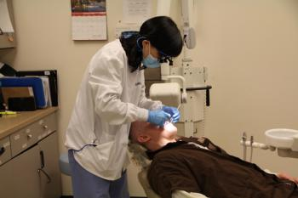
Health Services Unit (HSU)
HSU manages 130,000 medical contacts a year
Hybrid care model maintains MSO control while providing expansive specialty care
21 beds in ward-style setting for individuals in need of medical monitoring
Medication costs continue to rise
FY25 - $1,403,434
FY26 Projection - $1,645,263
Outside hospital trips are a regular administrative and operational burden
FY25 - 2,771 trips
FY26 Projection - 4,173 trips

Slide 22
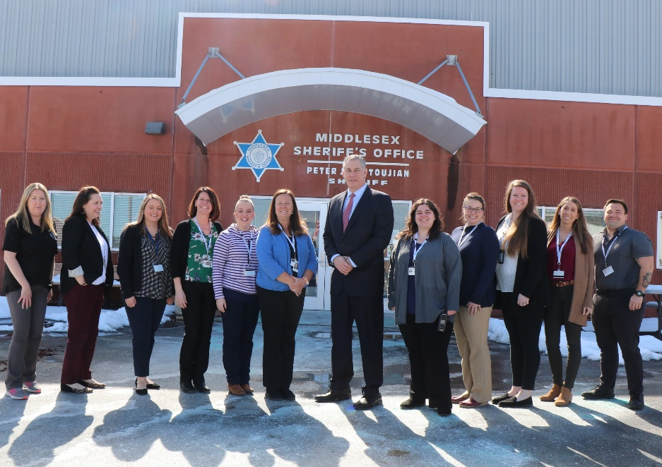
Regional unit for incarcerated individuals with complex behavioral health needs
Serves 9 counties (Middlesex, Barnstable, Bristol, Dukes, Essex, Nantucket, Norfolk, Plymouth and Suffolk) as well as eastern MA DOC facilities
From 2020-2025, 3,562 requests for 15 bed space
Admissions grew 86% from 434 to 806
Average length of stay grew from 5.88 to 7.11 days
Service and Safety Enhancement proposed under DCAMM Capital Project Request
Evaluation & Stabilization Unit (ESU)

Slide 23
Women’s Pre-Release Center
Women on county sentences historically housed at MCI-Framingham
Matter of equity and access to programming
Collaboration with other Massachusetts sheriffs to return women to county facilities as appropriate
Research on trauma-informed design and programming
Developed specialized training for staff applying to the Unit
Physical space includes living room, private bedrooms, as well as spaces for programming and face-to-face meetings with family and children.
Ties into other MSO programs on grounds, such as MATADOR and FSSU

Slide 24
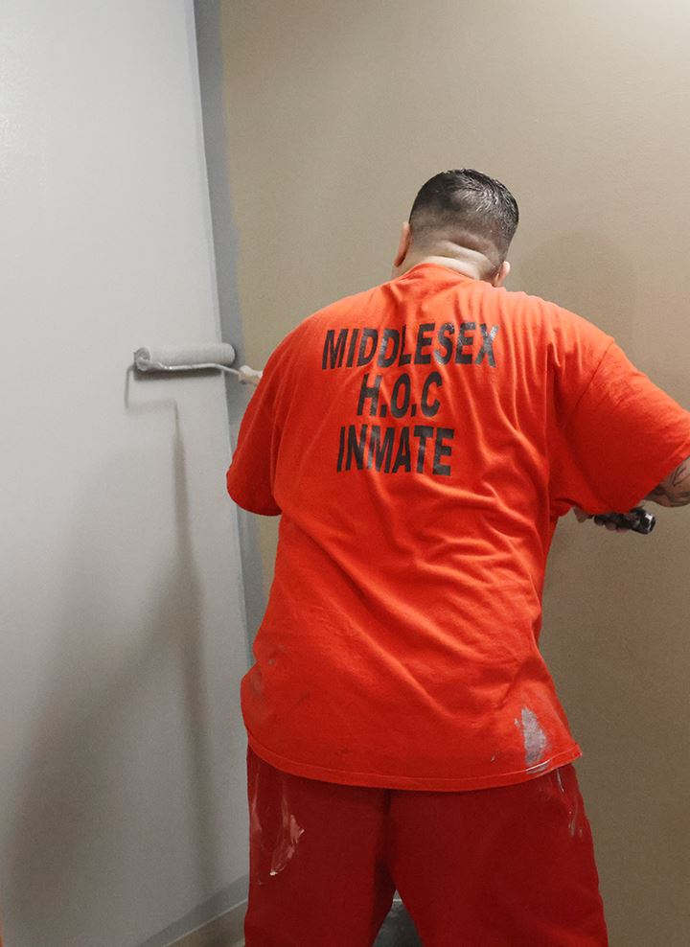
CWP/Work Release Building
Community Work and Work Release Programs are both pre-release
Individuals nearing the end of their sentence and preparing for re-entry
Opportunity to work in community, earn money that is held in a bank account to seed their re-entry
Minimum security placement, eligible individuals are screened and approved for participation by MSO staff.
CWP in CY25: 1,614 individuals completed 9,660 hours of work with an estimated cost savings of $375,750.00 to Middlesex cities and towns.

Slide 25

THANK YOU
Peter J. Koutoujian
Sheriff
pjkoutoujian@sdm.state.ma.us
www.middlesexsheriff.org

