Slide 1
Administrative Data and the 2030 Census
Amy O’Hara & Beth Jarosz

Slide 2
Overview
Administrative data sources and methods
(Brief) history of administrative data use
Data quality considerations
Privacy & confidentiality considerations
Consequences of differential participation

Slide 3
What is administrative data?
Administrative data is information that is collected and used for operational purposes.
These data are a byproduct of operations, rather than purpose-built for the census.
Data offer a robust way to augment self-response, but with three important considerations: (1) mismatch in data quality relative to census needs, (2) questions about allowable use, (3) consequences of differential participation.

Slide 4
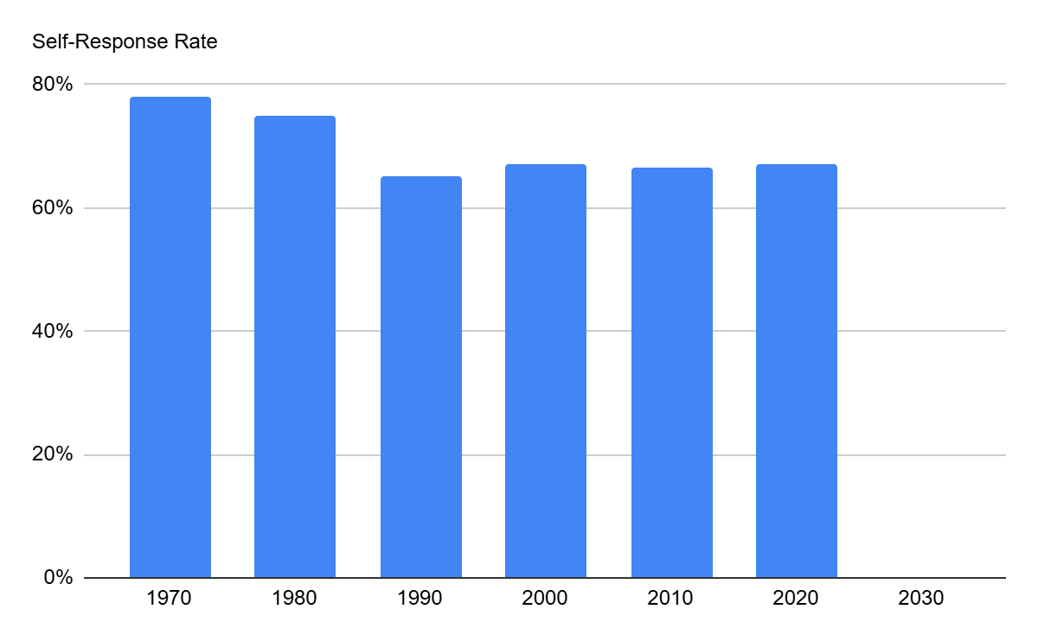
Background: Why Administrative Records (AdRec)?
Declining self-response 1970–2000
AdRecs reduce cost of Nonresponse Follow-Up (NRFU)
Potentially allow for enumeration without contact attempt(s)
Cost-reduction & modernization pressures

Slide 5
(Very Brief) History of Census Operations
1790 first U.S. census, conducted by U.S. Marshals
1880 initial use of trained enumerators to conduct census
1920 redistricting failed to pass Congress
1960 first “mail-out” census (beginning of widespread self-response)
2000 more formal use of postal records
2010 transition to “short form”
2020 first internet self-response (also wider use of administrative records)

Slide 6
History of Administrative Data in Census
Some sources have a long history of use, including:
USPS delivery sequence file
Group quarters administrator lists
Defense Manpower Data Center
More sources were incorporated into 2020 Census, and in new ways, including:
IRS
Medicare Enrollment Database
Supplemental Nutrition Assistance Programs (SNAP)
Many others have not yet been used, including:
School enrollment
Head Start
Medicaid / CHIP

Slide 7
How Administrative Data Can Support an Accurate Census
Frame Development
Enumeration
Evaluation
Before the census, records can help identify the addresses (houses and group quarters facilities) that need to be counted
Records can help identify locations that are probably vacant, reducing number of contact attempts
Records can help support accurate imputation for non-responding households or facilities
After the census, records can help understand who may have been missed and those who may have been overcounted

Slide 8
Administrative Record Data Quality
Definitions
Reference date, residence rules, household composition, race/ethnicity, and other details may differ between administrative data and census needs.
Universe and Coverage
Administrative data reflect participation, not the population as a whole.
Linkage Quality
Messiness in real world data means that records linked together for census use may miss cases (false negatives), or may introduce incorrect linkages (false positives).
Characteristics
Typically the census requires information about a person including their age, sex, race/ethnicity, relationship to householder, and housing tenure. Many administrative sources lack one or more of these.

Slide 9
Who’s Historically Undercounted
Who’s historically undercounted?
Renters
Young children (under age 5)
Black, Hispanic/Latino populations
American Indian/Alaska Native populations living on reservations
Who’s historically harder to count? All of the above, plus…
People who speak languages other than English
Low-income populations
Undocumented immigrants
People with disabilities
People who do not live in traditional housing

Slide 10

Key Quality Question: Is It Better Than the Alternative?
Photo: Elena Mozhvilo via unSplash

Slide 11
Differential Sharing and Differential Coverage
High Coverage
Social Security NUMIDENT
USPS DSF and MAF
LUCA*
IRS 1040, 1095, 1099
Drivers Licenses*
Medicare
SNAP*
GQ Admin Lists*
WIC*
TANF*
Low Coverage
Military Overseas
Bureau of Prisons
Foster care*
No Sharing
High Sharing
Purple = Frame
Green = Enumeration
* = State or Local Data
Notes:
Green = data that could be used for enumeration
Purple = data that can be used for frame development
* = data that comes from states (everything else is already held within the federal government)
Let’s start with purple first…
Top right, US Postal Service delivery sequence file and the associated Master Address File maintained by the Census Bureau covers the vast majority of residential locations in the U.S.
Moving left… But USPS and address update operations may miss non-traditional residences, non-standard addresses, accessory dwellings, illegal conversions, consolidations, and other changes within existing structures. Local Update of Census Addresses (LUCA) is an important local review, but many eligible governments do not participate (only about 30% participation in 2020).*
Group Quarters operations require identifying a primary point of contact for enumeration efforts. Although it’s identified as a separate data input here, it really is a combination of information from the MAF, LUCA, and field canvassing.
Moving on to enumeration operations and starting top right…
Social Security and IRS data cover a substantial portion of the population, and data are already available to Census Bureau
Moving down the list… Medicare covers about 20% of the population. Has been used by Census Bureau. But in 2024 MCBS pulled back on data sharing. There’s a question about whether or not that data will be shared in the future.
Data on military overseas and people in BOP custody = small share of the population (less than 300,000 people each) but important for coverage
Moving to the top left, drivers license data covers a substantial portion of the population (estimated at more than 230 million people) but very few states have shared that data with the Census Bureau
Safety net program participation has less coverage. For example, SNAP about 40 million in 2025) but more states share (22 states shared for 2020 Census).
Foster care data represent a small but important, and potentially miscounted, population. But to date we have not seen evidence of any states sharing their foster data system data with the Census Bureau.
Important points:
Participating in LUCA is an easy win.
Sharing WIC, TANF, and SNAP data may be more complicated, but those data sources cover people who are historically undercounted.
Sources:
2020 Local Update of Census Addresses (LUCA) Operational Assessment Report
https://www.census.gov/programs-surveys/decennial-census/decade/2020/planning-management/evaluate/eae/2020-operational-assessment-report-luca.html

Slide 12
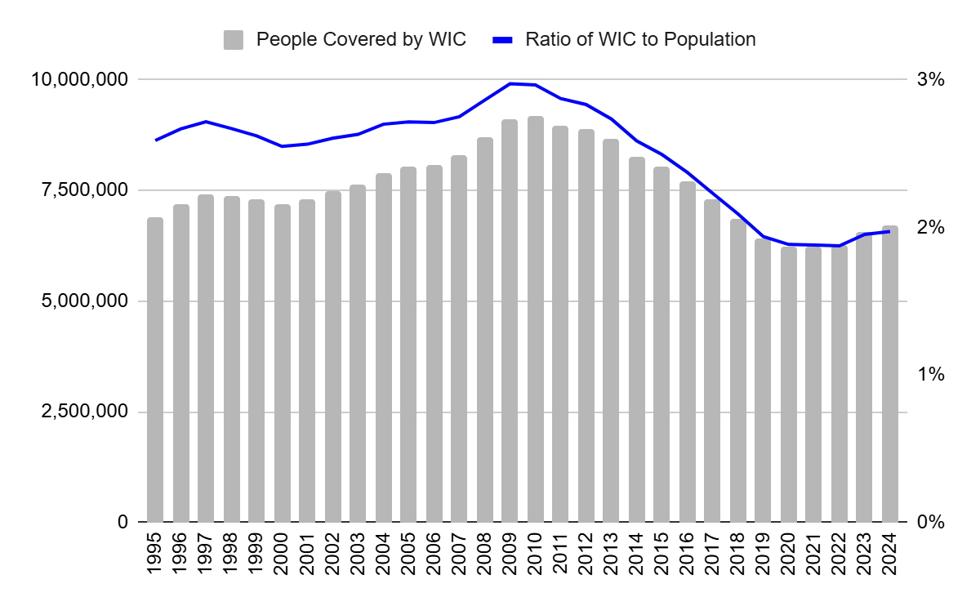
Example: WIC Participation (All Ages)
Women, Infants, and Children (WIC) participation changes over time due to economic conditions and policy changes.
As a share of total population, WIC covers less than 3% of people.
And in 2020 Census only 14 states shared their data with the Census Bureau.
Calculations based on USDA Economic Research Service, WIC Program; U.S. Census Bureau, Population Estimates

Slide 13
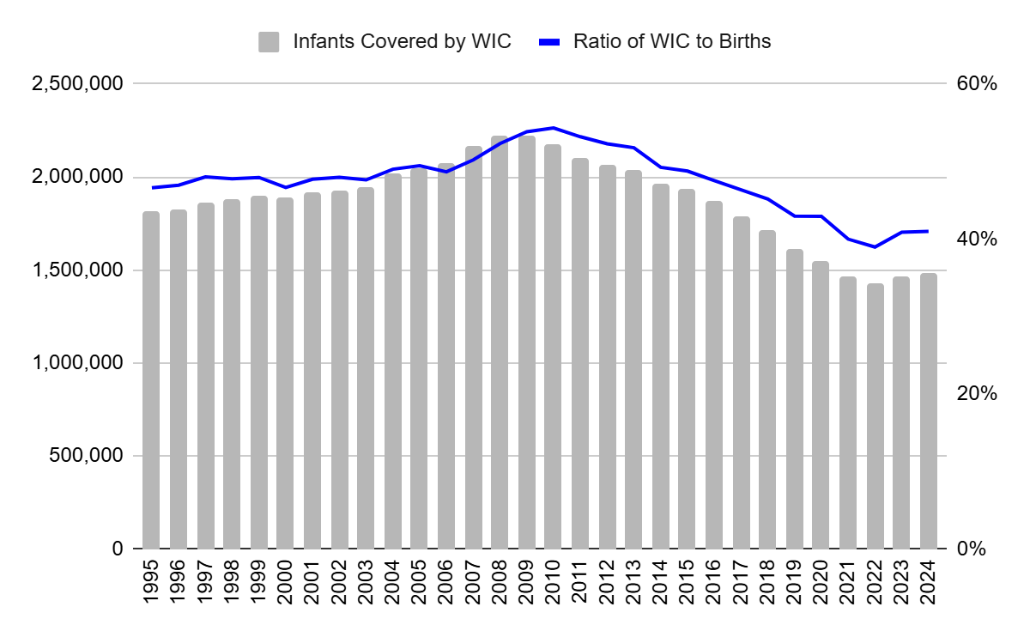
Example: WIC Participation (Infants)
Young children are one of the most undercounted demographic groups.
WIC covers 40-50% of infants.
WIC records could help reduce the persistent undercount of young children.
But in 2020 Census only 14 states shared WIC data with USCB. Concern about privacy and confidentiality is a barrier.
Calculations based on USDA Economic Research Service, WIC Program; CDC WONDER, Natality online databases

Slide 14
Data Privacy, Confidentiality, and Security
Privacy: Ask only about what’s needed
Confidentiality: Protect all data collected or acquired, ensuring that data products prevent re-identification
Security: Protect from corruption, thefs, and unauthorized access

Slide 15
Privacy
Privacy considerations for census and census-related data include
Evalulating necessity
Openness/transparency about how the data will be used
Respectful treatment of respondents
Confidentiality

Slide 16
Confidentiality
Confidentiality protections include limits on access to data internally at the Census Bureau and limits on published data
Historically used aggregation and data suppression to protect confidentiality
“Differential privacy” applied to published tables in 2020 to reduce the possibility of reconstruction and reidentification

Slide 17
Security (briefly)
Data security protections include
Access controls
Encryption
Physical security
Digital security, threat monitoring, detection, and response
Backup and recovery

Slide 18
“5 Safes” Bridges Data Privacy, Confidentiality, Security
Safe Data | Data is treated to protect any confidentiality concerns | Is there a disclosure risk in the data itself?
Safe Projects | Research projects are approved by data owners for the public good | Is this use of data appropriate, lawful, ethical and sensible?
Safe People | Those with access are trained and authorized to use data safely | Can the user(s) be trusted to use the data appropriately?
Safe Settings | Environment prevents unauthorized use | Does the infrastructure (physical and digital) limit unauthorized access?
Safe Outputs | Screened and approved outputs are not disclosive | Do the published results permit any singling-out of individuals or groups?
Adapted from: UK Data Service and fivesafes.org

Slide 19
Key Points
Administrative data may help ensure an accurate census count, particularly given declining public trust
Differential sharing across states may result in a higher risk of undercounts in states where data are not shared
Any administrative data sharing must be paired with robust privacy, confidentiality, and security protections

